Slide 1
How to get your itemized
invoice in ctcLink

Slide 2
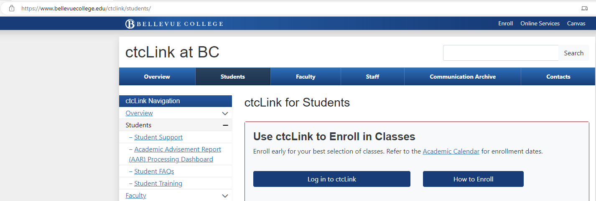
Using this link to get to the ctcLink mobile login
https://www.bellevuecollege.edu/ctclink/students/
Click ‘Log into ctcLink’

Slide 3
Click ‘ctcLink Login’

Slide 4
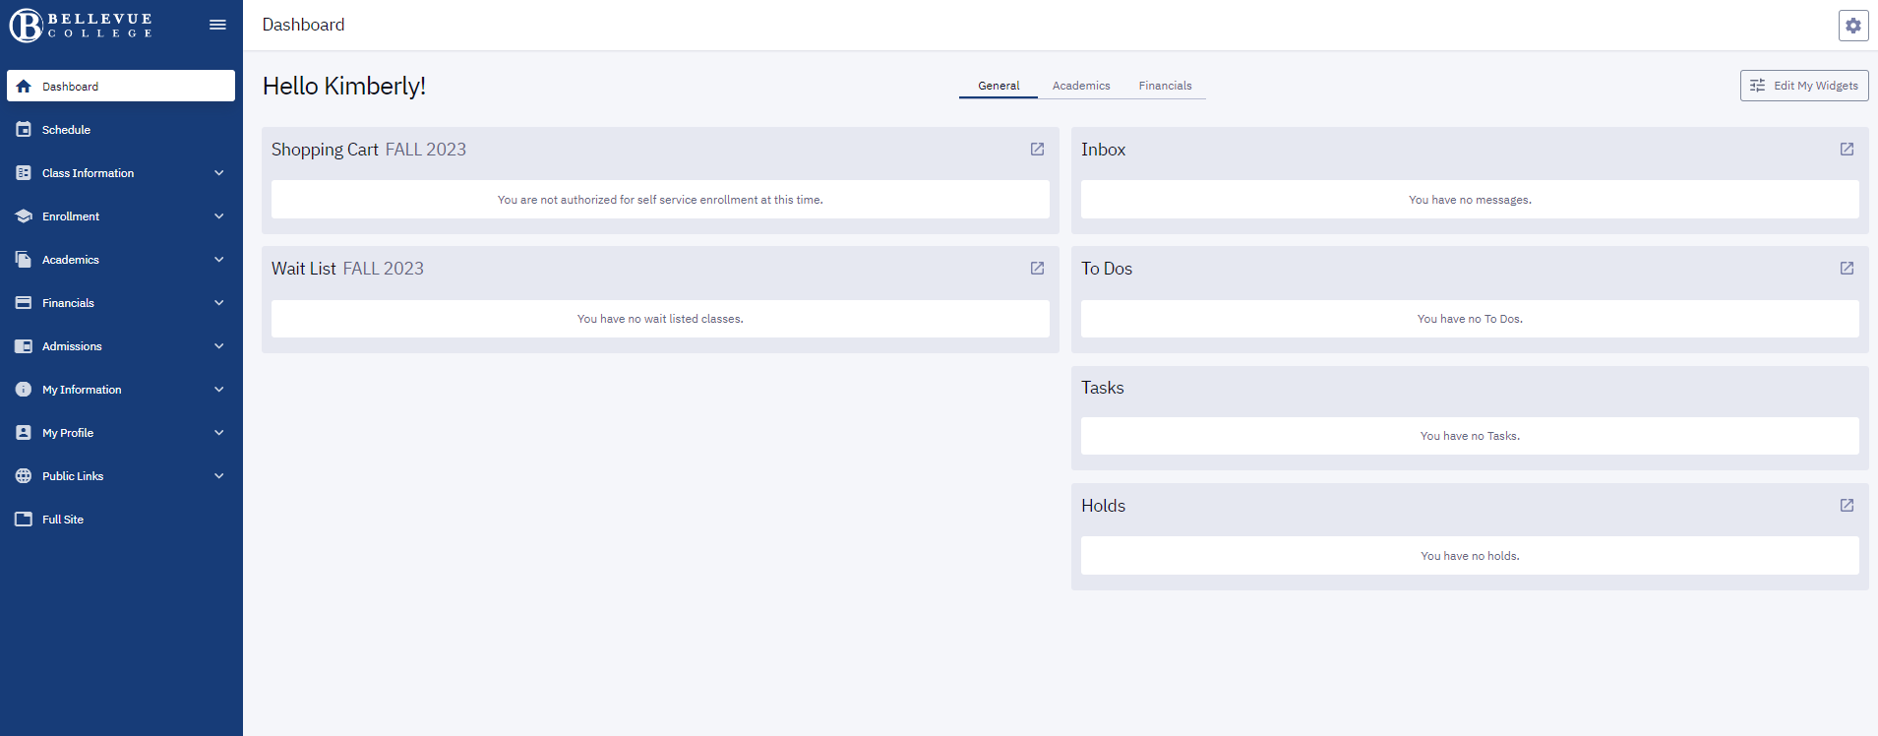
Your Name
After logging into ctcLink mobile
Click on ‘Financials’

Slide 5
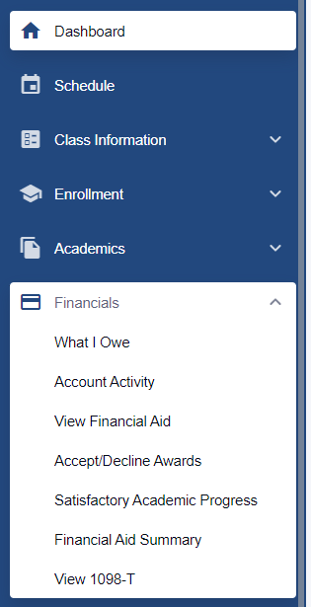
Click on ‘Account Activity’
Search by Term, or date range

Slide 6
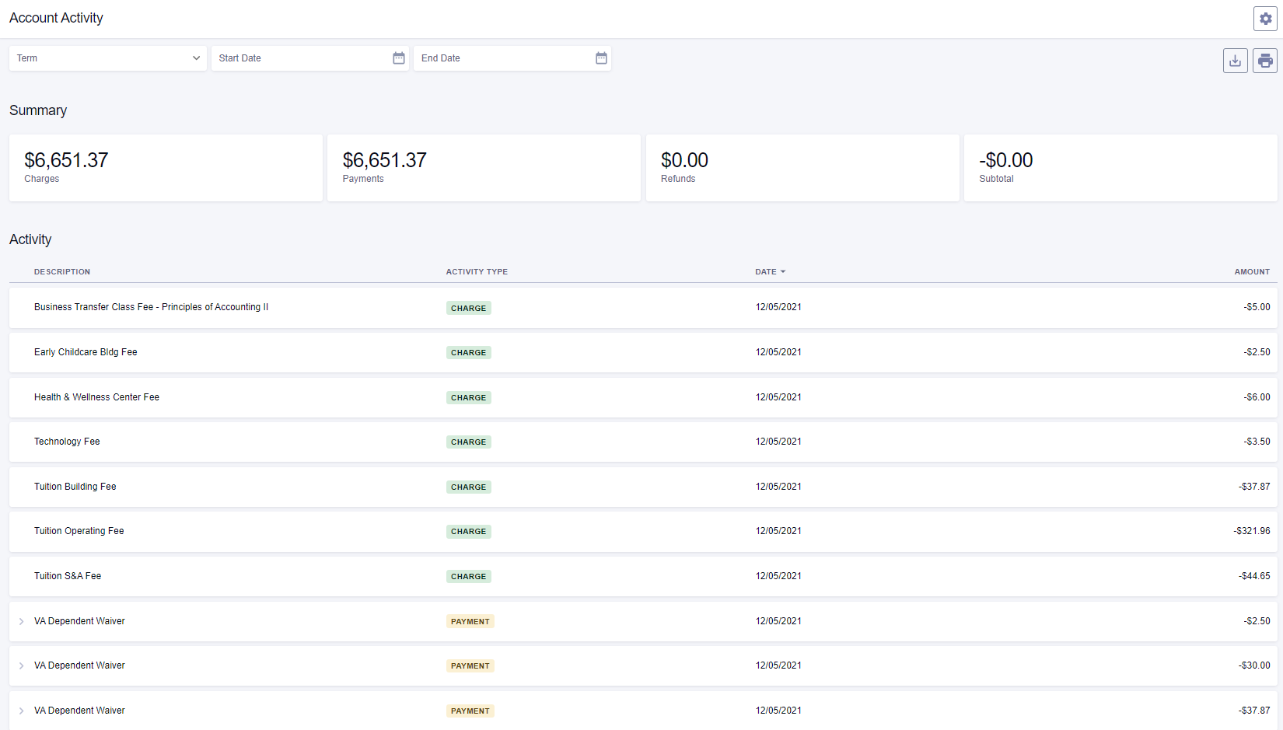
Activity is broken
down by ‘Type’
Clicking on the ‘>’ provides more information

Slide 7
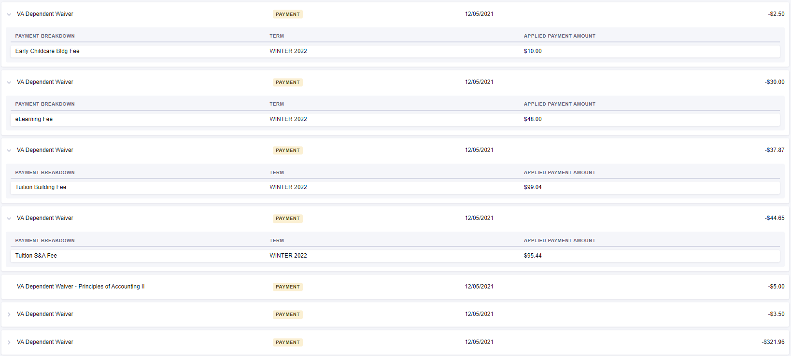
Clicking on the ‘>’ provided more information

Slide 8
Back at the top of this page, you have the option to ‘print’ to PDF
Your Name
Your EMPLID
With a more detailed breakdown for you to use as needed

