Slide 1

TILTing English Assignments
, from essays to zines

Slide 2
TILT = Transparency in Learning and Teaching
The central concept of TILT is to let students see behind the scenes of the course
--to see why we are doing what we doing
--to see how the assignments work together to provide practice in a set of related skills and areas of knowledge
--to see how the assignment will benefit them in this course, future courses, and in the world beyond school

Slide 3

Secret Handshakes
In educator and blogger Steven Volk’s phrase, a TILT-ed assignment reveals “academia’s ‘secret handshakes.’ It’s a similar concept to the one that underlies Cathy Birkenstein and Gerald Graff’s composition textbook They Say, I Say, with its presentation of academic-essay templates and its emphasis on dialogic communication in writing.
Volk, Steven. “Revealing the Secret Handshakes: The Rules of Clear Assignment Design.” After Class, 27 Sep. 2015, https://steven-volk.blog/2015/09/27/revealing-the-secret-handshakes-the-rules-of-clear-assignment-design/

Slide 4
Three Mainstays of any TILT-ed Assignment
The Task: What are we doing? What is its shape—its genre, its length, its medium?
Purpose: Why are we doing this? How does it fit into the course as a whole? How does it deliver a course outcome?
Criteria: How will the task be evaluated?

Slide 5
An example from English 101—
Critical Analysis Essay Assignment
Purpose: To gain practice in recognizing and deploying the elements of a successful argument.
Task: Write a paper of at least 1,000 words in which you respond to one of the questions below, focusing on either The Left Hand of Darkness or The Hundred Thousand Kingdoms. Use MLA style (see the Pocket Style Manual) for the heading information, page numbering, in-text citations, and crediting any works you may cite other than the novel under discussion. (Using outside research sources is discouraged, though. This is not a research paper.)
--For a model, see the sample MLA-style essay on p. 179 in the Pocket Style Manual. Another tip: remember that you do not need to put the author's name in the parenthetical citation if it's already clear which author you're quoting. Just the page number will be enough.
Outcome: Composing and revising in context. With this essay, you'll address a definitively different audience than you did with the Letter of Recommendation essay. That audience was a general, popular one; for this paper, it's an academic one. (Assume that your audience is familiar with the novel you're discussing, so that they don't, for example, need lengthy, or any, plot summaries.)
Writing critical or analytical papers in an English course hones skills that are useful in fields like business, law, and communications as well as any academic field. The more people who can write in a way that is at once persuasive, ethical, and engaging, the better the world runs.

Slide 6
Critical Analysis Essay assignment, continued
For any of the questions or options you choose, you will ground your argument in close readings from the novel under discussion. This means that the body of your paper will consist of your analysis of at least two specific scenes or passages in the novel, in which you interpret the meaning of the moves the author makes--the descriptions of characters, the delineation of a narrator's or point-of-view character's thoughts, setting descriptions, striking word choices--and tie those moves to your thesis, which itself should point to a larger statement of meaning (i.e., interpretation) of the novel.
Your thesis should be specific and debatable (meaning that another thoughtful reader could disagree with it) and stated early in the paper--on the first page, in a paper of 4-6 pages like this one.
(Suggested questions about each of the two novels we have read then follow.)

Slide 7
Critical Essay Grading Guidelines—
Before Updating for the Age of Generative AI
A is the grade for papers that include the following traits:
--The thesis is original, debatable, and insightful. It tells the reader something the reader didn’t already know. It makes a specific claim rather than a general observation.
--The paper uses supporting points that are clearly grounded in the text of the work(s) under discussion. Quotes of specific scenes or passages are used to clearly illuminate and develop the argument, and every portion of a quote is commented upon in the paper.
--The writer convincingly (and respectfully) rebuts valid counter-arguments to his/her/their thesis.
--The writer’s ethos is good; the writer does not use slang and doesn’t disrespect or dismiss any opponents to the writer’s argument.
--The prose style is clear, elegant, and sophisticated. The paper is close to error-free.

Slide 8
Critical Essay Grading Guidelines—
After Updating for the Age of Generative AI
A is the grade for papers that include the following traits:
--The thesis is original, meaning that it sounds like it came from a specific person. The thesis should be debatable and insightful. It tells the reader something the reader didn’t already know. It makes a specific claim rather than a general observation.
--The paper uses supporting points that are clearly grounded in the text of the work(s) under discussion. Quotes of specific scenes or passages are used to clearly illuminate and develop the argument, and every portion of a quote is commented upon in the paper. All works must be referred to in in-text citations as well as a bibliography page.
--The writer convincingly (and respectfully) rebuts valid counter-arguments to his/her/their thesis. Counter-arguments should be summarized and rebutted wherever it makes most rhetorical sense to do so.
--The writer’s ethos is good; the writer does not use slang and doesn’t disrespect or dismiss any opponents to the writer’s argument. Writers should feel encouraged to include references to personal experience (and to use the first-person pronoun) in supporting their arguments. Humor is acceptable.
--The prose style is clear, elegant, and sophisticated. The paper is close to error-free. Writers should feel encouraged to use a more poetical style, including metaphors, in connecting subjects and emotions to real-world objects and actions. Writers should feel encouraged to sound like themselves.

Slide 9
TILTing the Final Portfolio in Writing Fiction (English 237)
The old guidelines:
The final portfolio should consist of just ONE file which should include:
--the revised version of one of your story drafts from the course--or of all three installments of a longer work, if that's what you turned in for Stories 1-3
--a cover essay of around 750 words (can go longer) in which you address the following points:
what you were trying to accomplish in the story and how closely, or not, the revised version has reached those goals, in your view
what the reasons are for the changes you made in revision
your assessment of your goals/tastes/motivations in writing fiction.

Slide 10
TILTing the Final Portfolio in Writing Fiction (English 237)
TILTed guidelines:
Here it is—the work you’ve been building up to all quarter! A lot of imaginative and interesting work has been done in the course, and I’m looking forward to reading everyone’s portfolios.
Purpose: To revise a story in depth, sharpening its focus and enriching its theme(s) as well as making it still more appealing for a reader. To learn more about your own revision process by analyzing that process.
Outcomes: Meets all the course outcomes, especially “critique, revise, and edit works in progress.”
Task: Prepare a final portfolio, all in one file, which includes
--the revised version of the full-length story you submitted in the course
--a cover essay of around 750 words (can go longer) in which you address the following points:
what you were trying to accomplish in the story and how closely, or not, the revised version has reached those goals, in your view
what the reasons are for the changes you made in revision
your assessment of your goals/tastes/motivations in writing fiction.

Slide 11
TILTing the Final Portfolio in Writing Fiction (English 237)
The old guidelines:
The most successful essays will be structured around an interesting main idea that provides an insight into your process as a writer. This main idea should be woven throughout the essay in some way. The essay can be written as a regular critical essay or as a creative piece; it may be written as a story or a personal essay with images and memories, for example.

Slide 12
TILTing the Final Portfolio in Writing Fiction (English 237)
TILTed guidelines:
The most successful essays will be structured around an interesting main idea that provides an insight into your process as a writer. This main idea should be woven throughout the essay in some way. The essay can be written as a regular critical essay or as a creative piece; it may be written as a story or a personal essay with images and memories, for example.
Here are just a few examples of such main ideas:
I’d thought I’d never enjoy writing first-person narratives, but I discovered possibilities in them that I hadn’t thought of before.
Trying new techniques/ points of view/ genres made me appreciate more the ones I was already using. Here is what I learned about why I am drawn to writing X kind of story or using Y kind of technique or approach.
The experience of having my stories go through the peer-review process improved them in X way.
Here is what I learned about the way I am influenced by X writer or my reading in Y genre.
My journey in writing fiction this quarter has been an outward-expanding one in X ways.
My journey in writing fiction this quarter has been an inward-turning one (maybe even emotionally fraught) in X ways.

Slide 13
Alternative Assignments—Zine Project
(in combined English 101/ First-Year Seminar)
Purpose: To collaborate with a team to produce a publication containing pieces of writing, visual art, and graphic design on a topic of public or personal interest.
Outcome: In working on this assignment, students apply the skills of reading, writing, and editing to a project that has a more specific audience than a standard academic essay. Students will tell stories and make arguments through curating the contents of a zine. They also gain skills in group work. Finally, the assignment meets the FYS outcome of engaging actively with the campus or surrounding community.
Many students have found that the experience of forming a group and creating a zine has benefits beyond academic and professional ones--that they learn new things about their own identities and about themselves as social beings through working on this project.
Task: Work to evaluate, proofread, and edit a zine of at least 8 pages (no maximum length limit). Each group will make a zine on a topic and/or theme of interest to them. The zine will be similar to the examples you viewed in the BC Library on our visit there, earlier in the quarter. We will also have talked in class about zines and how to make them.

Slide 14
Example of a zine grading rubric
Vision
Zine fits with the focus that the writers laid out in the vision statement. Zine may even broaden, strengthen, or show new facets of the ideas the editors started with. The editors' letter addresses the audience and explains how the content fits with the editors' vision for the zine.
Design
The design of the zine fits with the vision and shows creativity and professionalism. The design is consistent throughout the zine (page design, fonts, etc.) and shows a collaborative effort among group members.
Content
The contents included in the zine have been curated for the selected audience. The zine feels like a collection of creative work that fits together under the vision of zine.
Correctness
The zine has been sufficiently proofread and edited. There are zero or few typos or mistakes.

Slide 15
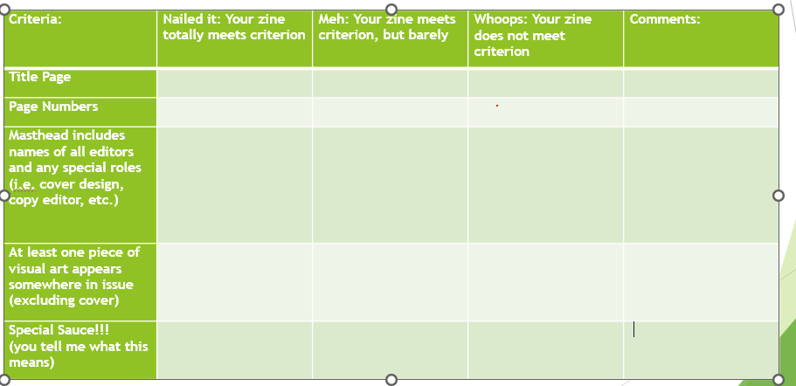
FINAL ZINE SCORECARD
ZINE TITLE:
EDITORIAL BOARD:
LITERARY CONTENT

Slide 16
Thank you!
Time for questions
and discussion of example(s)...

