Slide 1
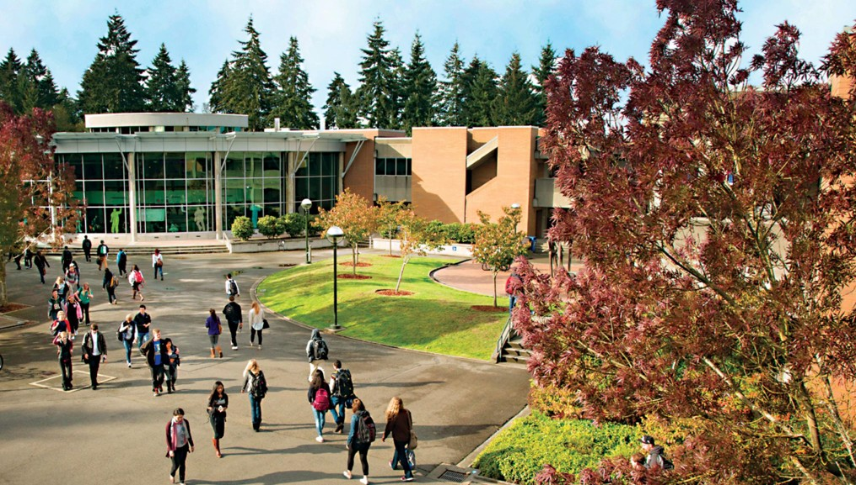



Bellevue College in the High School New Teacher Orientation
2026-2027

Slide 2


It’s kind of like an octopus
HS Students
HS Teachers
HS Administration
Parents
CHS Staff
Faculty Coordinators
College Administration
HS counselors/advisors

Slide 3
College in the High School Staff
We are now a part of the Connected Learning Group under the Academic Affairs Division, Our Dean is Amy Kinsley
Office:
  Susan Hampson—Director
  Heather Yoshinaka—Program Specialist
  Luna Far—Program Specialist
Discipline Area Faculty Coordinators
  English—Cara Diaconoff and David Lopez-Kopp
  Biology- Reza Forough
  Earth Space Science- Rob Viens
  Chemistry—Shraddha Deodhar
  Math—Liangmin Zhou and Sandi Xhumari
  World Languages--
  Spanish—Archana Always
  French—Lamia Mezzour-Hodson
  Political Science—Christina Sciabarra
  IT—Thomas Lee
  Music—Dan Kramlich
  Art- Deborah Leblang

Slide 4
Orientation Agenda:
PART 1:
What is College in the High School
  What should students consider before enrolling
  Equity impacts and benefits to students
NACEP Accreditation and Requirements
Timelines and processes
What’s new
PART 2:
Resources for students

Slide 5
What is College in the High School?
Official college courses at no cost, except private schools.
  Earn general education requirements
  We can help with educational planning/pathways
Generates official college records: GPA and transcripts
Allows students to stay on their high school campus
Provides access to college resources: Library, Academic Success Center, Advising, etc.
Benefits and equity impacts
  Students more likely to complete a two-or four-year degree
  BIPOC and low-income student's opportunities
Official college courses at no cost Generates official college records: GPA and transcripts
Allows students to stay on their high school campus
Provides access to college resources: Library, Academic Success Center, Advising, etc. Students must create a NetID to use the services.
Notes:
Academic Success Center = tutoring available online or in person

Slide 6

What Students Should Consider Before Registering
Is the student ready for the rigor of college coursework?
Is the student willing to be aware of all the deadlines for admissions application, course enrollments and drop/withdrawal deadlines? Best to apply and not enroll than miss the deadline.
  We provide you with a student welcome video (5 minutes) to play for them at the beginning of the year.
What are the potential effects on college GPA and future financial aid?
What are the students’ college/educational goals?
Will students’ intended future college/university accept the
credits?
Is the student ready for the rigor of college coursework?
Is the student willing to be aware of all the college admissions applications, course enrollment, and drop deadlines
What are the potential effects on college GPA and future financial aid?
What are the student’s college/educational goals? Will students’ intended “future” college/university accept the credits?
Notes:
Show the welcome video

Slide 7


























What is NACEP?
NACEP—National Alliance of Concurrent Enrollment Partnerships
NACEP has 6 Standards each with required a list of required evidence that our program meets the standards.
There are overall program standards, partnership (with districts), faculty, student, curriculum, assessment, and evaluation standards.
Please review the Instructor Handbook for more specifics.
All Washington Colleges that have a college in the high school program are required to be accredited by 2027
We received accreditation this May after a rigorous two-year process
We are happy to announce that we received notice of accreditation at the end of May.
Thank you all who participate in the program and especially those who participated in the virtual site visit last February.
Notes:
191 documents were submitted, this year to both NACEP and the state

Slide 8
NACEP Requirements
FOR CHS TEACHERS:
Application and approval – Instructor Handbook
  Includes syllabus in Bellevue College format
  Assessment paired with Bellevue College assessment—faculty coordinators will work with you on this.
  ctcLink ID process
CHS Program Orientation – This is it!
CHS Discipline-Specific Training with your Faculty Coordinator
Annual Professional Development – This year the coordinators will present a discipline specific professional development topic. SAVE THE DATE: October 28, 2027
Site visits (1st year and then every 4 years)
Must complete everything to be compensated
Medical leave, planned or sudden – we MUST approve your substitute if leave is more than 10 days – or classes must be cancelled.

Slide 9
Timeline
When do your courses enroll
Fall: First trimester courses. Grades posted in December. Students apply for FALL 2026
Winter: Students apply for Winter 2027
  Year-long courses—you teach the content in both semesters; example ENGL& 101 is year-long. Grade will be an average of the two semesters and posted in June.
  First semester courses--content is taught September through January; like if you teach MATH& 151 and then MATH& 152 in second semester. Grades posted in March
  Second Trimester courses. Grades posted in March.to 26-27 academic year.
Spring: Students apply for Spring 2027—if they are only taking a course starting in February
  Second semester courses. Grades posted in June.
  Third trimester courses. Grades posted in June
Course Evaluations. We send students and you a QR code to access evaluations. We do some in February and some in May. This is just for enrolled students and 20% return is appreciated.
  Second-semester courses
The reason year-long courses register in winter has to do with NACEP requirements. In college students do not get to see what grade they are getting before they enroll, NACEP requires that we follow college enrollment, so high school students, if they are not happy with the grade they are receiving, either should not enroll or make sure they drop by the deadline.

Slide 10
Processes 1 (class lists and applications)
If we have a data sharing agreement with the district?
  YES--They will send us your class lists-
    Bellevue SD, Renton SD, Lake Washington SD, Highline SD, Snoqualmie Valley SD—haven’t heard from Issaquah.
  NO—We will need you to send us the following information (student name, date of birth, school email address, class period and name of class, student grad date or grade level)
  We take the lists and compare it with our records to see who already has a ctcLink ID (students who have applied to Bellevue College)
Show your class the welcome video
Put the information we send you for the students in your Class Site
For winter classes we need your list by the end of September
First step for students is to apply if they have never applied to Bellevue College
  If they have applied to another college, they need to apply to Bellevue and will be assigned the same ctcLink ID.
  If they have taken CHS or Running start classes at the BC in the past—do not apply again.
Account Activation
Enrollment

Slide 11
Processes 2 (Placement/Prerequisite Grids)
  Placement/Prerequisite Grids
  We use this instead of making high school students come to take math and English placement tests—a NACEP requirement.
  It will be an Excel Spreadsheet and posted in our OneDrive by High School, tabs at the bottom are in alphabetical order by teacher last name.
    Putting in on OneDrive lets CHS staff and teachers edit the document and makes updates easier.
  We will send you a link to your school grid.
  You need to indicate how each students meets either the placement or prerequisite for your class. If you have more than one class, it will be on the same sheet. If your class does not have a prerequisite, you will still have a sheet.
  As we see you have completed the placement/prerequisite information, we will begin to add course numbers and permission codes.
  Automated messaging—
  First message is an invite to apply to take the class(es)
  Second is to send the enrollment information (class numbers and permission codes)
  We have asked the districts with a data sharing agreement to “safelist” our email, students will find the information in their HS email inbox or “junk folder”
  Teachers hand out codes
  If we do not have an agreement with your school, you will be giving the students the class numbers and permission codes
  Our Goal is to update the sheets daily (check for new student’s ID numbers, make sure they have the correct enrollment term, remove underage holds, add them to the college in the high school student group.
  We cannot remove a financial agreement hold—students need to accept and submit—no fees

Slide 12
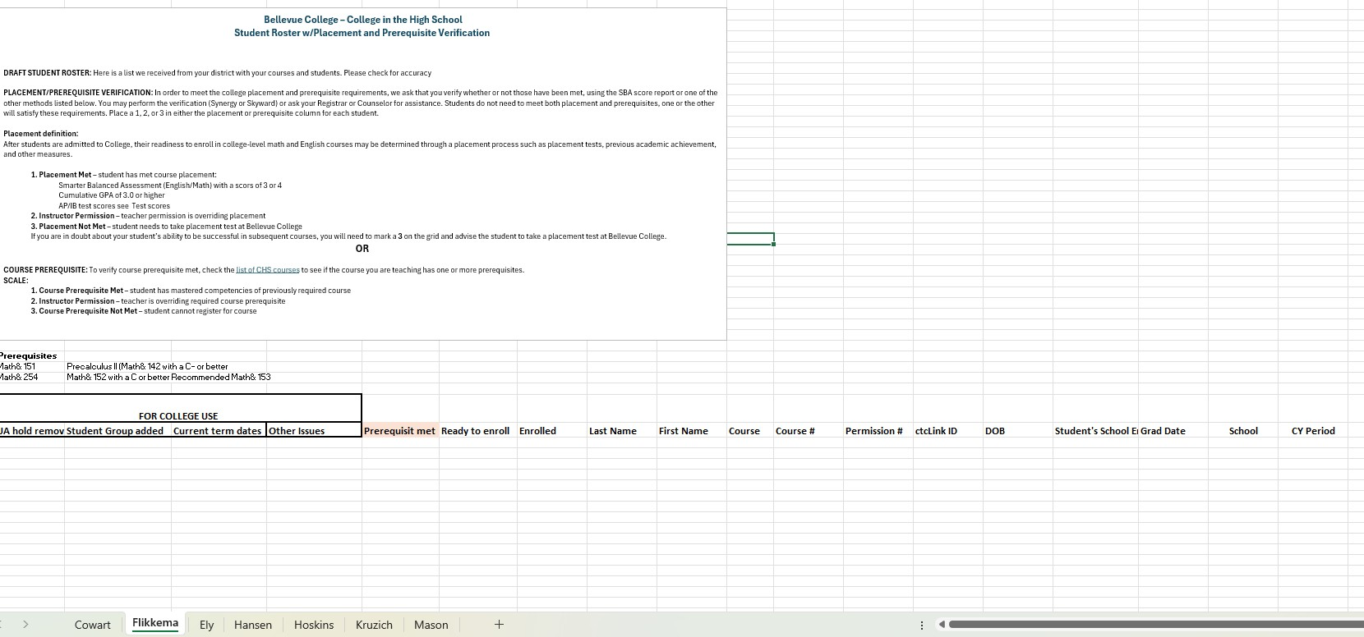

Slide 13
Processes 3
(Account Activation and Enrolling in classes)
  Account Activation
  Students who apply, will receive a “Welcome” letter sent to the email address they used in their application—check junk folder too.
  The letter contains their 9-digit ctcLink ID
  They will first need to activate their account—
    SAVE THE PASSWORD they create as they will use this to log in and enroll, and the process of retrieval is time consuming.
  Enrolling
  We check and update your spreadsheet each day and will put a “X” in the ready to enroll
  We have asked the districts to “safelist” our email, but students will find the information in their HS email inbox or “junk folder”
  Once a student has activated their account and they have their class number (same for each student in a section/period) and permission code (each students has a different code), they are good to enroll.
  Teachers hand out codes
  If we do not have an agreement with your school, you will be giving the students the class numbers and permission codes
  Or if you prefer, just always give out the codes—
  You could take the following columns in the grid copy and paste them into another document and post for students with the other CHS information.
    Last name, first name, course, class number, permission code

Slide 14
In Summary
What’s New
Safe listing our email through a data sharing agreement with the district so students can receive automated messaging. If we have an agreement with your district.
OneDrive access to placement/prerequisite grids so teachers and BCHS staff can both work on the updates at the same time.
Packet of materials to post for students on your class sites
Important BCHS web links
The BCHS Website
Key Dates and Deadlines
Student/Parent Resources
Teacher Resources

Slide 15
Resources for BCHS Students
To Access Resources:
Once a student applies and enrolls, they have access to many of the college's resources.
They will need to create a NetID (gives them a BC email address) in order to access the resources.
Resource Links:
  Academic Success Center-N250
  Benefits Hub-U217
  Counseling Center-U201
  Library Media Center-D126
  Neurodiversity Navigators-B131
Notes:
Academic success center—tutoring, in-person or online Benefits Hub—food support and emergency aid Counseling Multi lingual-Library Media—Books and other resources Neurodiversity drop-n support and resources

Slide 16
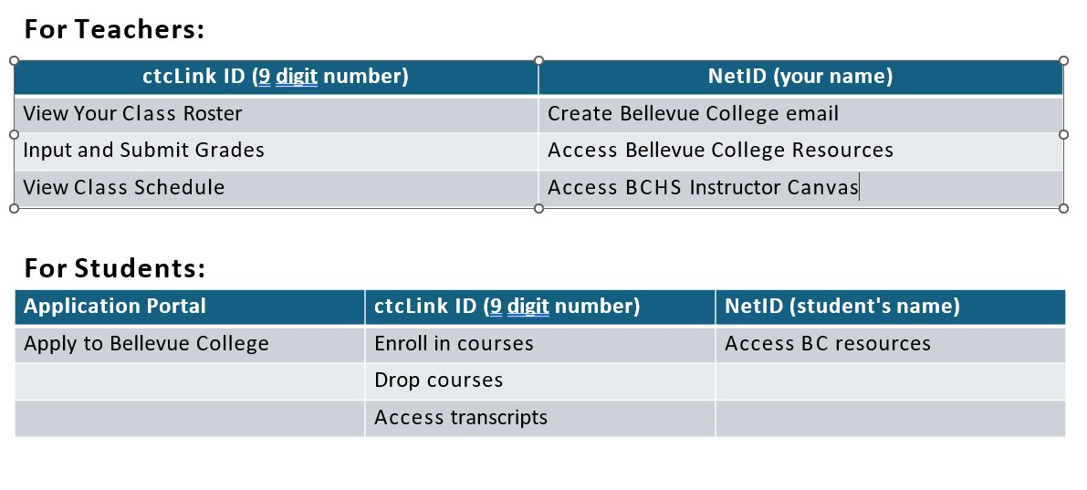
ctcLink ID vs. Net ID

Slide 17
Please Complete this Survey
Orientation Survey
Thank you for participating in our program and have a great school year!
Email: cihs@bellevuecollege.edu
Susan.Hampson@bellevuecollege.edu

