Slide 1
NEW STUDENT ORIENTATION
Notes:
Greet the audience
Introduce yourself
Check for accessibility

Slide 2
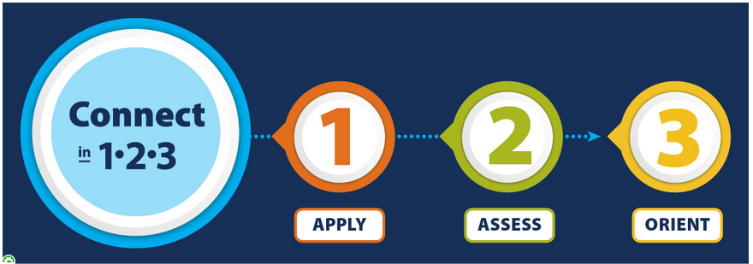
Welcome to Bellevue College!
-New Student Orientation-
Please…
Use the chat to write your questions
Mute yourself when not talking
Remember this is a “public” online space
Notes:
Make sure your audience is in the right place and refer RS, ABE, IE or ESC to the appropriate department.

Slide 3
Learning Outcomes
After today’s orientation, you should be able to do the following:
Identify which English and math classes you have placed into
Differences between university transfer degrees and professional/technical degrees
BC resources
Classes to take during your first quarter and register for them
Paying for classes
Schedule an appointment with an academic advisor
Complete the Intake Form
Notes:
Explain the goals of the meeting

Slide 4
Complete the Intake Form
https://www.bellevuecollege.edu/intakequestionnaire
Notes:
Please, share with students and give them some time to complete the intake questionnaire: https://www.bellevuecollege.edu/intakequestionnaire
The intake questionnaire help us to be proactive in helping you and connecting you to the appropriate resources
or
This form is for all new Bellevue College students and the information collected will be used as a way to learn more about your educational and/or career pathway. The information you provide will also be used to connect you to campus resources as soon as possible to best support you and your success throughout your time at BC. Thank you!

Slide 5
Learn About BC Pathways
Notes:
Bellevue College is committed to helping students choose a career and educational path and all of our degrees and certificates have nested within these 8 pathways. You could change your path at anytime, but this is a helpful guide for keeping students on path and completing their goals.
Or
We at Bellevue College understand that time and resources are precious. It is our goal to help you best use your time so that you can effectively and efficiently work toward your educational and personal goals. We are committed to helping you identify a path and stay on a path, and graduate so that you can continue moving forward!
Or
Pathways is the approach we use to organize career and education information into categories to help you connect your interests with different types of occupations and the related levels of education and training needed for them.
Or
Bellevue College is committed to helping students choose a career and educational path and all of our degrees and certificates are found within the following eight pathways:

Slide 6
Placement Testing
Placement Testing
Many BC degrees and certificates require English 101 completion or placement, as well as completion or placement into a certain level of math. So…
RECEIVE PLACEMENTS VIA “MULTIPLE MEASURES” OR
TAKE YOUR PLACEMENT TEST(S) EARLY!
*For important placement and testing information and resources,
review the Placement and Testing Services website.
Notes:
An important step to getting started at BC is to identify whether you must establish English and/or math placement. Many classes—and most degrees—at BC require some level of English and/or math, and taking care of this soon after you apply will help with your registration.
or
Whether this is your first time attending college or if you've previously attended another college or university, receiving math and English placement is important
or
The program you want and the major you want (if transferring) determine the math you need…don’t delay Math or English placement testing until later because it could delay your graduation and transfer. Let’s review the sheets.

Slide 7
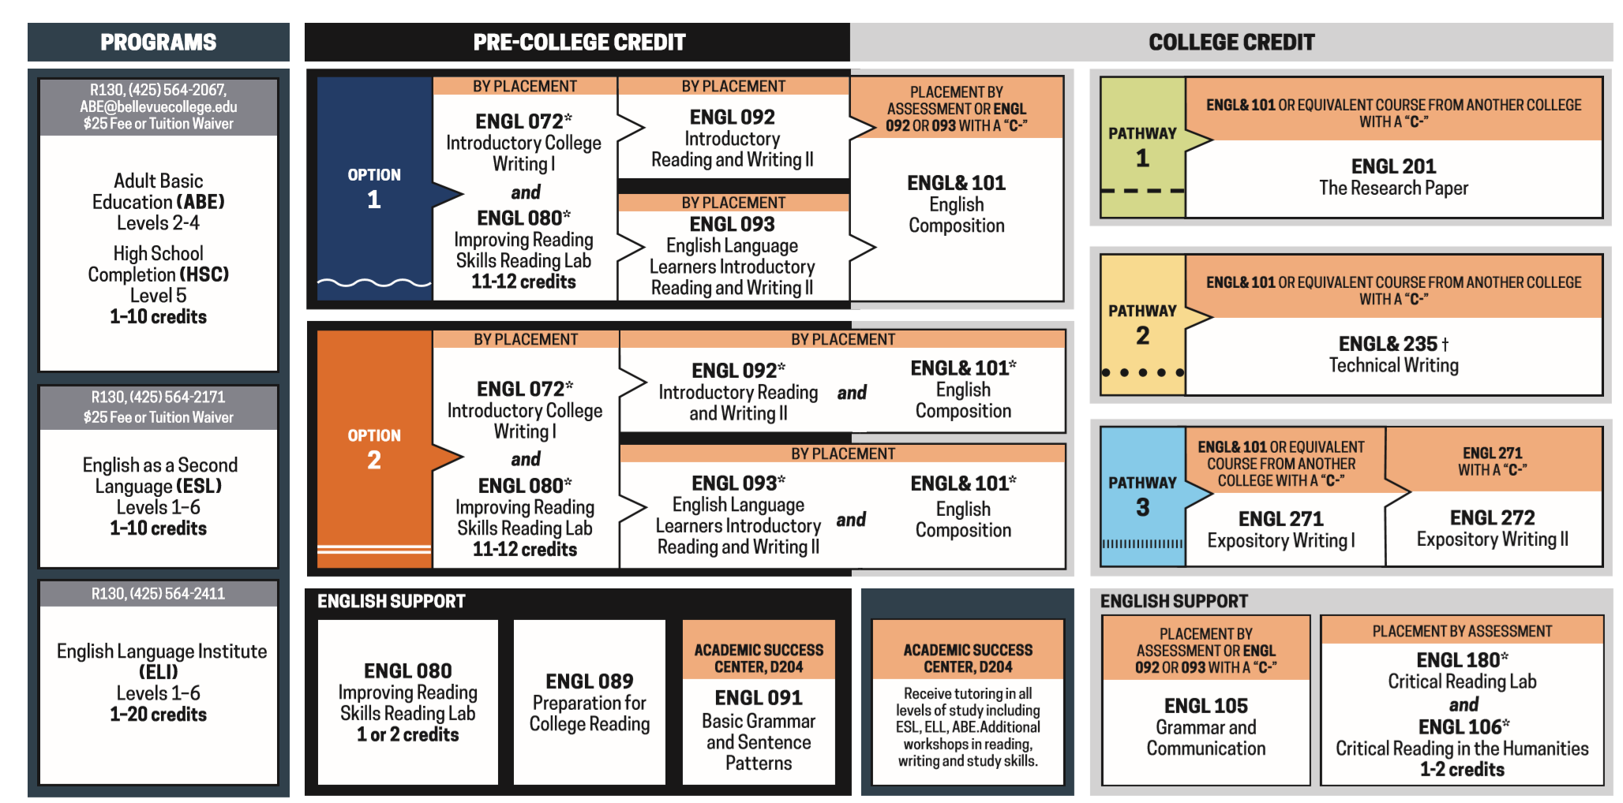
Written Communications
Notes:
Written Communication (ENGLISH) Placement using ACCUPLACER:
STEP 1- Present your placement Exams at BC or
Domestic high school transcript, and an overall GPA of 3.0 or higher
AP or IB exams,
Smarter Balanced Language Art score of 3 or 4, may be used in the year following HS graduation, or for Running Start students 
Placement from another Washington State Community or Technical college (reciprocity), less than two years old
STEP 2- Your intended major determines your English requirement. Always consult with your advisor for educational planning

Slide 8
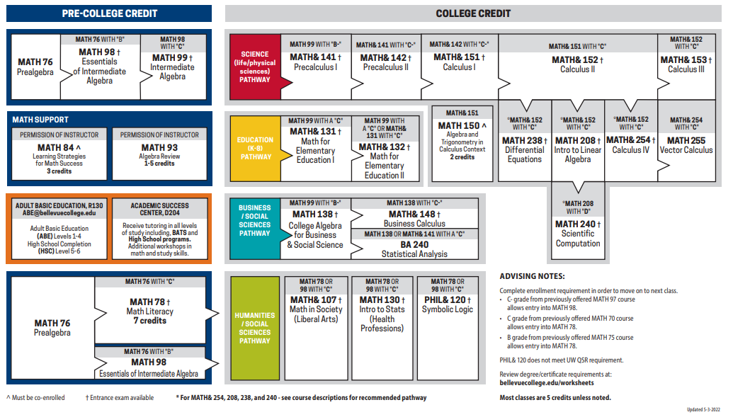
Quantitative/Symbolic Reasoning (QSR)
Notes:
ALEKS placement assessment 
AP/IB Exam results 
Smarter Balanced Test 
Applicable high school coursework 
Reciprocity, less than 1 year old
Review degree/certificate requirements at: bellevuecollege.edu/worksheets

Slide 9
Which Degree is Right for Me?
______________________________________________________________________________________________________________________________________________
Associate Degrees (2 years)
University Transfer Degree
Professional/ Technical Degree
Jobs/Career
Associate of Arts and Sciences
Associate in Business
Associate in Science
Associate in Music
Associate in Math Education
Associate of Arts
Associate of Applied Science-T
----------------------------
Certificates (less than 90 credits) *
Bachelor Degrees (4 years)
Bachelor Degrees (4 years)
Bachelor of Arts (BA)
Communication Studies
Dance
Psychology
Etc
Bachelor of Applied Science (BAS)
Information Systems
Interior Design
Healthcare Management
Radiation and Imaging
Etc
Bachelor of Science (BS)
Computer Science
Engineering
Biology
Etc
* Including Continuing Education (non-credit courses)
Jobs/Career
Notes:
Degree Types
There are many program options available to students at BC. From transfer associate degrees to bachelor's degrees, professional/technical certificates, and more, selecting what path to pursue is a big step towards determining what classes you'll take and when.
If you haven't decided what type of degree is best for your, or if you'd like more information about the different types of degrees, explore definitions below.
Transfer Associate Degrees
The two-year transfer associate degree is the most popular degree at Bellevue College. Agreements that BC subscribes to make it possible for students to more easily and efficiently transfer to four-year institutions. Students who choose a qualified degree path take 90 credits worth of general education courses at BC before they transfer to a four-year institution, most often with junior standing.
If you're considering a transfer associate degree, here are a few things to keep in mind:
Most transfer agreements only operate within Washington state
Speak with your academic advisor early if you plan to earn a transfer associate degree. There are multiple transfer associate degree tracks, and where each is accepted varies
Follow the degree plan closely to make resourceful use of your time at BC
Bachelor's Degrees
BC offers 12 bachelor's degrees in high-demand fields of study. Most of these programs are applied bachelor's programs, meaning students must first complete certain prerequisites at the associate level before applying to their program of choice. If you want to earn a four-year degree that helps put you on a fast track to career readiness, consider one of the following options at BC:
Applied Accounting, BAS
Computer Science, BS
Data Analytics, BAS
Digital Marketing, BAS
Health and Wellness, BAS
Healthcare Informatics, BAS
Healthcare Management and Leadership, BAS
Information Systems and Technology, BAS
Interior Design, BAA
Molecular Biosciences, BAS
Nursing, RN to BSN, BSN
Radiation and Imaging Sciences, BAS
Professional/Technical Degrees
Professional and technical certificates help students gain work-ready skills. These types of associate degrees can often be completed in two years and are designed for individuals looking to enter the workforce faster than a four-year degree.
Professional/Technical Certificates
Certificates are a great way to upskill or level up your career. BC offers many certificates for those looking to learn a new skill, gain more knowledge about a current one, or earn a credential to improve their resume.
For a full list of programs available at BC, visit the Bellevue College Programs of Study catalog (Links to an external site.).
er plans!

Slide 10
Academic and Professional Resources to Support Your Success
STUDENT CENTRAL
DISABILITY RESOURCE CENTER
NEURO DIVERSITY NAVIGATORS
ACADEMIC ADVISING
TRiO STUDENT SUPPORT SERVICES
MULTICULTURAL SERVICES
LIBRARY MEDIA CENTER
ACADEMIC SUCCESS CENTER
COUNSELING CENTER
CENTER FOR CAREER CONNECTIONS
STUDENT ENGAGEMENT
LGBTQ RESOURCE CENTER
Notes:
Each of these boxes is hyperlinked to the website for that office. If the students wish to learn more they can access this PPT online and visit these sites.
Academic advising: Course selection and educational planning, degree/certificate requirements, transfer questions
Academic Success Center: Tutoring services, skill building workshops, study resources
Autism Spectrum Navigators Program: Advocacy, access services and educational opportunities for students with Autism
Center for Career Connections: Career resources and services for all stages of a person’s academic and professional career (career assessment/advising, internships, classes and workshops)
Counseling Center: Counseling for academic and personal stress
Disability Resource Center: Accommodation and advocacy services for disabled services
LGBTQ Resource Center: Center that advocates for students, faculty and staff, continued education experiences on campus, recommendations for best practices on campus, resources for the BC community
Multicultural Resource Center (MCS): Direct student services to support multicultural student excellence in academics and overall college experience; promoting inclusivity across campus, social justice and belonging
Student Central: Placement Testing, Financial Aid, Enrollment Services, Evaluation &Graduation, Residency, Welcome Center
All boxes above are hyperlinked to the department’s website. Here are brief descriptions of what these offices do….
Student Programs: Student clubs, student government
TRiO Student Support Services: Individualized support for students who are first in their family to go to college, are low/limited income, or with disabilities.
Library Media Center: Access to borrowing various materials (i.e. books, periodicals, calculators, laptops, headphones, and other equipment! Librarians to help you with research for an assignment, and more!

Slide 11
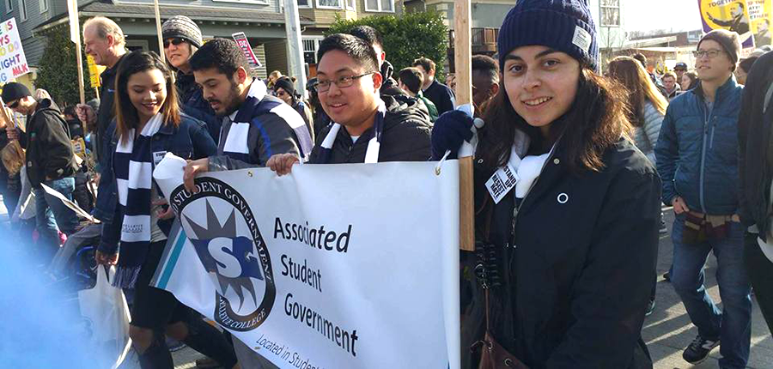
Associated Student Government: Get Involved!
Office of Student Engagement
Student Leadership
Student Empowerment
Build Community
Sign-up today!

Slide 12
UMOJA and Puente Scholars Program!
Umoja is Kiswahili word meaning: Unity.
The UMOJA Scholars Program at Bellevue College is being built in partnership with the UMOJA National Consortium to provide a supportive learning community, as well as critical resources dedicated to enhancing the cultural and educational experiences of Black, African American, and other students.
Puente Program
The Puente Program is a nationally recognized and award-winning academic program dedicated to advancing the education of Latinx students. The Puente Academic Program at Bellevue College is designed to support Latinx students in reaching their academic potential and returning to their communities as leaders and mentors of future generations.
Signup today!
Notes:
Describe the important of Umoja Program for Black, African Americans, and other students. It brings unity amongst students and allows us to build a community of scholars.
There are 68 Colleges conducting UMOJA programs in California. However, Bellevue College is the 2nd Washington state college adopting and implementing the UMOJA Scholars Program as part of the North West Region.
We are proud and honored to serve you.
The UMOJA Scholars Program at Bellevue College provides culturally relevant
College entry knowledge and support from Umoja trained and dedicated staff
Coaching with financial aid application process
Dedicated academic advising to create an academic road map to achieve your goals
Dedicated instructors with culturally relevant teaching practices
Access to mental health counseling (African American Counselor)
Dedicated tutoring from faculty and peers
Intentional connections to campus and community resources
Assistance with university transfer process
The Puente program started in 1981, at Chabot Community College in Hayward, California. The program combines accelerated instruction, intensive academic advising and counseling, mentoring, and other support for Latinx students with a cultural lens. The Puente program has helped thousands of Latinx students achieve their academic goals. We are glad to offer to you the Bellevue College Puente Program.
What makes the Puente program different and why should you participate?​
The Puente program is dedicated with your success in mind providing​
Entry to college information guidance and support​
Placement in a community-building cohort during your first year.​
A supported path to complete English and Math requirements during the first year of College. Avoid delays!​
Dedicated staff to provide you with academic advising, create an academic plan, and enroll in classes​
Professors that are dedicated to your academic success with culturally relevant instruction and hands -on active learning, developing strong study skills and strategies, explore career options and developing a plan to achieve your goals.​
A dedicated Counselor to help you with further guidance and support Bilingually English/Spanish​
College visitation and college transfer support​
Professional mentoring, tutoring and other academic support.​
Participate in culturally enriching activities outside of the classroom​

Slide 13
Learn More about UMOJA and Puente at BC!
UMOJA Lead:
Darnita Boynton Howard: d.boyntonhoward@bellevuecollege.edu
Puente Lead:
Hector Guzman: hector.guzman@bellevuecollege.edu
To request UMOJA Information Session, please contact:
Multicultural Services (MCS)
Homepage: bellevuecollege.edu/mcs/
Email mcs@bellevuecollege.edu
Phone: 425-564-2208
Notes:
Please connect with Umoja Advisors to join the program! For more information, reach out to Henry Amaya, Director of MCS.

Slide 14
COVID-19 Resources
COVID-19 Student Portal
BC Vaccination Attestation (Confirmation) and Exemption Requirements and Information
Note: BC President’s Cabinet is requiring students, faculty,
and staff to be fully vaccinated by the beginning of Fall Quarter 2021.
Learning and Video Conferencing Platforms:
Microsoft Teams
Zoom meetings
Federal Higher Education Emergency Relief Funds (HEERF)
Laptop Loan Program
Notes:
Due to the COVID-19 health crisis, most classes and services at Bellevue College are being provided in a remote format until further notice. While this is a challenging shift, please know that resources are available and we are here to support you.
To help you access information and resources during this time, we have developed a COVID-19 Student Portal (Links to an external site.). Use this to find important campus announcements, updates, services, and resources.
In response to the college moving all classes and services online due to the COVID-19 heath crisis, the Bellevue College Associated Student Government (ASG) donated $100,000 for the purchase of 200 laptop computers to be loaned to students who need them to access classes and campus services.
In collaboration with Academic Affairs, ITS (Information Technology Services), Library Services and Student Affairs, the ASG Laptop Loan program is available for students registered for classes in the quarter they wish to receive a laptop. Laptops are available for loan on a first come, first served basis. Use the link to complete the online application.

Slide 15
Need Help Paying for School?
There are several funding options out there. To find out what funding you may be eligible for, be sure to complete 1) the Free Application for Federal Student Aid (FAFSA) OR the Washington Application for State Financial Aid (WASFA). Please check in with the Financial Aid Office if you are unsure of your status!
“FINANCIAL AID”
Also, complete the
Financial Literacy Training
Workforce Ed.
BC Foundation
V. A.
Work-Study
Notes:
Bellevue College makes college-level education accessible. Our Financial Aid Office (Links to an external site.) offers resources to help you stress less about paying for college so you can stay focused on what matters: achieving your goals.
It's never too late to apply for financial aid for the current academic year. Aid can be retroactively applied to your account once your eligibility is determined, and applications are processed throughout the year in the order they're received.
Financial Aid: https://www.bellevuecollege.edu/fa/apply/applicants/
This financial aid link provides info about FAFSA (Free Application for Federal Student Aid) as well as WASFA (Washington Application for State Financial Aid)
Veteran’s Services: https://www.bellevuecollege.edu/veterans/ (for veterans or veteran’s dependents to access GI benefits.
Workforce education: https://www.bellevuecollege.edu/we/ (for worker retraining, and various other programs)
Work Study: https://www.bellevuecollege.edu/workstudy/ (part of your financial aid award –funds on and off campus jobs through your financial aid award).
Bellevue College Foundation: https://www.bellevuecollege.edu/foundation/ (BC scholarships funded through donors)
If you are new to iGrad, you will first need to sign-up to get access to this free money management tool.

Slide 16
Campus Rules and Policies
STUDENT PRIVACY (FERPA): We cannot discuss your academic record with others w/o your consent.
STUDENT CONDUCT: Academic dishonesty and misconduct (examples: behavior issues/disruptions, use of drugs/alcohol, vandalism, physical assault)
TITLE IX: Relationship violence, sexual misconduct, stalking, gender discrimination
REPORT CONCERNS: https://www.bellevuecollege.edu/reportconcerns/
Call the Violence Against Women Hotline: 1-800-799-7233, or visit https://www.thehotline.org/resources/vawa/
Also, complete the Sexual Assault Prevention training: You will be receiving an email from Everfi/Foundry
A full list of our policies and procedures is found on our Policies and Procedures web page.
Notes:
At Bellevue College, your safety and security is our priority. Please take the time to know your rights and responsibilities as part of our community.
In this module we will cover:
Family Educational Rights and Privacy Act (FERPA): your information is kept private
Student Conduct Code: addresses transgressions from verbal to physical abuse and Academic dishonesty
Title IX of the Education Amendments of 1972 prohibits gender-based discrimination on all college programs and activities
How to report a concern: help us thrive in a diverse, safe, and secure community for all of us.
Remember, you are a student as soon as you are admitted, even if you haven’t taken a class yet and remain a student for one year after you stop taking classes
In an emergency (eminent danger to you or others) call 911 THEN call Bellevue College Public Safety at 425-564-2400 to notify them of the issue
For immediate response to other, non emergency situations call Bellevue College Public Safety at 425-564-2400.
Buying a parking permit
Campus Clarity Training
The goal of this training is to provide preventative actions that will stop further progression of sexual violence and prevent incidents before they occur. There are other forms of programming, resourcing, and education that can supplement prevention within the training.
This training is required within the first two quarters of college, it may be completed at a later date, an email reminder will be sent to remind you.

Slide 17
Sexual Assault Prevention: Required Trainings
Sexual Assault Prevention for Adult Learners:
This course will cover how to recognize and take action in potentially harmful situations, including options for how to respond if someone comes to you for help. Your identity and life experience puts you in a unique position to make a positive difference in the lives of other students, as well as others you care about.
Sexual Assault Prevention for Adult Learners emphasizes the importance of consent in long-term relationships and teaches adult learners to identify and address common forms of abuse such as financial abuse and child manipulation in personal and professional contexts. Adult learners build confidence to intervene with strategies suited for in-person and online environments.
Sexual Assault Prevention for undergraduate:
Sexual Assault Prevention for Undergraduates enables students to recognize sexual assault and harassment behavior, identify healthy and unhealthy relationship practices, and equips students with essential skills to navigate consent-based conversations and engage in bystander intervention safely.
Sexual Assault Prevention Training: You will be receiving an email from Everfi/Foundry

Slide 18
Academic Standing
In general
For financial aid
Maintain at least a 2.0 cumulative AND quarterly GPA to avoid academic probation
Academic Standing Procedures: https://www.bellevuecollege.edu/policies/id-3200p/
Maintain at least a 2.0 cumulative AND quarterly GPA AND complete at least 67% of the courses you enroll in to maintain your financial aid eligibility
Satisfactory Academic Progress (SAP) Requirements: https://www.bellevuecollege.edu/fa/youraid/sap/
Notes:
Academic standing is based on a student's overall grade point average (GPA). Students must earn a cumulative and quarterly GPA of 2.0 or higher to remain in good academic standing. On the contrary, there are certain procedures to quickly identify and alert students with low academic achievement and provide those students with assistance to improve their academic performance.
Please follow these general recommendations when determining your academic standing:
Also
It is extremely important to maintain good academic standing (2.0 GPAs or higher). If students don’t maintain good standing, it can affect how many classes they can take each quarter, could delay graduation (even if all required classes are completed student’s can’t graduate if GPAs are below 2.0!), can impact financial aid eligibility, and can impact transferring to a University

Slide 19
How Many Classes Should I Take?
To be considered “full time,” you must be enrolled in at least 12 credits
Most “full-time” students take 3 classes
1 credit = typically 1 hour you spend in class each week
1 typical college class = 5 credits
Remember the 1,2,3 Rule!
For every 1 hour of class
Expect 2 hours of homework
Which equals a 3 hour time commitment
Notes:
What are the various commitments you have IN ADDITION to school? Work? Family? Others?
You are not just a student; you balance various and often competing commitments. When selecting your course load be mindful of the 1, 2, 3 Rule so you can set yourself up for success.
Type of class: Online; asynchronously & synchronously, hybrid, and on-campus.

Slide 20
When and How to Pay for Classes
Know Your Deadlines
Refer to the Academic Calendar for registration information and tuition deadlines
Visit the BC Student Central office, if you have questions about your registration, tuition, and/or financial aid
Know Your Payment Options
Multiple payment plan options
One quarterly enrollment fee of $25
Visit Student Financial Services

Slide 21
Next Steps for First-time-to-College Students
Register for courses for the upcoming quarter, including the First Year Seminar (FYS).
FYS is a required course for new students within AAS-DTA.
Purchase a parking permit via the Public Safety website, if you plan to drive to campus
Familiarize yourself with Canvas (our online learning system) and view the tutorial
Sign up for emergency alerts through BC Alerts
During the next quarter, schedule an academic advising appointment to plan for future quarters. Plan early, and DO NOT wait until your registration date to schedule an appointment!

Slide 22
Next Steps for Students with Prior College Credit
If you completed prerequisite courses at another college/university, get prerequisites cleared for BC classes
Submit Qualifying Test Scores, High School or Prior College Transcripts
Placement Testing
Available online, use this link to submit your request To transfer your prior college credits, if any, request your official transcripts to be sent to BC AND submit a request for an official evaluation

Slide 23
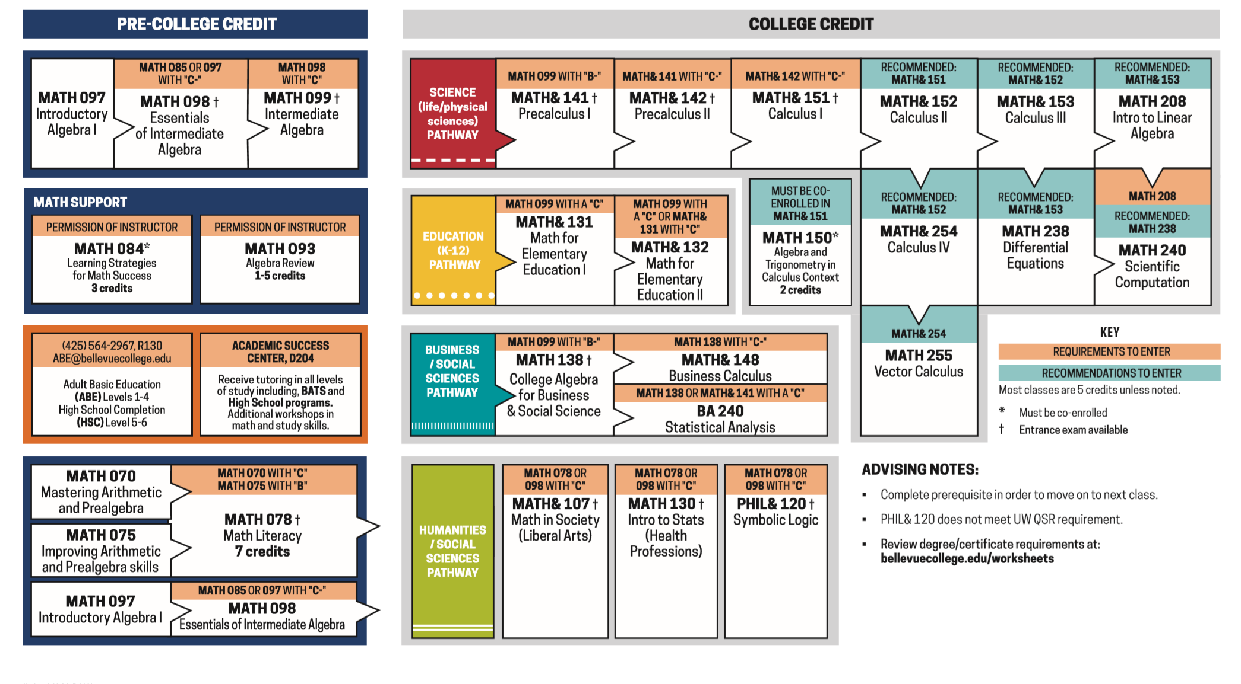
Quantitative/Symbolic Reasoning (QSR)
Transferring credits to BC
Credit from courses taken at another college
International Credit
Advanced Placement (AP) and International Baccalaureate (IB) scores
Military Training
Health or Industry certifications
Work or life experience
To learn more, please visit our Transfer Credit page.
Notes:
If you have previously earned college credits, you may be able to reduce the number of credits you need to graduate with a degree or certificate. BC accepts various types of credit, including the following:
STUDENT SUCCESS TIP: Submit a request to have any of your previous credits reviewed and evaluated as soon as possible.

Slide 24
CANVAS
Canvas is the Learning Management System or "LMS" for delivery of online classes at Bellevue College.
There are online workshops that help you familiarize with CANVAS
When you register for a course, it might take up to 24 hours for you to get access to your Canvas.
Canvas Help
Contact your teacher to make sure you have been added to the group.
Request Canvas Help (Links to an external site.)or call Service Desk @ 425-564-4357
Notes:
https://bellevuecollege.teamdynamix.com/TDClient/2044/Portal/KB/ArticleDet?ID=24207
Access Canvas through your Bellevue College Portal
Before getting started, familiarize yourself with Canvas
If there is time, show them the interface briefly.
Tips for success:

Slide 25
Which Classes Should I Take?
See the
First Quarter Course Recommendations
handout on the Academic Advising website
Notes:
Each area of study has a program worksheet. These, provide information on classes and degree requirements that are needed to graduate. The worksheets provide detailed information on your degree/certificate:
The amount of credits need, a list of required classes, and more!.
It is extremely important to confirm your educational plans with an academic advisor and stick to it. Deviating from your plan could impact the length of time to completion.

Slide 26
Now…Let’s Register!
To Select Classes and register …
Log in to your computer using your ctcLink ID and password
Visit www.bellevuecollege.edu
Click on “Classes” on the top right
Add to Cart and Enroll!
*If you need assistance, please ask a question in the chat
*If your account is blocked submit a ticket: www2.bellevuecollege.edu/sc-requests/
Notes:
PRESENTER: Use the following test student info to demonstrate how to enroll: Open several tabs
ctcLink ID: XX080CS01
Password: Test123
REMIND STUDENTS THAT THEY WILL REGISTER FOR SUMMER/ FALL QUARTER STARTING IN MAY! SEE AN ADVISOR FOR ADDITIONAL PLANNING IN EARLY SPRING SO THEY ARE READY TO REGISTER IN NOVEMBER!
Be sure to write down the item numbers for the classes you wish to take as well as any alternatives.
A step-by-step registration guide image and description of this process: https://www.bellevuecollege.edu/welcome/registration-and-advising/

Slide 27
Registration Steps!
1. Log in: to your computer using your ctcLink

Slide 28
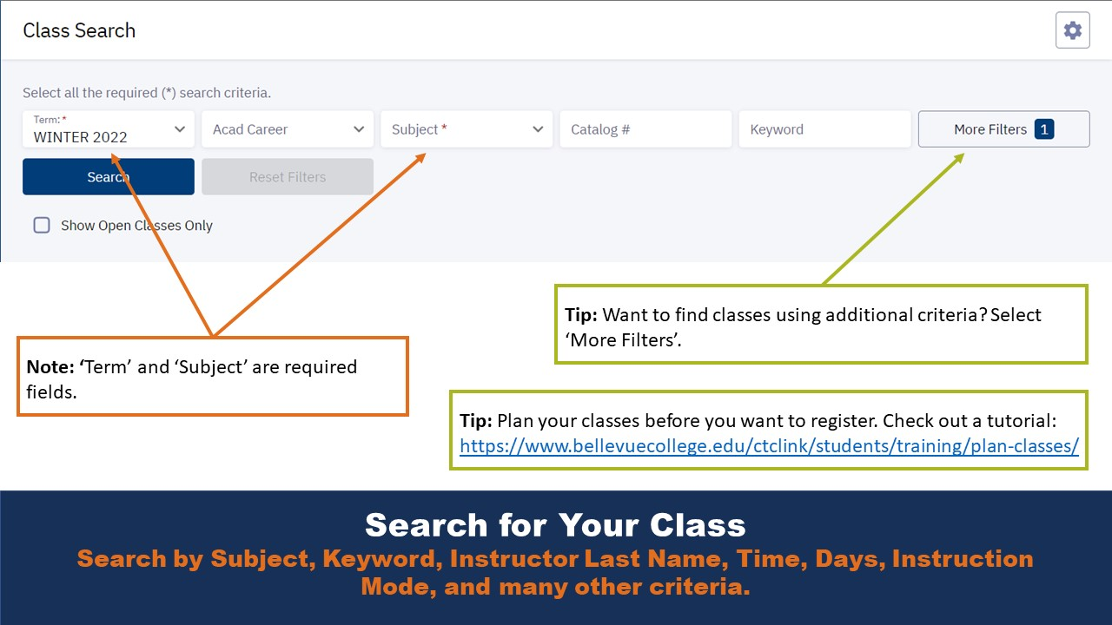
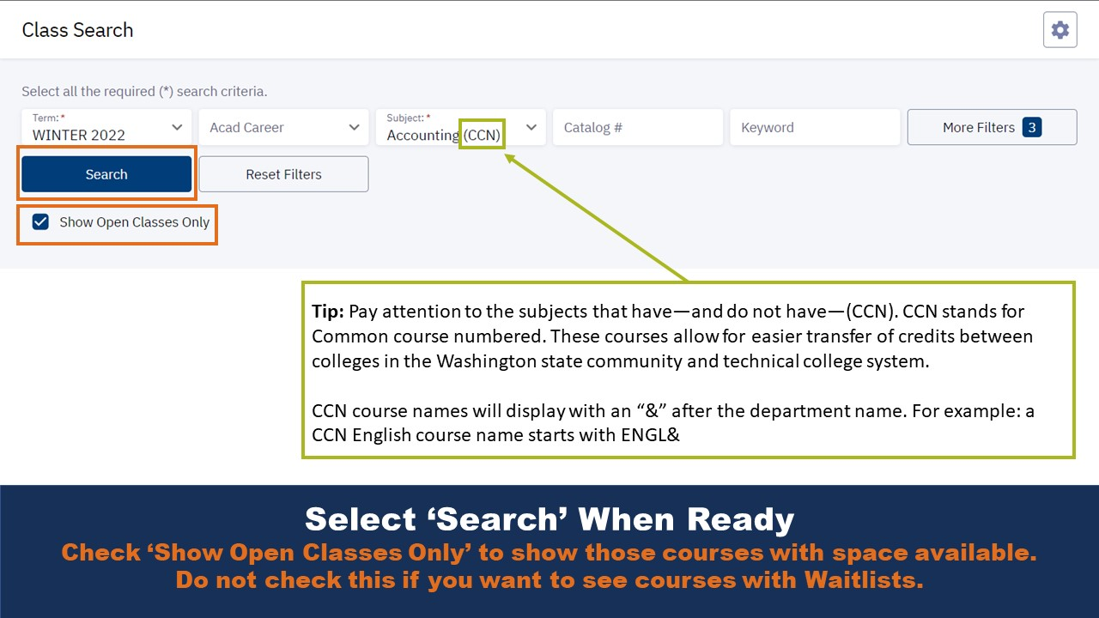
Registration Steps!
2. Class Search

Slide 29
Registration Steps!
3. Select Course and Add to Planer, Add to Cart, or Enroll

Slide 30
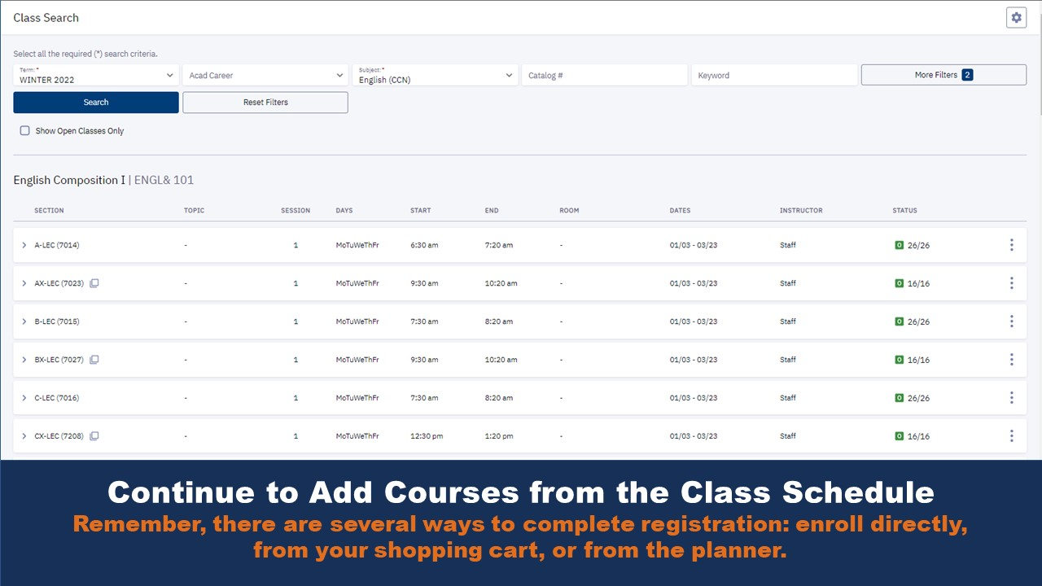
Registration Steps!
4. Permission Number, Waitlist, or Add more Courses

Slide 31
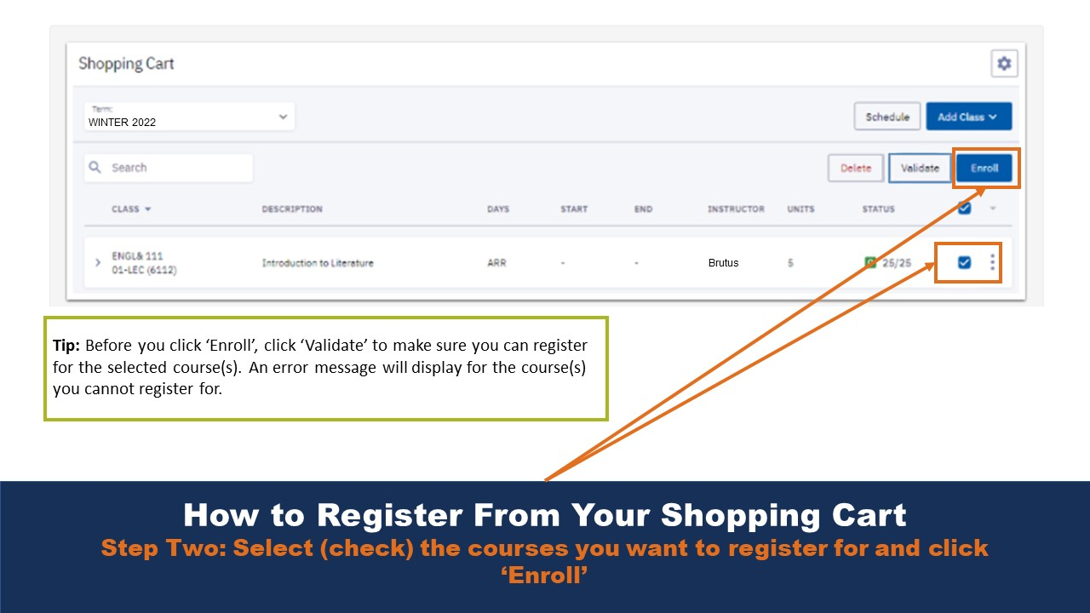
Registration Steps!
5. Register using your Shopping Cart

Slide 32
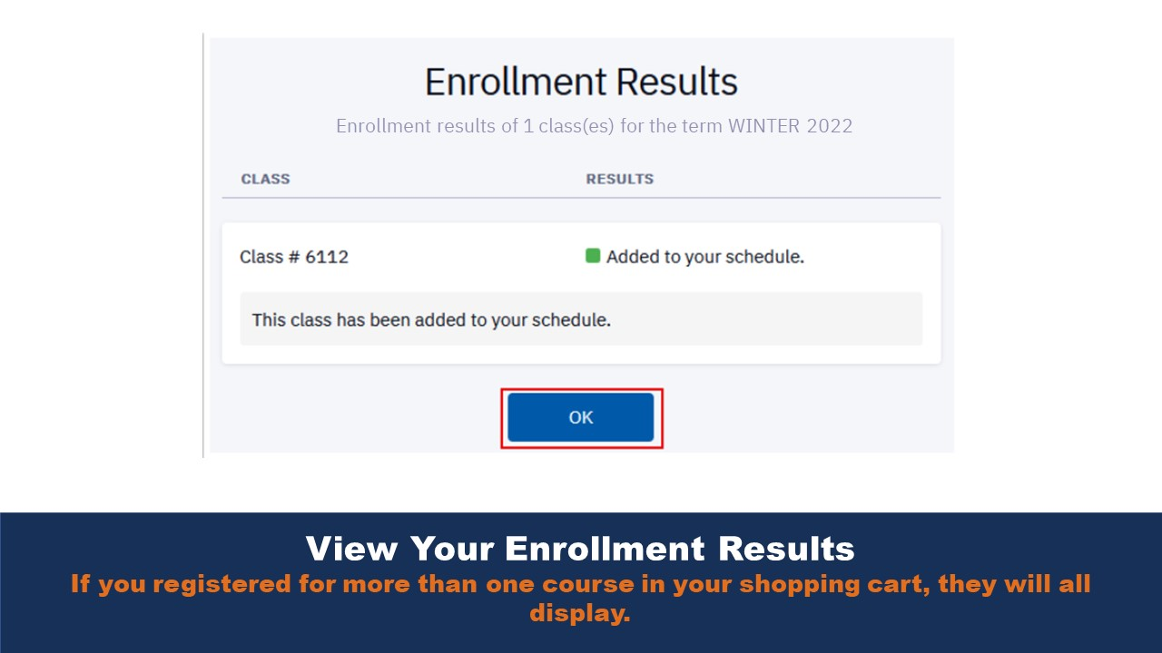
Registration Steps!
6. Enrollment Results: Completed!

Slide 33
Questions?
Notes:
Other recommendations:
Check your Bellevue College email (Links to an external site.) and Canvas (Links to an external site.) for any updates.
Check your schedule (Links to an external site.)and locate your classes on the campus map (Links to an external site.). (Links to an external site.)
Be sure your tuition and fees (Links to an external site.) have been paid.
Outline your first day schedule. Specifically, indicate what you plan to do during each hour of your entire first day. Consider using a sample schedule template (many can be found via an online search) or a calendar on your phone.

