Slide 1
Home Energy Assessment Guide
Andrew Westenbroek
Bellevue College Office of Sustainability

Slide 2
What we will cover
What a home energy assessment is and why you should do one
Basic energy and power knowledge to better understand the assessment
How to do a home energy assessment and what the goal of it is
Steps to take after completing your assessment

Slide 3
What is a home energy assessment?
ID power- and energy-using items in your home
ID efficiency measures
ID the structural state of your home
ID your energy use practices and reduction practices

Slide 4
Why do a home energy assessment?
The purpose of an energy audit is NOT to stop using your every-day items
BUT using less of them always helps :)
The purpose of an energy audit IS to:
Better understand how many things in your home use power and various forms of energy
Identify possible energy efficiency measures
Reduce your energy bills and reduce your personal pollution output!

Slide 5
Background: what are power and energy?
Power (kW)– the electricity (electrons) that moves along power lines from the power station to your house
P = W/t
1 W, 1000 W = 1 kW, 1000 kW = 1 MW
Energy (kWh) – using a specific amount of power for a specific amount of time
E = P x t
Using a constant supply of 1 kW for 1 hour means you used 1 kWh
(1 kWh = 1 kW x 1hr)
Using a constant supply of 2 kW for 0.5 hours means you used 1 kWh
(1 kWh = 2 kW x 0.5 hr)

Slide 6
Background: gas is energy and water absorbs it
Gas (Therms)– the gas that moves along gas lines or is stored in a tank at your house
Therms = CCF x BtuFactor --> 100 Therms = 93.998 CCF x 1.06385
100 CCF = 106.385 Therms
Water (gallons) – provided by city or well system
Water is heated through electricity or gas

Slide 7
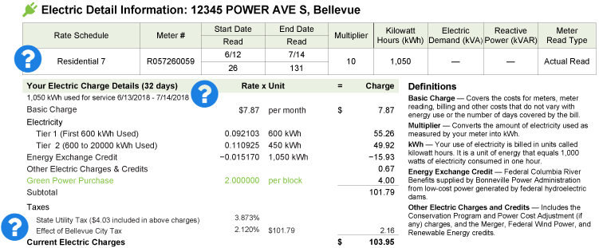
Energy bills
Your power bill is measured in kWhs
It becomes more expensive the more you use
You can opt into green power programs

Slide 8
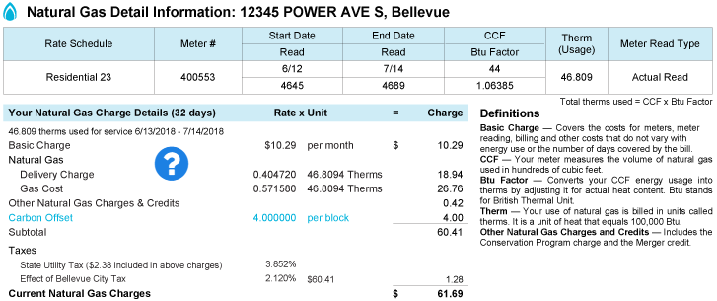
Energy bills continued
Your gas bill is measured in Therms
It becomes more expensive the more you use
You can opt into carbon offset programs

Slide 9
How to reduce energy use w/ same products?
Energy efficiency!
Getting the same desired result (ex: light levels, heater temperature, working computer) while using less energy
If we want to use the items in our homes for the same amount of time, then we need to reduce the amount of power they require
E = P x t --> 2 kWh = 2 kW x 1 h --> 1 kWh = 1 kW x 1 h

Slide 10
What requires power?
Anything electric!
Lights
Electronics (computers, TVs, phones, tablets, tools, treadmills)
Appliances (fridge, freezer, washer, dryer, heaters, ACs, fans)
Batteries

Slide 11
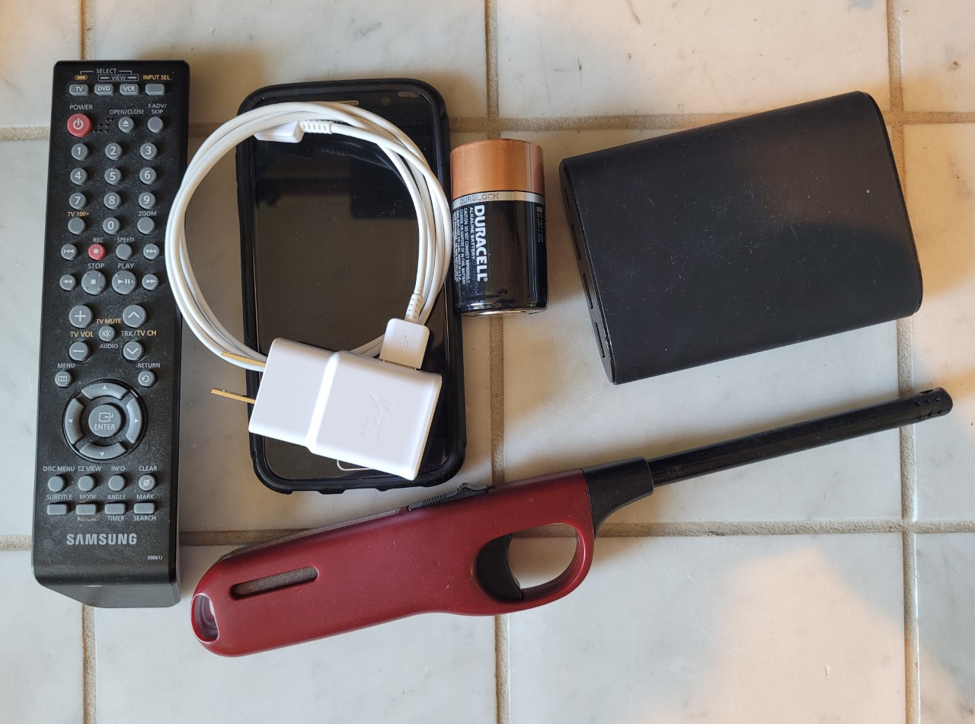
Wired VS Battery powered/energy storage items
Wires
Directly provide power (tv, appliances, lights)
Batteries/energy storage
Store energy then deliver power when the item is being used (phones, laptops, controllers)

Slide 12
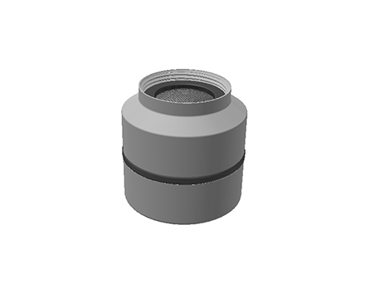
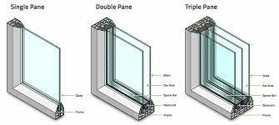
Energy Efficiency Measures Examples
Heat pump technology – for water heating and space heating
Low flow/smart flow faucets and shower heads
Energy Star Certified electronics and appliances (require less power/better at heating/cooling)
LED light bulbs
Double and triple pane windows

Slide 14
What to do?
Complete your home energy assessment by completing the Home Energy Assessment Score Sheet and filling in the Home Energy Assessment Data Sheet

Slide 15
Assessment tips
Take pictures
Taking pictures of lights bulbs, information stickers on your devices, etc. will be helpful when you are looking to upgrade them with more efficient products. If you ever have questions about a switch, show the picture to someone working at the store to help make sure you get the right switch
One at a time
Start with just one type of product, or just one room. Start with taking an assessment of just your lights or do everything in just one room.

Slide 16
Next Steps
Complete your home energy assessment
Identify potential energy efficiency measures
Implement them!
Have fun! You don't have to switch everything at once. Try starting with some lights and actively try to reduce your excess or wasted energy

Slide 17
PSE Resources
https://www.pse.com/rebates/energy-saving-tips/choose-your-led-bulb
https://www.pse.com/rebates
https://pse-marketplace.com/welcome/
https://www.pse.com/rebates/lighting
https://www.pse.com/en/account-and-billing/My-Bill/howtoreadyourbill

