Slide 1

Writing Lab Workshop

Slide 2
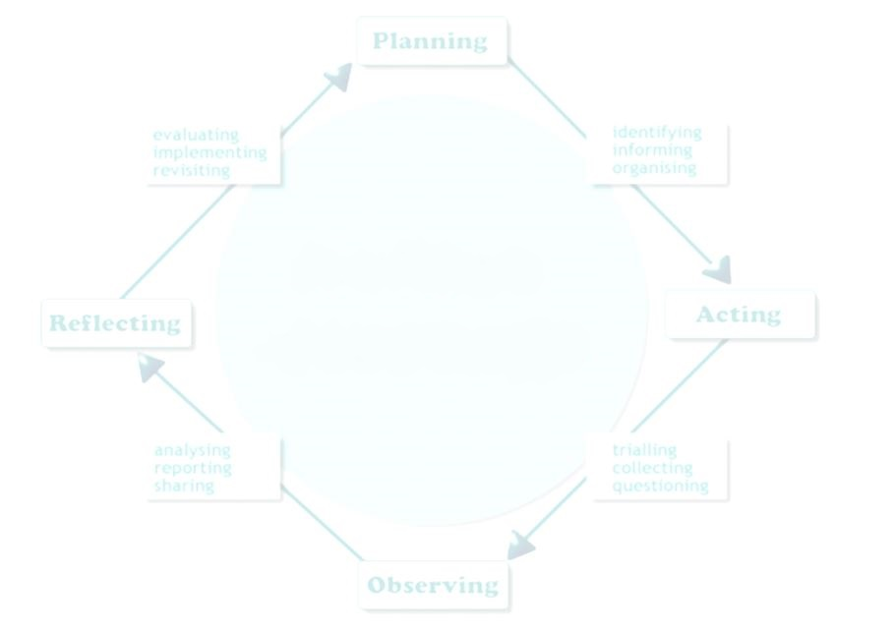
Crafting Effective
Research Questions

Slide 3
Why a Research Question?
Research is a circular process: questions, investigation, analysis, questions, investigation . . .
Developing a “research question” is part of starting the research process
If you try to write a research paper on a question you already know the answer to, it will be boring and harder to research than one based on discovery!

Slide 4

Find a Topic of Interest to YOU
When you find your work interesting, it will come across to others through your writing!

Slide 5



Topic vs. Issue
A topic is a thing or idea an essay can be written about.
An issue is a thing or idea that has
sides that people can debate.
What are the issues connected to your topic?
What are debatable sides on those issues?

Slide 6

What Is Already Known?
Search the topic in databases to see what issues others have recently investigated about it.
Consider what your ideal audience would already know about your topic and what questions they might be curious to know answers to, and/or what issues they are debating on that topic.

Slide 7
Preliminary Questions
What is a mystery or problem connected to the topic?
Who is involved in the mystery or problem?
What do you want to learn in your research process?
What is your goal for your assignment?

Slide 8
Preliminary Questions cont’d
Will you be able to find authoritative or scholarly information on the topic?
Will investigating push you to think more deeply or challenge your assumptions?
Now, what are some “How . . . ” and/or “Why . . . ” questions that you have?

Slide 9
Evaluating Research Questions
To evaluate the effectiveness of your research questions, you have to know what a “good” research question is!

Slide 10

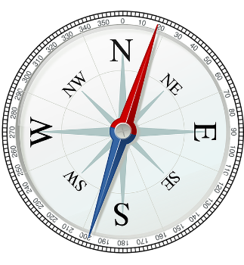

A good research question…
Drives curiosity about an issue or a mystery
Helps you to find direction for inquiry
Focuses the scope of the research
Stimulates investigation and analysis

Slide 11

What makes a good research question?
It is focused, but not too narrow
It is clear, not vague
Its scope is manageable in the given time
Someone has a stake in the answer(s)
It cannot be answered yes/no or with a simple Google search
It requires analysis, not only opinion

Slide 12

Evaluating Your Research Question
Is it focused?
First draft: What are the negative effects of smart phone use?
This question doesn’t define what the type of negative effects the writer will research--mental health? negative social effects? others?
Also, who do smart phones negatively effect?
Individuals? Society at large? If not specified, the scope is too broad for a typical college paper.

Slide 13
Evaluating Your Research Question
Is it focused?
  First draft: What are the negative effects of smart phone use?
Considerations for revision (discuss):
    What type of negative effects do you want to explore?
    Who is the target population of smart phone users
    you will study?

Slide 14

Evaluating Your Research Question
Is it focused? (not too broad, not too narrow)
Draft: What are the negative effects of smart phone use?
Sample Revision: What impact does smart phone use have on intimate relationships?
  Focus is narrowed to effects on intimate relationships.
  Instead of assumed negative effects, the writer will collect data on all effects, positive or negative.
  Topic is now more focused, helps direct writer to find answers.

Slide 15

Evaluating Your Research Question
Is it clear?
First Draft: Why are social networking sites harmful?
  It’s not clear how harm is defined.
  The question assumes that “harm” is already proven
  or accepted.
  In what way are social networking sites harmful,
  and to whom?

Slide 16

Evaluating Your Research Question
Is it clear?
First Draft: Why are social networking sites harmful?
Considerations for revision (discuss):
  How is harm defined in this context?
  Which networking sites will be considered?
  What population will be studied?

Slide 17

Evaluating Your Research Question
Is it clear?
First Draft: Why are social networking sites harmful?
Sample Revision: How are 12- to 16-year-olds addressing privacy concerns when using social media such as Facebook and Instagram?
  This revision clarifies:
  who we are talking about/what population (12- to 16-year-olds)
  which specific sites (Facebook and Instagram)
  what the harm could be (loss of privacy)

Slide 18
Evaluating Your Research Question
Is it manageable in scope?
First Draft: Is college the best option for people?
Many additional questions arise because the scope is too broad.
  What types of people? (young, career-seeking, career-changing, or all?)
  What other options besides college will be considered?
  How is “best” defined—affordability, future job placement, meaningful or fulfilling work?
A paper that attempted to answer this question would be too long and probably not researchable within the time frame.

Slide 19
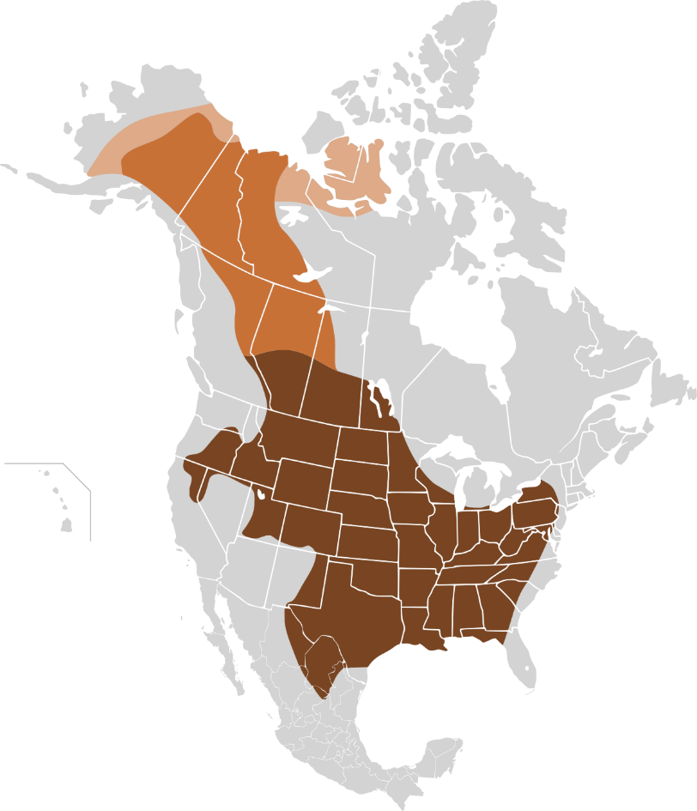
Evaluating Your Research Question
Is it manageable in scope?
First Draft: Is college the best option for people?
Considerations for revision (discuss):
  What specific options besides college will be considered and why?
  Which group of people will you study?
  How will you define “best”?

Slide 20
Evaluating Your Research Question
Is it manageable in scope?
First Draft: Is college the best option for people?
Revision: What impact would providing two years of free community college have on degree completion in higher education?
  The topic is narrowed to a more specific option—community college.
  It addresses one specific type of “good” option: affordability.
  Potential data sources might be other countries or states that provide free tuition for higher education.
  The scope of the question has been narrowed significantly, and is more manageable.

Slide 21

Evaluating Your Research Question
Is a stakeholder identified?
First Draft: Are internships good?
  This is a very broad question without a clear direction.
  It seems obvious that having previous job experience would be helpful to anyone looking for a job, so why might this be a needed area of research?
  Is there any population that might NOT benefit from internships that would make this a topic of research?
  Is there a less obvious population who may benefit from offering or receiving internships?

Slide 22

Evaluating Your Research Question
Is a stakeholder identified?
First Draft: Are internships good?
Considerations for revision (discuss):
  Internships are either unpaid or lowly paid. Are internships only usable for those who already have financial support from another source?
  Are internships a good way for employers to find and retain qualified and desirable permanent employees?

Slide 23
Evaluating Your Research Question
Is a stakeholder identified?
First Draft: Are internships good?
Sample revisions:
  How can internships be made accessible for job seekers who have no other financial support?
    Stakeholders are job seekers who are the sole supporter of self and families.
  What percentage of internships result in hires of well-qualified employees who stay with the company for more than two years?
    Stakeholders are companies who want to trial test potential employees and reduce employee turnover.

Slide 24
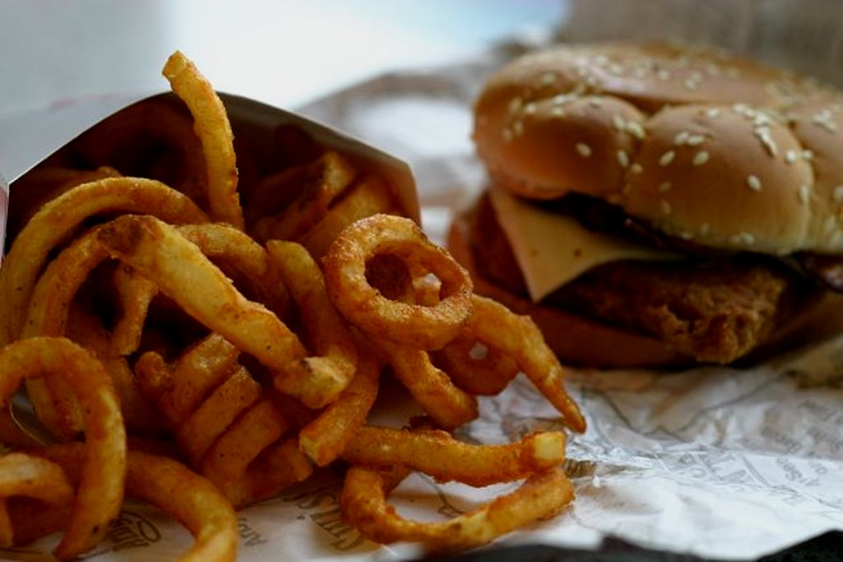
Evaluating Your Research Question
Does it raise more questions?
(No simple, easy answers)
Does it require analysis?
First Draft: Is fast food bad for your health?
  Likely to find an answer to this question with a simple Google search.
  Invites more opinion than provides direction for research and analysis (“bad for you” may be very subjective)
  Can be answered with a simple yes/no, or one-word answer.

Slide 25

Evaluating Your Research Question
Does it raise more questions?
Does it require analysis?
First Draft: Is fast food bad for your health?
Considerations for revision (discuss):
  What do people NOT already know about fast food
  and its effects?
  Who are the people that care about selling/buying fast food?
  Who are the people that care about fast food’s effect on health?

Slide 26
Evaluating Your Research Question
Does it raise more questions?
Does it require analysis?
First Draft: Is fast food bad for your health?
Sample revision: How does the (fast) food industry influence nutrition and health standards?
  The answers to this question would . . .
    require analysis (what is relationship between industry and health standards?)
    not simply address the question by mere opinions alone
    require solid research (into nutrition and health standards)
    consider multiple perspectives (companies and consumers)

Slide 27
Practice: Choose a Topic or Issue That Is Researchable
From SUNY Empire State College:
https://www.esc.edu/online-writing-center/exercise-room/can-topic-be-researched/

Slide 28
Practice: Is the Research Question Too Broad or Too Narrow?
From SUNY Empire State College:
https://www.esc.edu/online-writing-center/exercise-room/research-question-broad-or-narrow/

Slide 29
Sample Research Questions
Does flossing teeth consistently improve dental health?
Do television advertisements negatively manipulate children?
Has the Trump presidency caused an increase in racial violence?
Does Seattle have a larger homeless problem than the average US city?
Using the evaluative criteria in the checklist, work in groups to assess and, if needed, to revise questions.

Slide 30
What Makes a Good Research Question?
Evaluation Criteria
Its focus is not too broad, not too narrow
It’s clearly stated, not vague
It is researchable within my time frame
Those who have a stake in the answer are identified
It requires analysis, not only opinion
It can’t be answered in one word, raises more questions

Slide 31
Next Steps in the Research Process
You are not ready to start deep research until you can speak for at least 2 minutes about the context and mysteries of your topic!
Build a working knowledge of your topic before you launch your major research.
Ask open-ended “how” and “why” questions about your general topic.
Consider the “So what?” question. Not only why this topic matters to you, but also why it should matter to others.

Slide 32
Keep in Mind
Research is not about deciding what you think you know about a debatable topic and then looking for only that information which supports your stance. –That is the opposite of research!
Review and think about the questions you’ve drafted. Pick one or two that keep you interested for thorough investigation.
Analyze and synthesize sources before writing.
The answer to your RQ could be your thesis statement!

Slide 33
Additional Resources
From the University of Guelph, Canada, download a PDF worksheet:
https://learningcommons.lib.uoguelph.ca/item/developing-research-question-worksheet
From Indiana University at Bloomington:
For more question examples, see the bottom of the handout--https://libraries.indiana.edu/sites/default/files/Develop_a_Research_Question.pdf
From George Mason University:
Forming Research Questions--
https://writingcenter.gmu.edu/guides/how-to-write-a-research-question
Brainstorming Techniques--
https://writingcenter.gmu.edu/guides/brainstorming-techniques

Slide 34
Additional Resources
“Formulating Your Research Question” from Vanderbilt University:
https://cdn.vanderbilt.edu/vu-wp0/wp-content/uploads/sites/164/2019/03/28042508/Formulating-Your-Research-Question.pdf
“What Makes a Good Research Question” from Duke University:
https://twp.duke.edu/sites/twp.duke.edu/files/file-attachments/research-questions.original.pdf
A classroom using the Question Formulation TechniqueTM
https://vimeo.com/116974103 (Sorry—there’s doesn’t seem to be CC/subtitles)

