Slide 1

Normandy
June 2024
Li Liu, Eva Norling & Bruce Wolcott
Arts and Humanities, Bellevue College
Oct 2023 / Program info session
Notes:
Line spacing + Page numbers

Slide 2
Agenda
01 Team introduction
02 Program content
03 Program cost
04 Application
05 questions?

Slide 3
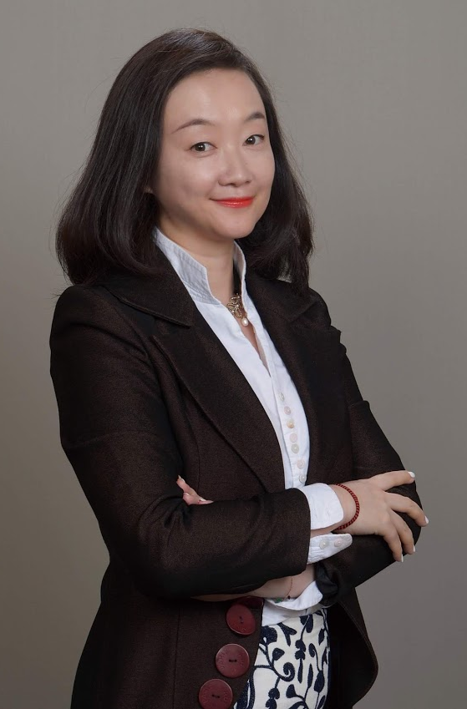
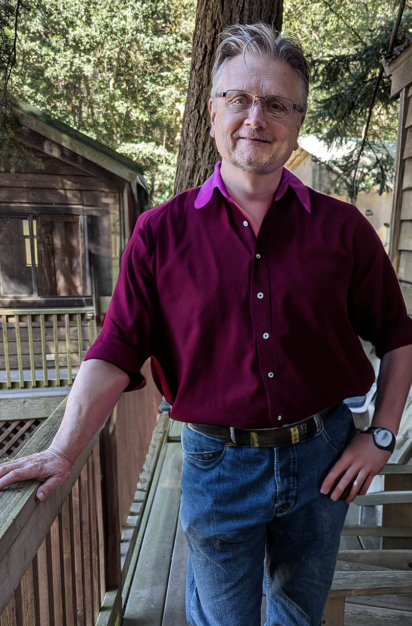
Team
01
Li Liu
Communication Studies / WCCCSA Study Abroad coordinator
Visual narrative / “Save Private Ryan”
Eva Norling
French / German
French language and culture / “pré-salé”
Bruce Wolcott
Communication Studies / XR Lab
XR and VR visual platforms / “Seekbeak”

Slide 4
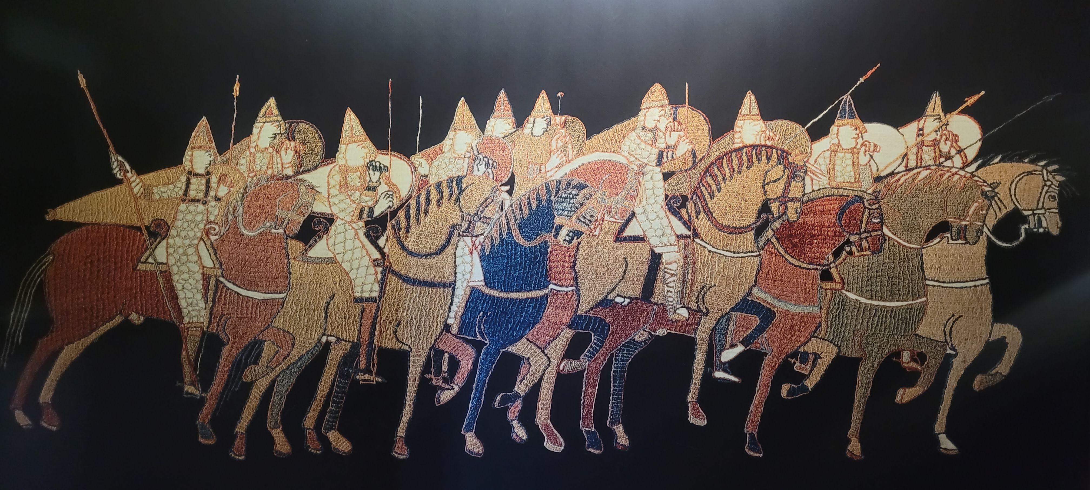
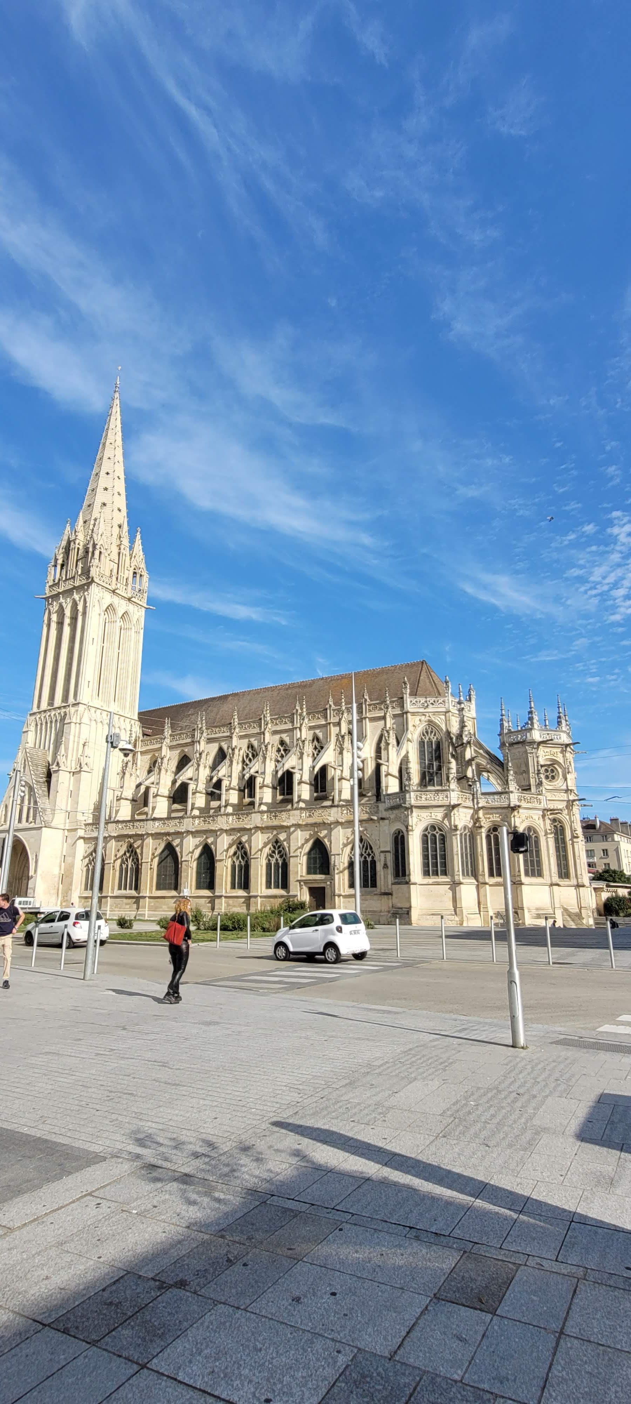

Program content
02
Program dates:
June 21 – July 12, 2024
Hybrid program, with 10 days on BC campus, followed with 10 days in Normandy.
2. CMST 294, Special Project – Narrative of War that covers war-time visual narrative across legacy (animation and films) and innovative platforms (VR and XR), by immersing students in French culture.
3. Tours of the D-day landing beaches, Bayeux Tapestry, and Mont-Saint-Michel.
4. Opportunities of learning to use innovative visual platforms as part of your program experience.

Slide 5
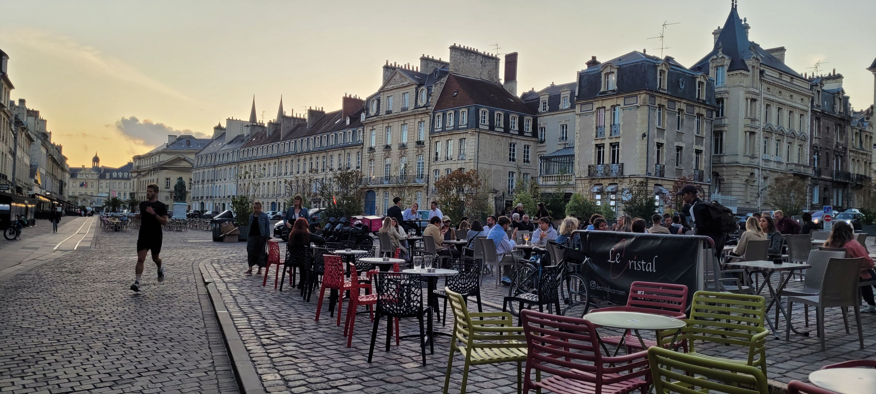
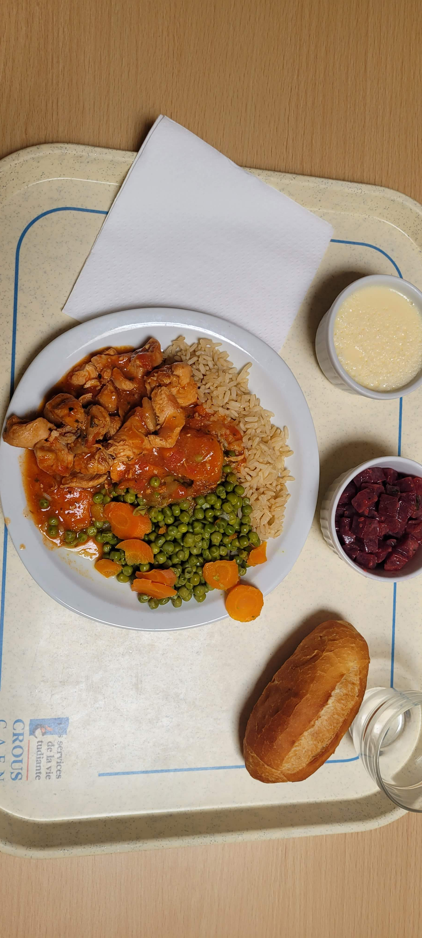
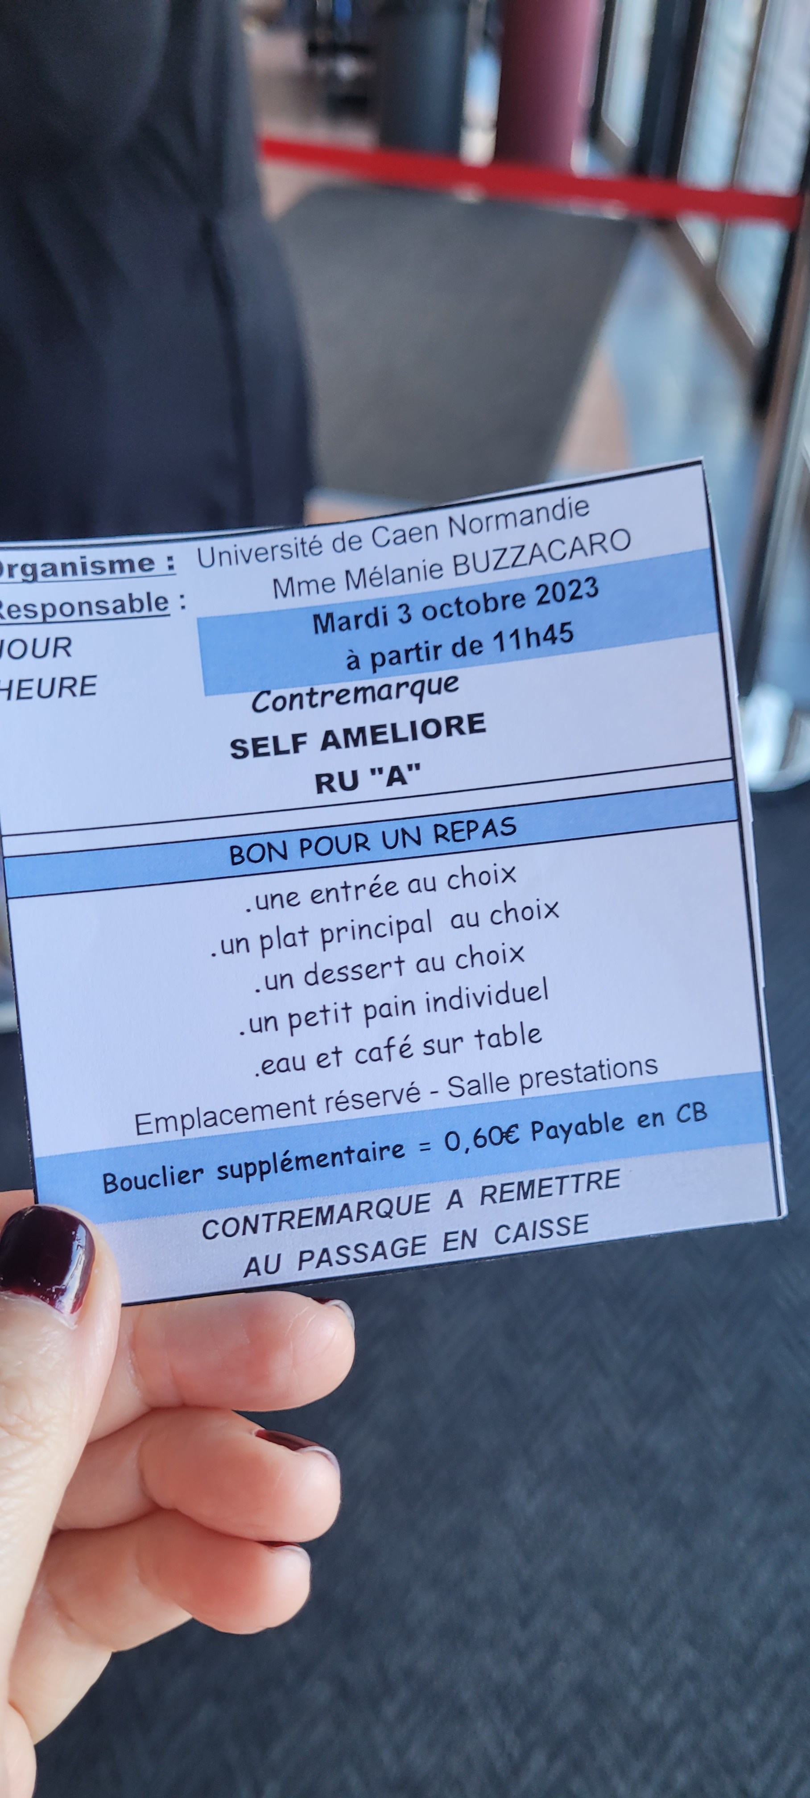
Program cost
03
Program cost: $1,500 per person
Cost include daily lunch on campus, group activities, accommodation, insurance and on-site French culture instruction.
Cost does not include international round-trip air fare, BC tuition, or other personal expenses.

Slide 6

Application due: Nov 3, 2023 program fee due: Nov 10, 2023
1. submit the application form via email to Li Liu, li.liu@bellevuecollege.edu , or in hardcopy to R130 (main campus);
2. submit either an essay (as instructed in the application form), or participate in either one of the following faculty meets via Zoom (Zoom link ): 12:30 Friday Oct 27 / Friday Nov 3;
3. submit payment either in the form as a check (payable to "Bellevue College / Normandy program summer 2024) to R130 (main campus) or via credit card (with 2.5% additional fee).
Contact: Li Liu, Ph.D Communication Studies
Arts and Humanities, Bellevue College li.liu@bellevuecollege.edu

