Slide 1
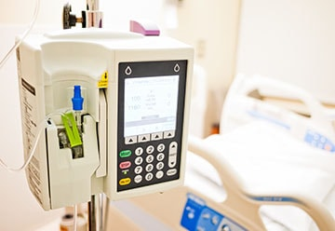
SmartPumps
Hannah Johnson, Emily James, Nikita Volchkov
*Image Source: https://www.medonegroup.com/aboutus/blog/how-smart-pumps-reduce-medication-errors-in-healthcare-settings

Slide 2
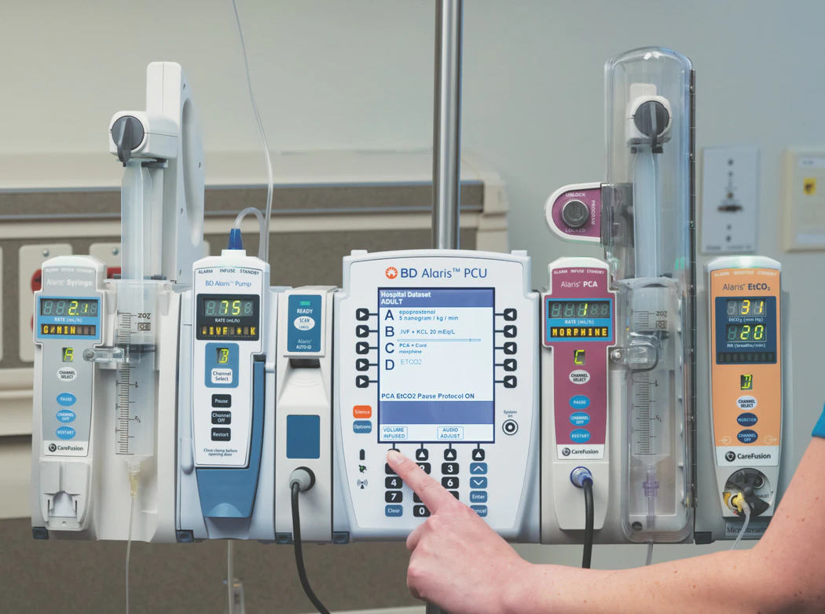
What are SmartPumps?
“Smart pumps have been designed to improve patient outcomes by reducing the number of adverse drug events related to intravenous (IV) pump medication administration. Smart pump-related technology such as two-way communication and integration with an electronic medical record system enable wireless drug library updates, automatic programming, and automatic documentation” (Kavanagh et al., 2018).
*Image Source: https://www.hpnonline.com/infection-prevention/article/21118032/smart-for-safety-savings

Slide 3
The Impacts
Less time consuming for nurses
Increase patient safety (less medication errors, less buttons to push, more safety blocks)
Increased revenue for the hospital due to improved charge capture
*Image source: https://techcrunch.com/2019/06/13/alaris-infusion-pump-security-flaws/

Slide 4
How Does It Work?

Slide 5
References
Biltoft, J., & Finneman, L. (2018). Clinical and financial effects of smart pump-electronic
medical record interoperability at a hospital in a regional health system. American
Journal of Health-System Pharmacy : AJHP : Official Journal of the American Society of Health-System Pharmacists, 75(14), 1064–1068. https://doi.org/10.2146/ajhp161058
Kavanagh, T. P., Tse, E., & Vitoux, R. R. (2017). The crucial link in successful smart
pump adoption: The critical care nurse. Canadian Journal of Critical Care
Nursing, 28(4), 29–34.
NurseMinder. (2018, May 15). Alaris IV Pump Training for Nurses [Video]. YouTube.
https://www.youtube.com/watch?v=gTQgmQ9N0wk
Schub, T. B., & Cabrera, G., MD. (2018). Medication Errors: Using Smart Pumps.
CINAHL Nursing Guide.

