Slide 1
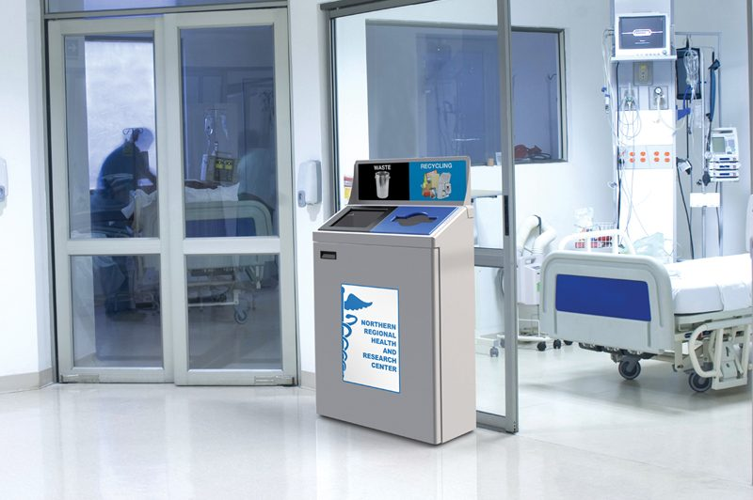
PSA 2 - Waste Reduction and Recycling in the Operating Rooms
Hannah Johnson, Emily James, Nikita Volchkov
*Image Source: https://cleanriver.com/6-steps-to-start-a-hospital-recycling-program/

Slide 2
Facts
“The operating room (OR) as a major source of spending and waste generation in a medical facility,9–11 accounting for 650 to 1200 kilograms of medical waste per day and more than 3 million kilograms of GHG emissions per hospital annually.” (Thiel, Woods, Bilec, 2018).
“Operating rooms (ORs) have a particularly large environmental impact; they account for 20% to 30% of all hospital supply costs” (Martin, 2017).
“The healthcare sector is the second leading contributor to waste in the United States, producing more than 112 billion kilograms of waste annually. Using a conservative estimate, healthcare facilities produce approximately 13.6 kg (30 lb) of waste per patient per day” (Martin, 2017).
“The waste from total knee replacements in Canadian hospitals and found this procedure alone produced about 450 tons of waste over the period 2008–2009” (Potera, 2012).

Slide 3
What can be done: Waste Segregation
Problem: Waste wasn’t being sorted correctly and materials that could have been recycled, were not.
Goal: To improve waste segregation and achieve a higher compliance with regulatory requirements and cost savings along with having a positive impact on the environment.
How it was solved: Waste was segregated properly. It was broken up into:
Recyclable waste (paper, plastic unbroken glass)
Pharmaceutical waste (medication)
Medical waste (items that contain bodily fluids)
Solid waste (items that don’t fall into any category).
Findings:
The amount of medical waste and solid waste decreased.
The sharps container didn’t need to be replaced as often.
The amount of recyclable waste increased.
Knowledge increased amongst OR staff as seen though surveys
*Image Source: https://www.shutterstock.com/search/recycle+bin

Slide 4
What can be done: Improve Energy Practices
Image sources: https://images.app.goo.gl/GQtPnNC5TLUeY3K17
https://images.app.goo.gl/MuqhSxTAbEKHYXaf6,
Problem: Hospitals use more energy than they need to and rely on non-renewable natural gas leading to excessive GHG emissions.
Goal: To reduce greenhouse gas emissions.
Ways to Help:
Switch to low-carbon, renewable energy sources like nuclear and hydropower.
Install occupancy sensors to minimize energy use during non-operative or low-use times.
Findings:
In the case study, switching to renewable energy sources reduced GHGs about 10% per procedure.
Use of sensors in the OR reduced electricity use by one third over the course of a year per OR.

Slide 5
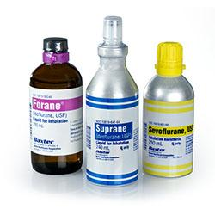
Anesthetic gases
Anesthetic gases including isoflurane, sevoflurane, and other halogenated ethers are 3,760 more powerful at trapping heat than CO2. As much as 95% of these gases are simply vented outside.
“By one estimate, the yearly anesthetic gas emissions from a midsize hospital are equivalent to carbon dioxide emissions from 1,200 automobiles” (Potera, 2012).
The development of canisters that trap these anesthetic gases. These canisters contain crystalline contents that have the capability of allowing the trapping, recovery, and recycling of anesthetic gases.
This minimizes the amount of greenhouse gases in the atmospheres as well as helping alleviate the supply shortage of manufactured anesthetic gases.
*Image source: https://www.crna-school-admissions.com/blog/introduction-into-crna-school-pharmacology-inhaled-anesthetics/

Slide 6
Reference Page
Martin, D. M. (2017). An Initiative to Optimize Waste Streams in the Operating Room: RECycling in the Operating
Room (RECOR) Project. AANA Journal, 85(2), 108–112.
Potera, C. (2012). Strategies for Greener Hospital Operating Rooms. Environmental Health Perspectives, 120(8),
A306-7. https://web-a-ebscohost-com.ezproxy.bellevuecollege.edu/ehost/pdfviewer/pdfviewer?vid=1&sid=879e1905-d584-4a18-86c8-59010ebf6102%40sessionmgr4008
Thiel, C. L., Woods, N. C., & Bilec, M. M. (2018). Strategies to reduce greenhouse gas emissions from laparoscopic surgery. American Journal of Public Health, 108, S158–S164. https://doi-org.ezproxy.bellevuecollege.edu/10.2105/AJPH.2018.304397

