Slide 1
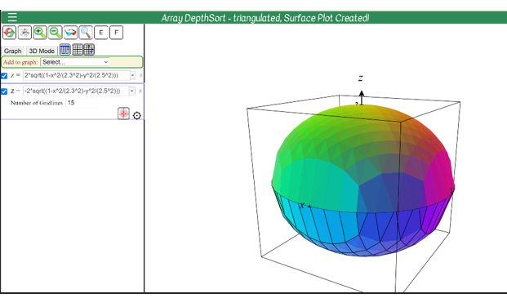
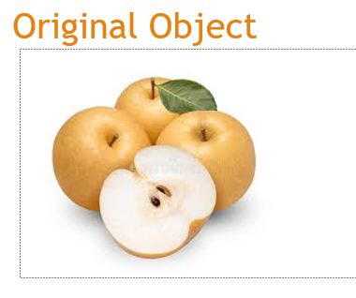
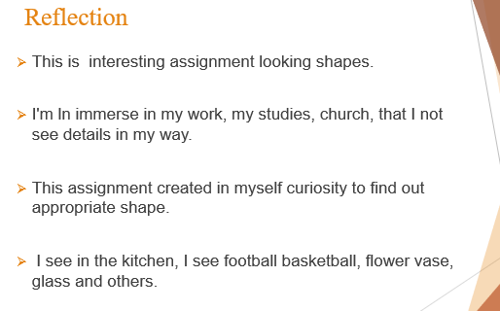
Project Title
Your name if you chose to share | Course Name | Teacher’s name |
Problem Overview
Manual Skecth
Final Figure
Original Object
Math Equations
Reflection
Notes:
To change this poster, replace our sample content with your own. Or, if you'd rather start from a clean slate, press the New Slide button on the Home tab to insert a new page. Now enter your text and pictures in the empty placeholders. If you need more placeholders for titles, subtitles or body text, copy any of the existing placeholders, then drag the new one into place.

