Slide 1
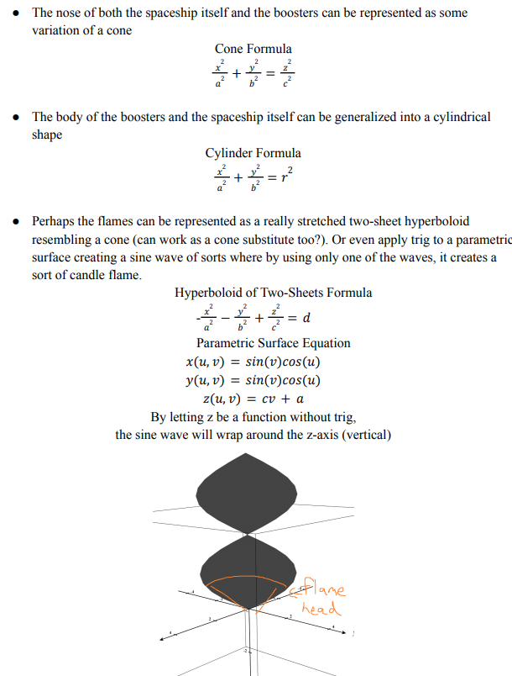
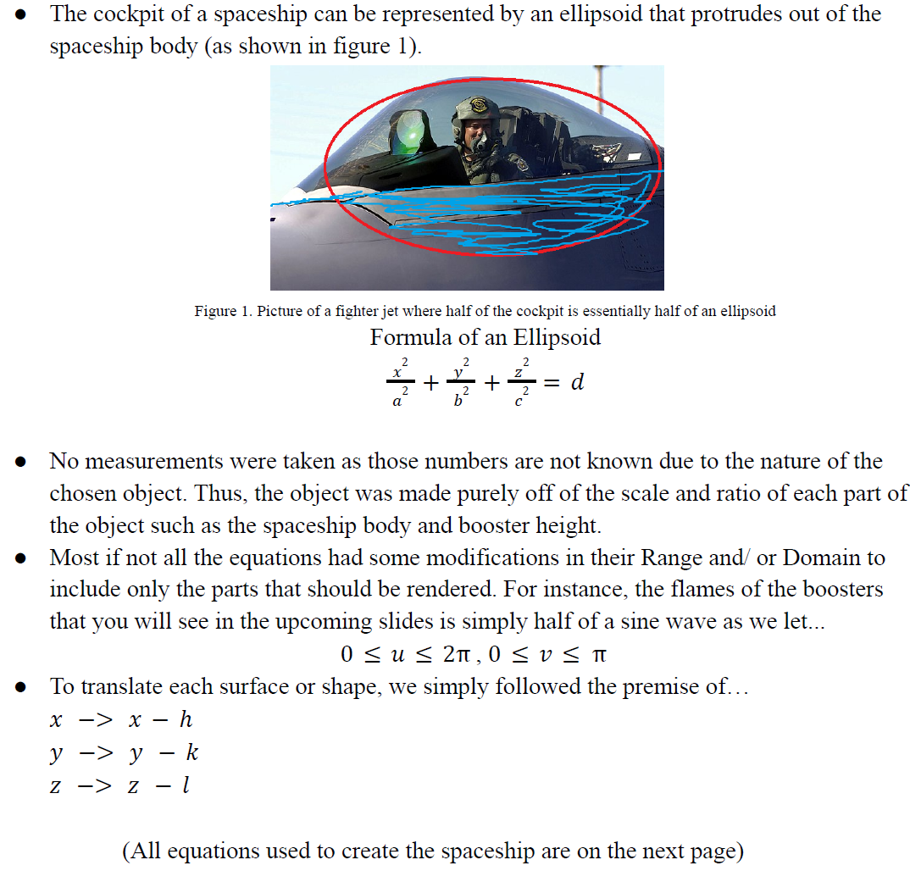
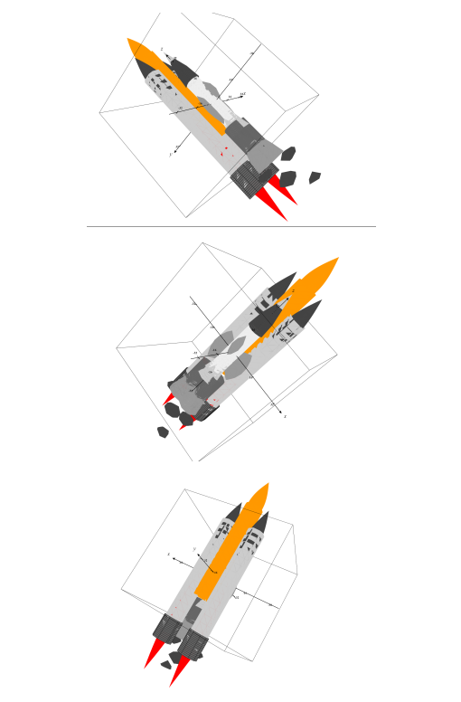
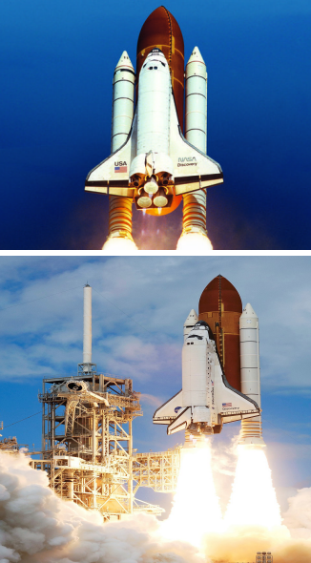
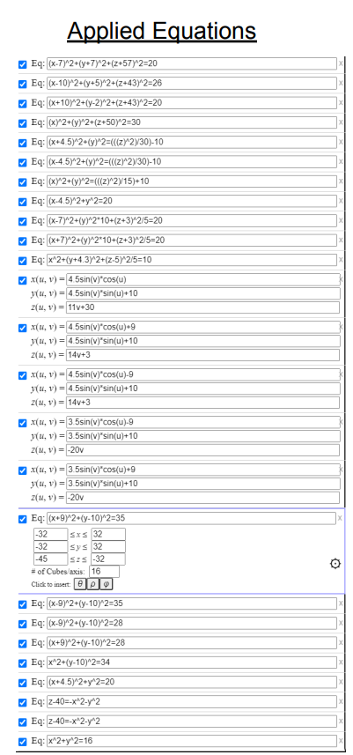
3D Model of a Spaceship with Math!
Add a brief overview or summary of your project. (Use the Bullets button on the Home tab to remove the bullets.)
Math& 254
Problem Overview
Manual Sketch
Final Figure
No measurements were taken as those numbers are not known due to the nature of the chosen object. Thus, the object was made purely off of the scale and ratio of each part of the object such as the spaceship body and booster height.
Most if not all the equations had some modifications in their Range and/ or Domain to include only the parts that should be rendered. For instance, the flames of the boosters that you will see in the upcoming slides is simply half of a sine wave as we let...
0 ≤ 𝑢 ≤ 2π , 0 ≤ 𝑣 ≤ π
Original Object
Math Equations
Reflection
The most exciting part of what we experienced and learned was how each part of the formulas we found adjusted the 3D surface/ shape it produced. We learned a lot on how each operand(s) and operator(s) caused a specific effect, giving us a better understanding on how to manipulate the formulas and equations to meet our specific use cases. The most challenging aspect of this assignment was the aforementioned. However, we were able to overcome this obstacle as this project was done as a group where ideas were tossed around and recycled until truth prevailed. Having completed this project, we were able to get a more firm grasp on visualizing three dimensionally with group work being a main point of growth and success. With that, we look to apply group work to more things as we do as a lot of us tend to work solo, meeting mental roadblocks that can’t be solved alone. We can’t imagine how stumbled some of us would have been had it been a solo project. But perhaps what we learned the most was how mathematics was not just numbers, but also a tool in defining reality in such a way that humans could better understand the world around us.
Notes:
To change this poster, replace our sample content with your own. Or, if you'd rather start from a clean slate, press the New Slide button on the Home tab to insert a new page. Now enter your text and pictures in the empty placeholders. If you need more placeholders for titles, subtitles or body text, copy any of the existing placeholders, then drag the new one into place.

