Slide 1
University Transfer Workshop
International Education Spring Quarter 2021

Slide 2
Welcome!
Please help us make this virtual workshop successful by:
sign in using our sign in sheet
muting your mic (to prevent extra noise)
turning off your video (to help with connection)
if you have a question, type your name in the chat (to reduce multiple people talking at the same time). Advisors will call your name so you can ask your question
you may find it helpful to add Closed Captioning so you can read what is being said
we will be recording this session

Slide 3
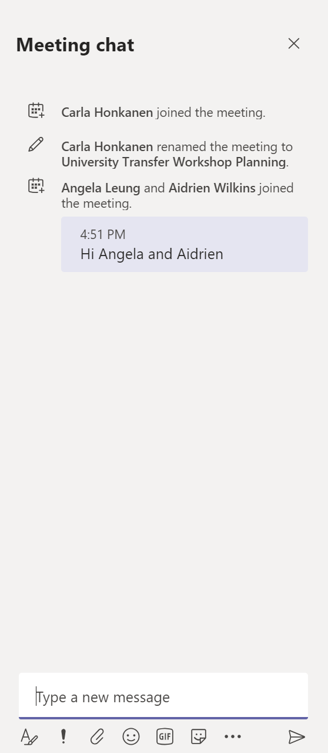
Opening Chat in Teams
Step 1. select the Chat icon (two icons to the left of the red phone icon) from the bar below
Step 2. View the right side of your screen to view the Meeting chat

Slide 4
Workshop Goals
Today you will learn:
How to choose a university for transfer
How to research a school
How to plan your transfer process

Slide 5
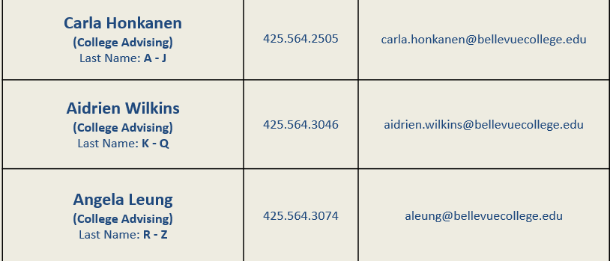
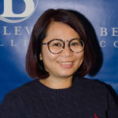
College Advising

Slide 6
How to Choose a University

Slide 7
Choosing a University: What to consider
Location & Setting (rural/urban/suburban)
Majors offered
If you have questions about selecting a major for transfer, please contact your IE advisor
Tuition and financial assistance
Enrollment size
University Reputation (Ranking)

Slide 8
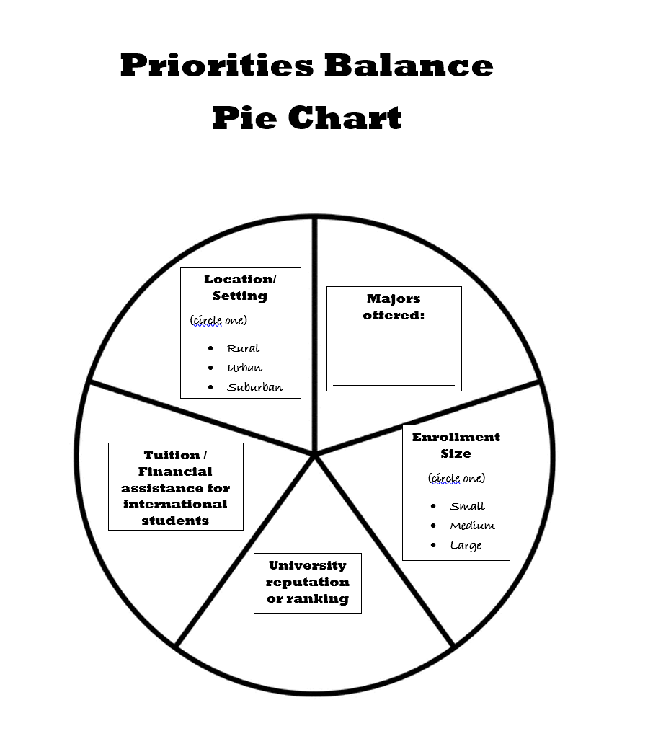
What are your priorities?
Activity: Priorities Balance Pie

Slide 9
How to Research Transfer Schools

Slide 10
College Search Resources
U.S. News Best College Rankings
http://colleges.usnews.rankingsandreviews.com/best-colleges
College Board: College Search
https://collegeboard.org/
Peterson’s
https://www.petersons.com/

Slide 11
Is this school right for me?
Activity: Research Hunt-Find your match schools
Step 1) sign on to https:/www.collegeboard.org/
Step 2) Find 2-3 schools that:
Offer your major
Cost is in your budget and/or offer scholarships to international students
Match the size of school you want
Are in you preferred type of location (city or rural)

Slide 12
Questions?
If you have a question, please type your name in the Meeting chat. An advisor will call your name when it is time for you to ask your question.

Slide 13
Reminder for Late Arrivals
Please help us make this virtual workshop successful by:
sign in using our sign in sheet
muting your mic (to prevent extra noise)
turning off your video (to help with connection)
If you have question, type your name in the chat (to reduce multiple people talking at the same time). Advisors will call your name so you can ask your question
you may find it helpful to add Closed Captioning so you can read what is being said
we will be recording this session

Slide 14
Preparing for the Application Process

Slide 15
Application Checklist
1) Application (often online)
2) Application Fee
3) Application Deadline (May need to apply to university and the specific major. Deadlines/requirements may be different)
4) Personal Statement (Quarterly workshops at Academic Success Center-view BC website for info)
5) English Proficiency
6) Transcript (Bellevue College, other colleges, high school-depends on school)
Note: You may submit your transcript twice (at time of application and once you have completed degree)
7) Letters of Recommendation (not as common but some schools require)

Slide 16
What do I need to apply?
Activity: Research the application requirements for University of Washington or Seattle University (your choice)
Step 1) Go to http://www.Washington.edu/ or https://www.seattleu.edu/
Step 2) Find the following:
1. Application Fee
2. Application Deadline
3. English Proficiency Requirements
4. Personal Statement Required?
5. Letter of Recommendation Required?
6. Identify the admissions contact information for the school
7. Identify the advising contact for the program, if this is a separate contact

Slide 17
Seattle University English Proficiency
Option 1: Exam Option
TOEFL 86 iBT
IELTS 6.5 Duolingo 110
Option 2: Transfer from a regionally accredited college/university
You must:
a) have 45 credits for a regionally accredited college/university at the time of application,
b) complete college-level English composition with a 3.0 or higher grade,
and c) have a cumulative GPA of 3.0 or higher
Note: there are a few other ways to meet the English Proficiency requirements. Please check with your IE Advisor if you want to review these other options.

Slide 18
UW Seattle |  | UW Bothell | UW Tacoma
TOEFL (iBT) recommended 92 or higher | Option 1 | TOEFL (iBT) 83 or TOEFL PBT 557 | TOEFL (iBT) 83 or TOEFL PBT 558
TOEFL (iBT) minimum 76 |  | TOEFL (iBT) 76 - 82 or TOEFL PBT 540 - 553 (Admission requires completing a specified section of B WRIT within the First Two Quarters at UW Bothell) | TOEFL (iBT) 82 or TOEFL PBT 557 or below is not accepted
IELTS recommended 7.0 |  | IELTS 6.5 | IELTS 6.5
IELTS minimum 6.0 |  | IELTS 6.0 (Admission requires completing a specified section of B WRIT within the First Two Quarters at UW Bothell) | IELTS 6.0 or below is not accepted
 | Option 2 (must meet all requirements) | 1. minimum 2.75 transferable coursework GPA | 1. minimum 2.75 transferable coursework GPA
 |  | 2. minimum grade of 3.0 (B) in the equivalent of UW ENGL 131 English Composition (ENGL& 101 at BC) | 2. Complete two college-level English composition classes with a GPA of 3.0 (B) or higher in each course (for example: ENGL& 101 and ENGL 201 at BC)
 |  | 3. minimum grade of 3.0 (B) in the equivalent of UW ENGL 141 Writing from Research (ENGL 201 at BC)
 |  | 4. Complete 90 transferable quarter credits | 3. minimum 30 transferable college-level credits from another accredited U.S. higher education institution
English Proficiency Requirements for University of Washington

Slide 19
University of California English Proficiency
https://admission.universityofcalifornia.edu/admission-requirements/transfer-requirements/preparing-to-transfer/basic-requirements.html

Slide 20
Common Application Mistakes: Advice from UW Seattle
1. Not meeting the English proficiency requirement
2. Not submitting departmental application and not having a back-up major. This includes not preparing for the Writing Skills Assessment (WSA) for UW Business Programs
Bothell: https://www.uwb.edu/babusiness/admission-requirements/assessment
Seattle: https://foster.uw.edu/academics/degree-programs/undergraduate-programs/admissions/standard-admission/wsa-registration/
Tacoma: https://www.tacoma.uw.edu/WSA
3. Personal statement errors
Being too general
Focusing on first choice of major and not listing second major
4. Not having 40 transferrable credits at the time of application

Slide 21
Campus Visits
Visiting a campus is a great way to learn about a school and identify if it is a good fit for you
Attend UW Seattle Transfer Thursdays
https://admit.Washington.edu/visit/transfer-Thursday/
Campus tours and in-person information sessions are currently on pause. Online admission information sessions are being held instead.
Attend UW Tacoma Transfer Tuesdays (transfer webinars during COVID-19)
https://www.Tacoma.uw.edu/admissions/transfer-tuesdays
UW Bothell holds major-specific info sessions (online)
https://www.uwb.edu/admissions/visit

Slide 22
Advice from former BC students now attending universities
“Students interested in transferring to UW-Seattle should pay attention to classes that need to be completed pre-application.”
“Meet with an advisor early in your studies to create an educational plan that will keep you on track for registration/graduation.”
“Make sure to take sequential classes at the same school. Many universities don’t transfer in sequential classes that were taken at different schools.”
“Plan to take any core/critical class with one attempt. Many capacity constraint / competitive programs do not have grade forgiveness policy which means they will re-calculate GPA with every course completion.”
“Explore and identify second choice of major and take the prerequisite courses as well. ”

Slide 23
On-campus Resources
Use your on-campus resources:
Library
U.S. World and News Report
IE Advisors
Academic Advising

Slide 24
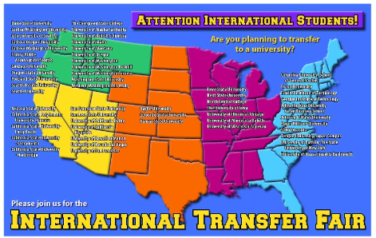
Attend the IE Transfer Fair
Has anyone attended an IE Transfer Fair?

Slide 25
Other Transfer Events
Writing Compelling Personal Statements Sign up on BC’s Academic Success Center website: https://www.bellevuecollege.edu/asc/workshops/
Dates Tues. May 18 2:30-3:30pm and Thurs. May 20 11am-12pm (via Teams)
International Scholarships with Central Washington University: An overview of all scholarships available to international students, deadlines, and qualifications. Thurs. May 20 3-4pm via Zoom. Contact: Kimberly.Valenti@cwu.edu
Seattle University Virtual Admissions Workshops https://www.uwb.edu/admissions/visit Virtual Appointments https://admissions.seattleu.edu/portal/torgersm

Slide 26
When am I ready to graduate?
Degree Audit
https://www.belleveucollege.edu/degreeaudit/
Meet with your IE Advisor: Second Year Meeting
Understand 60-day grace period/options after graduation
CPT/OPT Planning
Understand the transfer process
Submitting the Transfer Out Request to IE with an acceptance letter from your new school
Applying for graduation
Make an academic plan (identify courses and pre-requisites)

Slide 27
Next Steps: It’s important to plan ahead!

Slide 28
Questions?
If you have a question, please type your name in the Meeting chat. An advisor will call your name when it is time for you to ask your question.

Slide 29
Thank you for Attending!
Next step: schedule your Second Year Meeting with your IE Advisor
Please take our survey!

