Slide 1
Early Alert for Academic Support
Board of Trustees Presentation | June 16, 2021

Slide 2
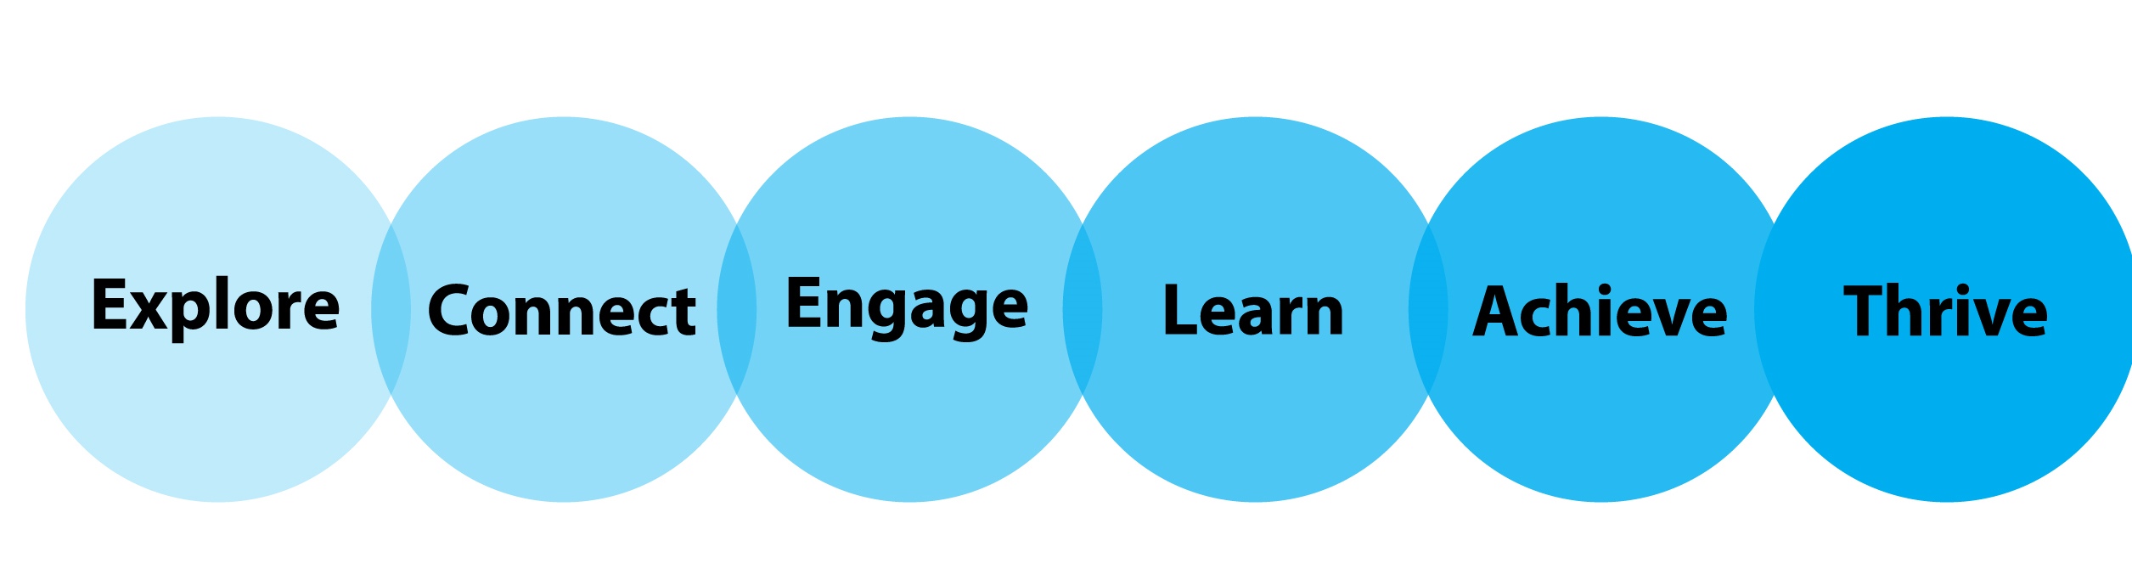
Early Alert Mission
Bellevue College's Early Alert for Academic Support Program, a student success initiative, proactively integrates and coordinates campus programs, support services, faculty, and staff in support of closing the equity gap.
Bulldog Trail
Notes:
I’ve included the Bulldog Trail on this slide because it represents the different stages of a student's journey at BC and I want to make sure we’re intentionally thinking about how initiatives such as Early Alert fit in. The Bulldog Trail starts with the explore stage where prospective students are learning about BC and our programs and extends to the Thrive stage where students graduate and return to BC to continue their lifelong learning. The Early Alert for Academic Support Program really focuses on supporting the Engage and Learn stages of the Bulldog Trail by providing proactive and personalized outreach to students demonstrating academic distress.
The Early Alert for Academic Support program is focused on an asset based approach rather than a deficit model of looking at student performance. This program is focused on early intervention to support student success. Students who have an alert submitted are not "in trouble" but will receive intentional outreach and referrals to support services that will support their continued success.

Slide 3
Early Alert Vision
Bulldog Trail
The Early Alert for Academic Support Program strives to connect students to integral campus resources, services, and faculty that will support, encourage and empower them and their academic success at Bellevue College and beyond. The Early Alert for Academic Support Program also works to educate students as they navigate the college environment, so they develop the relationships, resilience and confidence to seek out support in the future should the need arise.
Notes:
We want early alert to be more than the campus providing solutions to students BUT ALSO use this as an educational experience where students learn and develop the skills needed to successfully navigate the college environment and beyond.

Slide 4
Early Alert for Academic Support
WHO- The Early Alert Program is available to all students and is based on faculty observation of student performance early in the quarter.
WHAT- Early Alert is an academic intervention program designed to provide strategic, and proactive outreach to all students demonstrating academic distress. Early Alert is an academic support designed to connect students with academic services and resources.
WHERE- Outreach is done via
Notes:
We know that in addition to being a student, our students have other (often multiple) competing priorities and responsibilities. And sometimes those impact their success in school. This program is here to remind students we are here for them-holistically.
The Early Alert for Academic Support Program is designed to learn more about each student’s needs and strategize with them for success through discussion of campus resources and services.
We are working to emphasize with students as they onboard and during an Early Alert call or email that they ARE NOT in “trouble”. Rather, we are reaching out to you EARLY in the quarter with the goal of helping.

Slide 5
Early Alert for Academic Support
WHEN- After an instructor observes that a student…
…they may submit an Early Alert on behalf of the student. Then outreach begins! Alerts may be submitted Weeks 1-5.
WHY- To develop and promote a culture of care for our students
Never attends class
Misses class/stops logging in to Canvas
Misses assignments or quizzes/tests
Performs poorly on quizzes or exams

Slide 6
Program Goals
To work with students who are demonstrating academic difficulty by identifying and addressing their specific needs and serving as a link between the student and support services/resources that may aid in their success.
To support instructors by providing outreach and intervention to students with academic difficulty, thus helping to support their workload and ability to focus on teaching their students.
To increase knowledge of campus-wide services & supports for students receiving early alert outreach.
Notes:
Please note that the program goals identified on this and the next slide are not finalized. They are under review and revision with the support of Zach Morgan in Effectiveness & Research.

Slide 7
Program Goals Continued
To promote a culture of care in that we strive to never saying “no” to students, but rather to guide students to all available resources that may benefit them and their academic and personal well-being.
To focus on student retention as a spectrum of retention, recognizing that not all students may be retained in a class and that may be the best option for the student at that time.
Notes:
Retention could be
-Retention in the class for which the early alert was submitted that quarter OR
-If the student does drop the class, they are retained at BC due to the culture of care they received with the Early Alert intervention and the support of other services on campus.

Slide 8
How it Works
Faculty
Observe
Attendance
Faculty
Submit Early Alert Form
Early Alert
Alert closed out
Participation
Performance
Faculty updated
Early Alert
Alert is triaged
Outreach begins
Student connected to services and resources
Notes:
The process start to finish.

Slide 9
Spring 2021 Data Highlights
*Students may have had more than one alert due
to instructor error, multiple alerts for the same class,
or alerts for multiple classes.
Total Alerts | 524
Alerts with unique SIDs | 433 (83%)
Alerts with duplicate SIDs* | 97 (17%)

Slide 10
Spring 2021 Data Highlights
Notes:
Math classes had a total of 66 alerts (13% of the total)
English classes had a total of 51 alerts (10% of the total)
This makes sense given that nearly every degree and certificate require ENGL 101 and a math class

Slide 11
Spring 2020-Spring 2021
* Spring 2020 was our pilot quarter. Alerts only focused on students who did not log into Canvas the first three days of the quarter

Slide 12
Program Strengths & Successes
Improved processes for automating initial communications, closing alerts and notifying instructors of progress
Debut of Early Alert webpage
Quarterly newsletter with updates, resources and student stories for faculty and staff
Exceptional partnerships
Early Alert Committee of dedicated faculty, staff and Lead Peer Educators
Academic Affairs, Student Affairs, ITS, Institutional Advancement/Marketing
Partnership with Faculty Commons to include Early Alert information in new faculty orientation and best practices
Powerful student stories
Notes:
During fall quarter a student received an early alert for never attending. Turns out they detained by ICE. Through collaborative efforts of Early Alert, WE, Enrollment Services, and Financial aid to get he student administratively dropped, and ensured there would not be any negative impact on their financial aid so they can come back and continue their education when they are able to do so.
Student who’s grandfather committed suicide shortly after fall quarter started. She forgot she was even enrolled because she was so focused on her family. Provided her information on counseling support (also submitted a CARE report), and information to request a withdrawal after the deadline.
Student who left high school to have a change in environment and be around more mature people. Enrolled in the CEO program and was excited to start classes. Everything is only-this is not their preferred learning environment. Lockdown for 10+ months, not able to go to school, barely goes outside, not feeling motivated at all. Hard to even get out of bed. Student was referred to counseling, DRC, and ASC and their CEO specialist was also looped in to provide additional support.
Veteran dealing with PTSD, multiple hospitalizations, struggling mentally and emotionally. Extensive outreach done via EA, DRC, Counseling.
All of this under the cloud of a year long pandemic and the anxiety and grief surrounding the loss of life as we know it, loss of life in general (loss of family and friends here and abroad-student in India with loss of multiple family members; working multiple jobs; being a student/parent/partner/caregiver/employee). Our students have been through a lot.

Slide 13
Program Challenges & Growth Areas
Still growing and developing-It’s all iterative!
People power
Equity
Among faculty submitting alerts
For students
Notes:
The equity piece is two-fold:
We want to ensure that as many faculty as possible are participating in the program and that the same faculty are not the only ones submitting early alerts, that there is equity among the faculty.
We want to ensure that the early alert program is equitable for students-that receiving early alert outreach and support is not a “luck of the draw” with regard to who they select as instructor, but is a standard practice and available to all students.

Slide 14
Looking Forward
Sharing and responding to results of faculty survey sent out Winter 2021
Understanding impact-In progress with drafting proposal for qualitative data gathering among Early Alert recipients
Hiring and training of Peer Educators to support outreach efforts to improve response time
Notes:
Right now our data is all numbers, which is great for understanding program usage: how many students receive alerts and participation among faculty. We want to understand more from students: What impact did the phone/email outreach have on them? How do they define success (acknowledging everyone defines it differently given their personal circumstance); their level of awareness of EA, etc.
We are solidifying our proposal for gathering this qualitative data with a goal of calling students this summer who received an Early Alert this spring quarter. This is our first step. As we continue to move forward with our data collection we will call students who received alerts from other quarters as well.

Slide 15
Questions?
Melissa E. Martinez
Early Alert Coordinator
Melissae.Martinez@bellevuecollege.edu | Early Alert Website

