Slide 1
Employee
Online Health Assessment
Bellevue College Flu Team

Slide 2
Training Objectives
Know the expectations for coming to campus
Learn how to complete the Online Health Assessment
Learn the next steps and requirements for coming to campus
Read responses to frequently asked questions

Slide 3
Expectations for Coming to Campus

Slide 4
Expectations for Coming to Campus
Prior to coming to campus, employees MUST:
Obtain supervisor approval.
Complete and submit an online health assessment each day they come to campus.
When on campus, employees MUST:
Check in at the appropriate health screening location before entering a building.
Wear a mask/face covering (except when working alone or through an approved reasonable accommodation with HR).
Maintain physical distance of six feet from others.

Slide 5
Completing the Online
Health Assessment

Slide 6
Step 1: BC Campus Check In Page
To complete the Online Health Assessment, please visit:
https://www2.bellevuecollege.edu/campuscheckin/
Students and employees will need to use their BC username and password to log in.

Slide 7
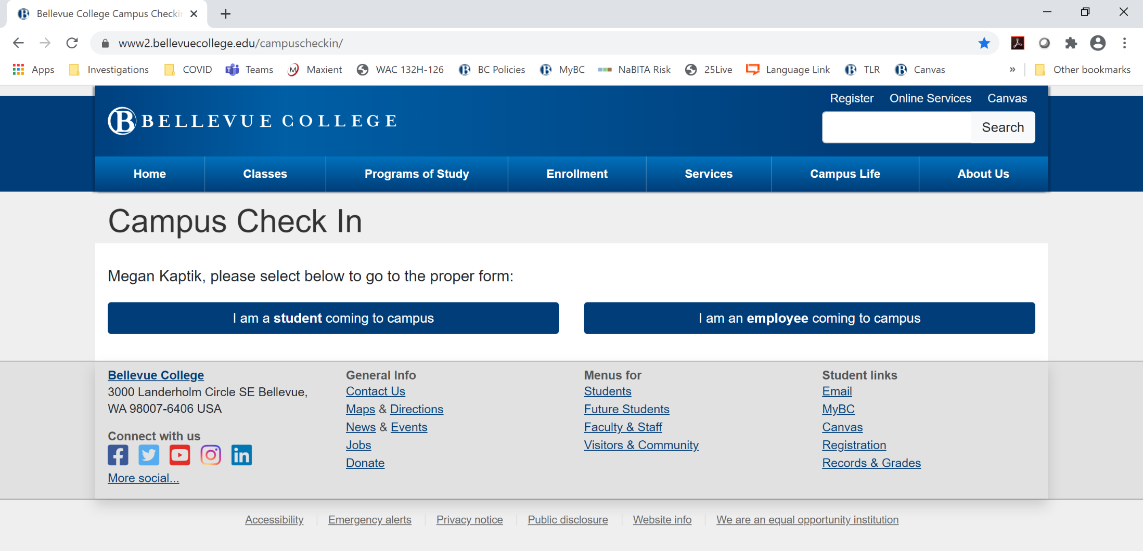
Step 2: Select Role

Slide 8
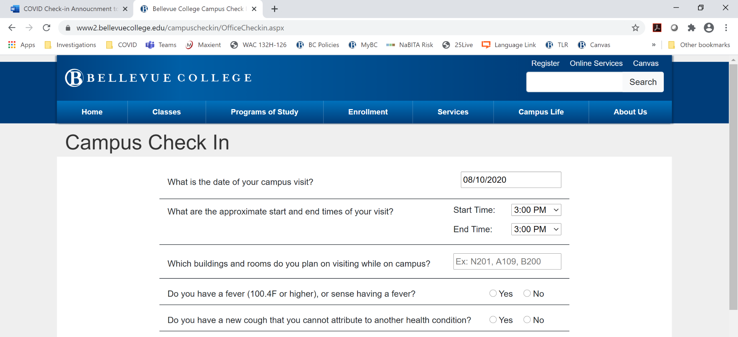
Step 3: Complete Screening Assessment

Slide 9
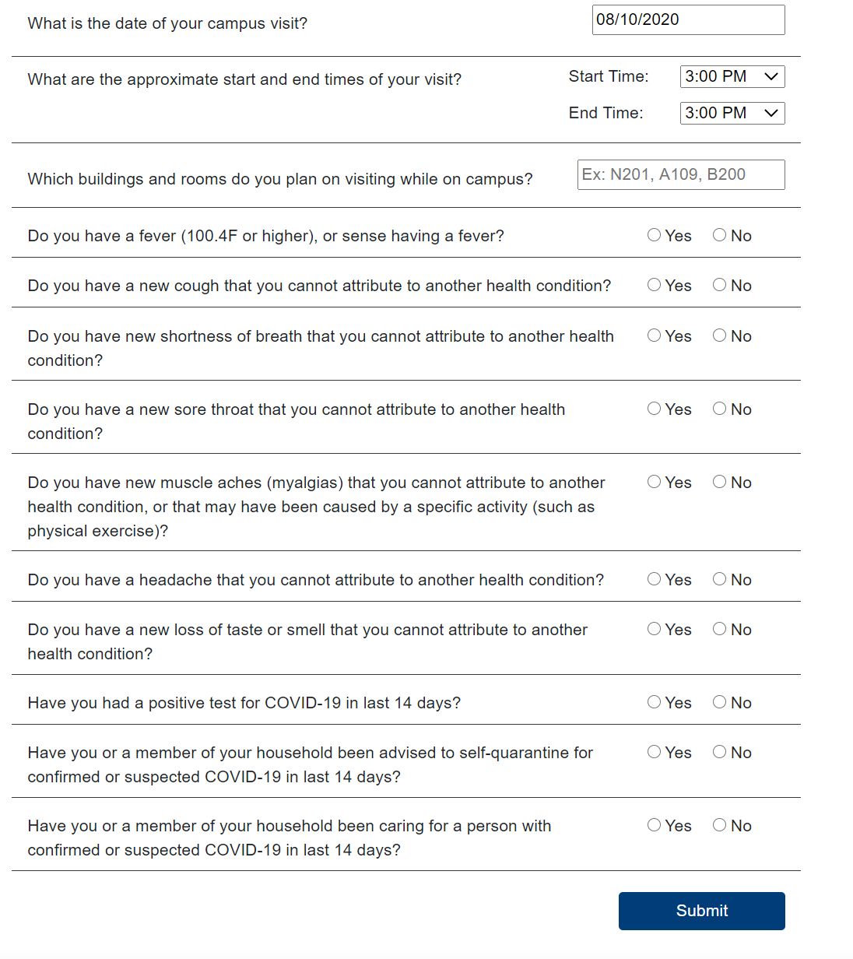
1
2
Assessment Details
3
Enter today’s date.
Enter anticipated arrival time and departure time.
List the rooms and/or buildings you expect to visit. Be specific when possible. Use building number and room number, not "my office".
Complete remaining yes/no questions.
Submit
4
5

Slide 10
Next Steps
Based on health assessment questionnaire answers, directions are given

Slide 11
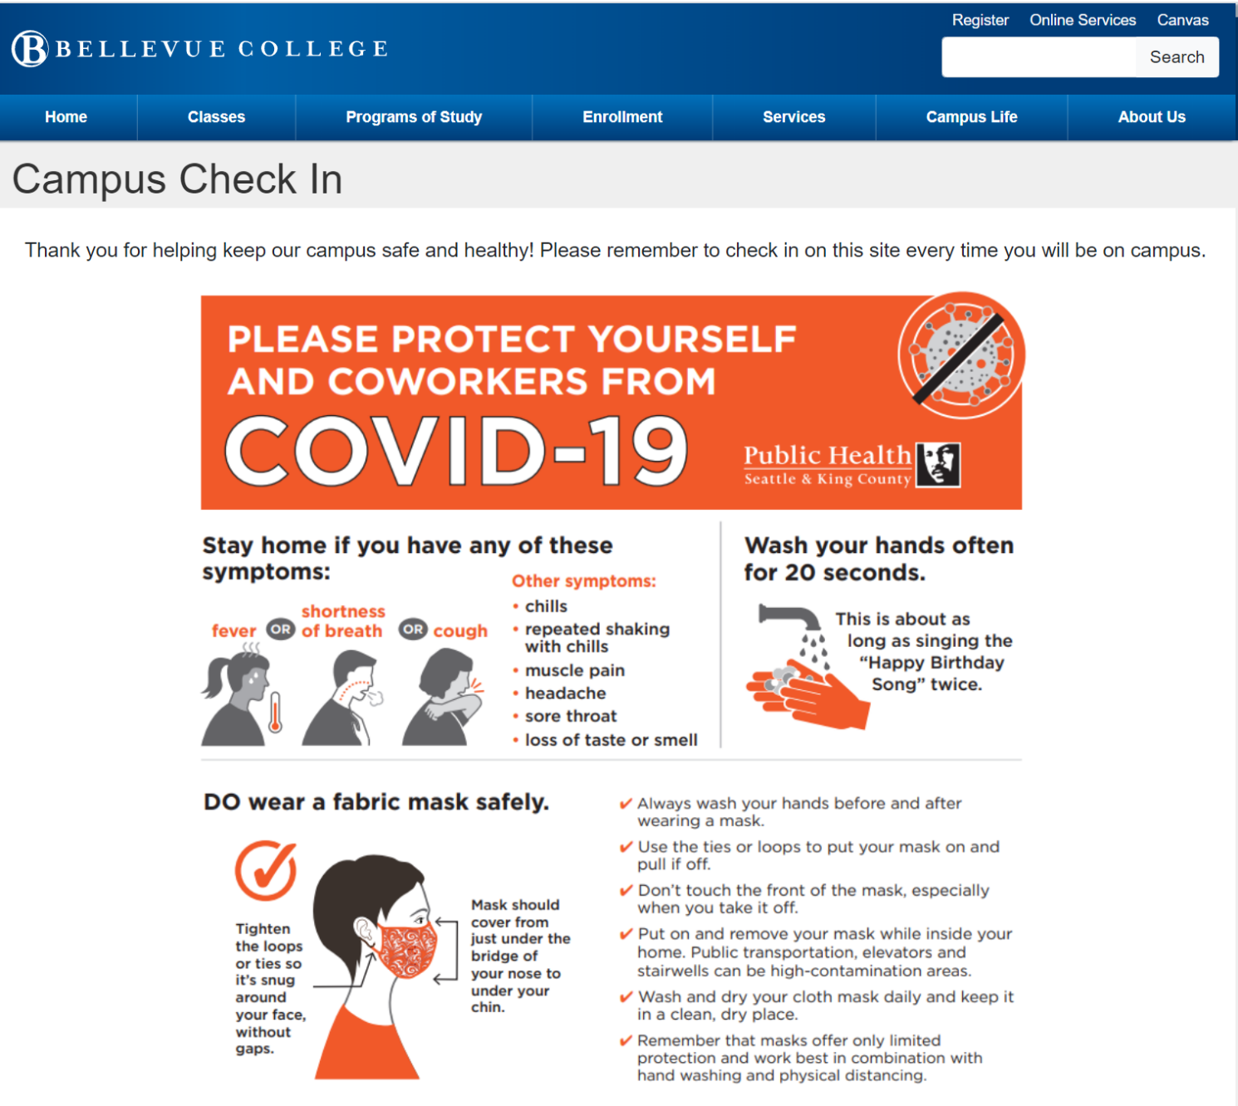
If You Answer No to All Symptoms
You may come to campus with supervisor approval.
When coming to campus, remember to wear a mask, maintain physical distancing (6ft) and wash your hands frequently.

Slide 12
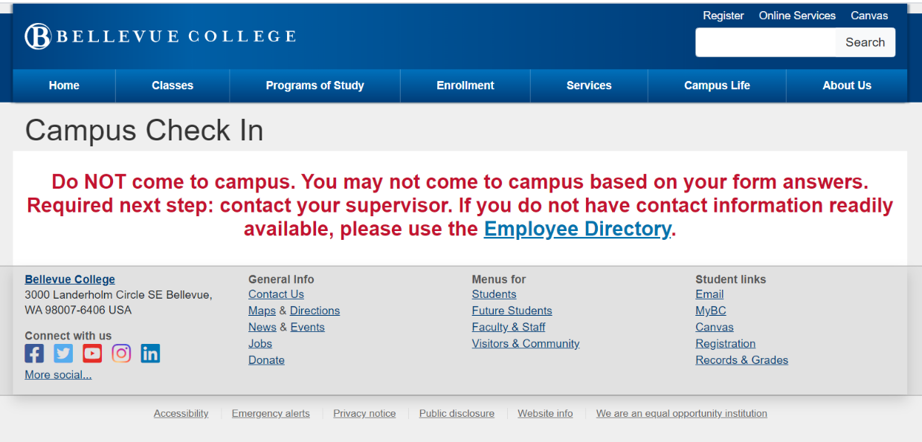
If You Test Positive or Are Self-Quarantining
DO NOT come to campus if:
  You had a positive test for COVID-19 in last 14 days OR
  You or a member of your household been advised to self-quarantine for confirmed or suspected COVID-19 in last 14 days.
You must also:
  Notify your supervisor.
  Contact Human Resources.
  Not return to campus until you are cleared to do so by appropriate medical authorities and HR.
Per directives from Governor Inslee, seek medical guidance from appropriate medical authorities.

Slide 13
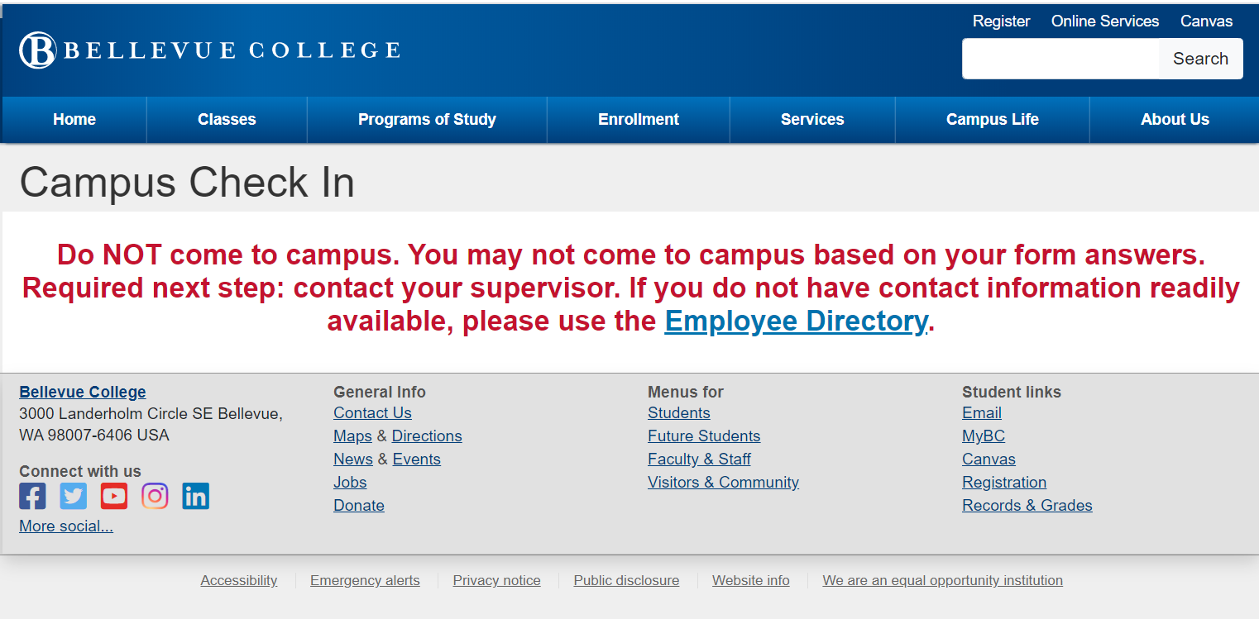
If You Have a Fever
DO NOT come to campus if:
  You have a fever (100.4F or higher), or sense having a fever.
You must also:
  Notify your supervisor.
  Contact Human Resources.
  Not return to campus until you are cleared to do so by appropriate medical authorities and HR.
Per directives from Governor Inslee, seek medical guidance from appropriate medical authorities.

Slide 14
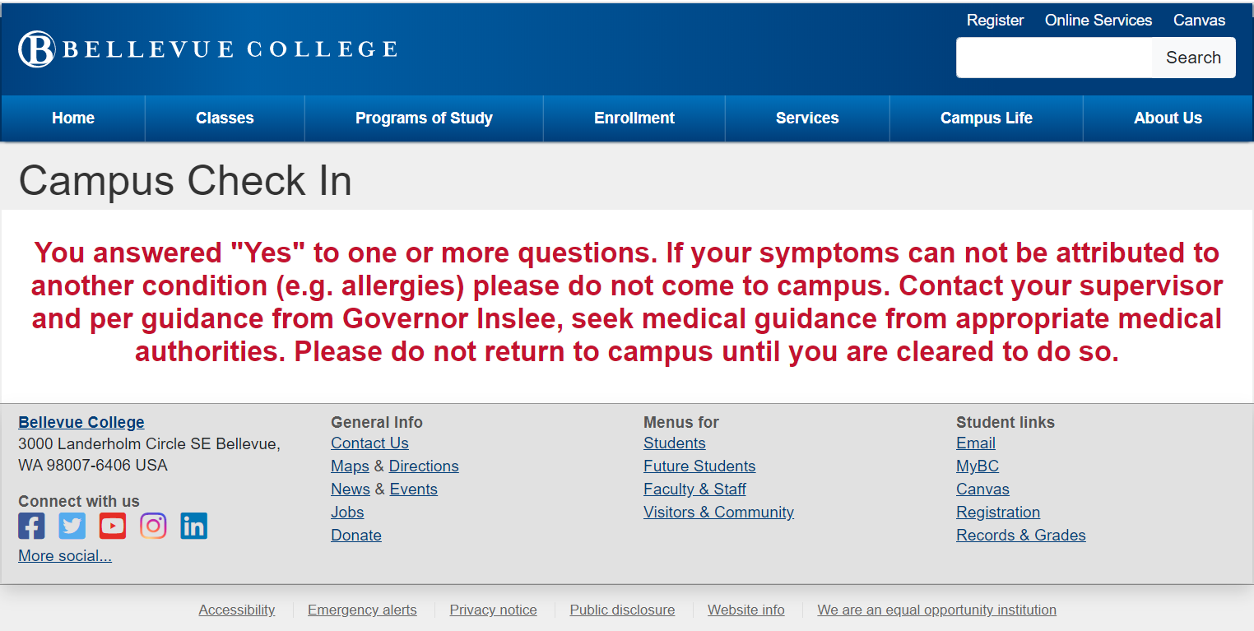
If Other Symptoms are Present
DO NOT come to campus if:
  You answered "Yes" to one or more questions AND
  Your symptoms cannot be attributed to another condition (e.g. allergies).
You must also:
  Notify your supervisor.
  Contact Human Resources.
  Not return to campus until you are cleared to do so by appropriate medical authorities and HR.
Per directives from Governor Inslee, seek medical guidance from appropriate medical authorities.

Slide 15
Frequently Asked Questions

Slide 16
Why Do I Need to Submit a Health Screening?
To protect the BC Community
To properly disinfect campus
To aid contact tracing
To comply with state guidance

Slide 17
Who Has Access to My Screening Answers?
Building Health Screening Location
ANSWERS TO INDIVIDUAL HEALTH QUESTIONS
NAME & IF CLEAR TO COME TO CAMPUS
DATE, TIME, LOCATION INFORMATION
Supervisor
Campus Operations
Supervisor
Human Resources
Human Resources
Human Resources
Building Health Screening Location

Slide 18
How Is My Personal Information Protected?
Health response data are kept confidential in Human Resources.
Per Proclamation 20-64, no personally identifiable information gathered for contact tracing purposes is released.
Records will be maintained until no longer needed, then destroyed.

Slide 19
What Do I Do If I Forget to List a Location?
Employees can make multiple submissions.
Complete a new online health assessment if you forget a location or go somewhere unexpected.
It is important to submit corrections on the same day.

Slide 20
What if I Entered Incorrect Information?
Complete a new health screening assessment with the correct information.
If you answered “yes” to a symptom, but do not have any symptoms, contact Human Resources immediately.

Slide 21
I Am a Supervisor. How Do I See Submissions For Employees in My Area?
Supervisors can access a check-in report through https://reports.bellevuecollege.edu/reports
To access the report, a supervisor must be on-campus or using a VPN
The information contained in the supervisor report does not contain any health-related information, but should still be considered private and should not be shared with anyone outside of HR.

Slide 22
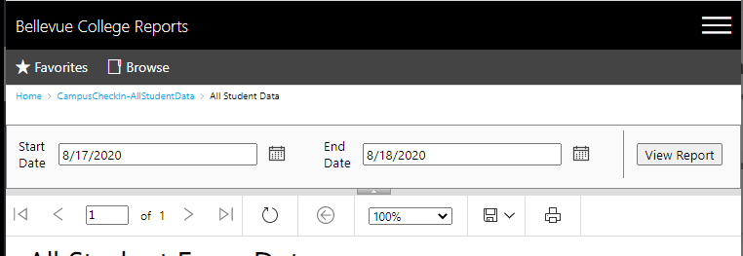
My Supervisor Report is Blank. Why?
Supervisors can only see direct reports.
An employee did not submit an online health assessment.
The report defaults to the current date. Supervisors may need to change the dates.
1
2

Slide 23
An Employee I Supervise Was Directed to Not Come to Campus. What Do I Do When They Contact Me?
Direct the employee to stay home until they are cleared to return by appropriate medical authorities and HR.
Direct the employee to contact Human Resources.
Ask the employee to complete a COVID-19 Report Form located at www.bellevuecollege.edu/reportconcern. This form routes to Human Resources.
Maintain privacy.

Slide 24
Contact Information

Slide 25
Human Resources Contact Information
Gretchen Bird gretchen.bird@bellevuecollege.edu
Suzette Yaezenko suzette.yaezenko@bellevuecollege.edu

