Slide 1
Student
Online Health Assessment
Bellevue College Flu Team

Slide 2
Training Objectives
Know the expectations for coming to campus
Learn how to complete the Online Health Assessment
Learn the next steps and requirements for coming to campus
Read responses to frequently asked questions

Slide 3
Expectations for Coming to Campus

Slide 4
Expectations for Coming to Campus
Prior to coming to campus, students MUST:
  Have a scheduled class or official College business to conduct on campus.
  Complete and submit an online health assessment each day they come to campus.
When on campus, students MUST:
  Check in at the appropriate health screening location before entering a building.
  Wear a mask (except through an approved reasonable DRC accommodation).
  Maintain physical distance of six feet from others.

Slide 5
Completing the Online
Health Assessment

Slide 6
Step 1: BC Campus Check In Page
To complete the Online Health Assessment, please visit:
https://www2.bellevuecollege.edu/campuscheckin/
Students and employees will need to use their BC username and password to log in.

Slide 7
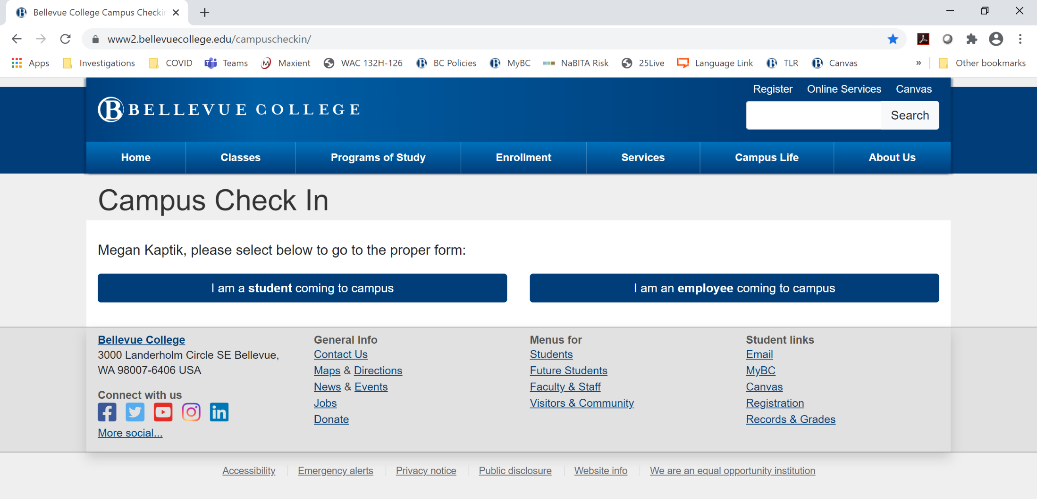
Step 2: Select Role

Slide 8
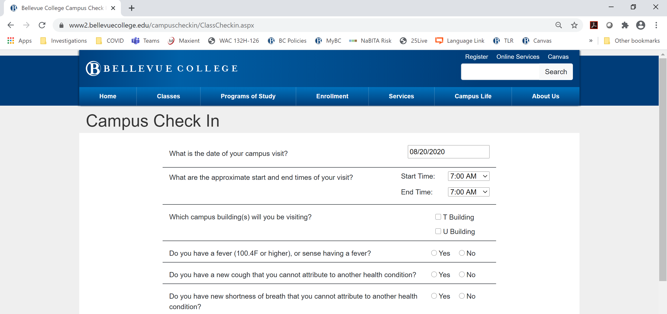
Step 3: Complete Screening Assessment

Slide 9
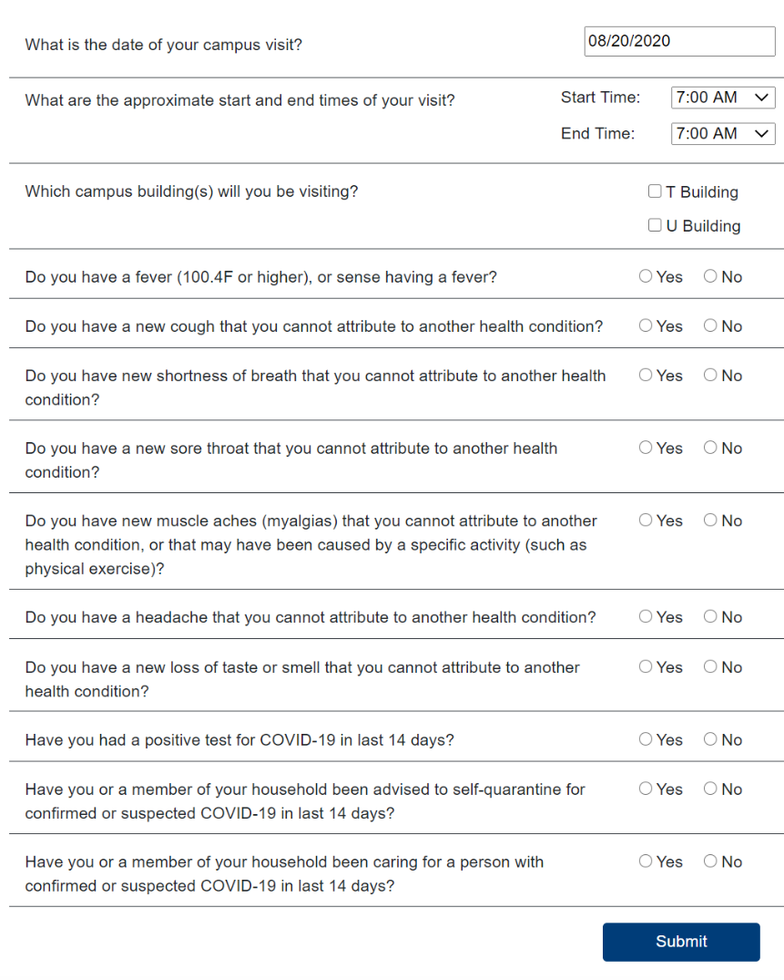
1
2
Assessment Details
3
Enter today’s date.
Enter anticipated arrival time and departure time.
Check which building you plan to visit.
Complete remaining yes/no questions.
Submit
4
5

Slide 10
Next Steps
Based on health assessment questionnaire answers, directions are given.
If there is a health or safety concern, students will be referred to a member of the BC CARE Team for follow-up.

Slide 11
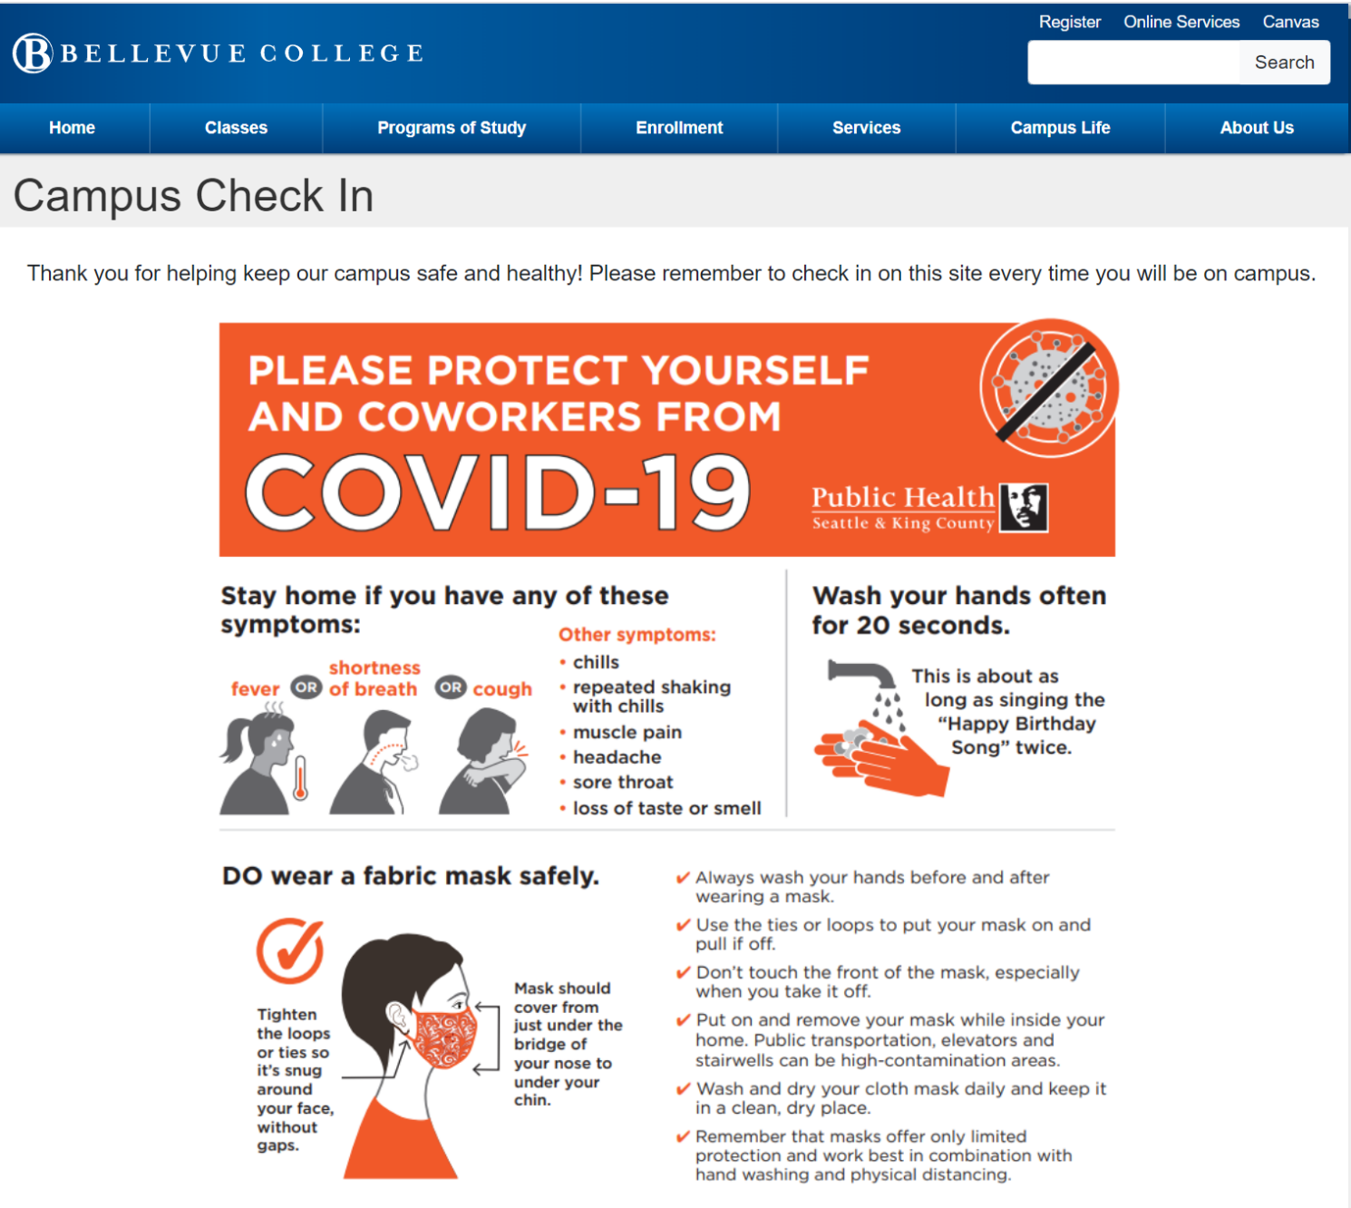
If You Answer No to All Symptoms
You may come to campus for a class or to conduct other official College business.
When coming to campus, remember to wear a face covering, maintain physical distancing (6ft) and wash your hands frequently.

Slide 12
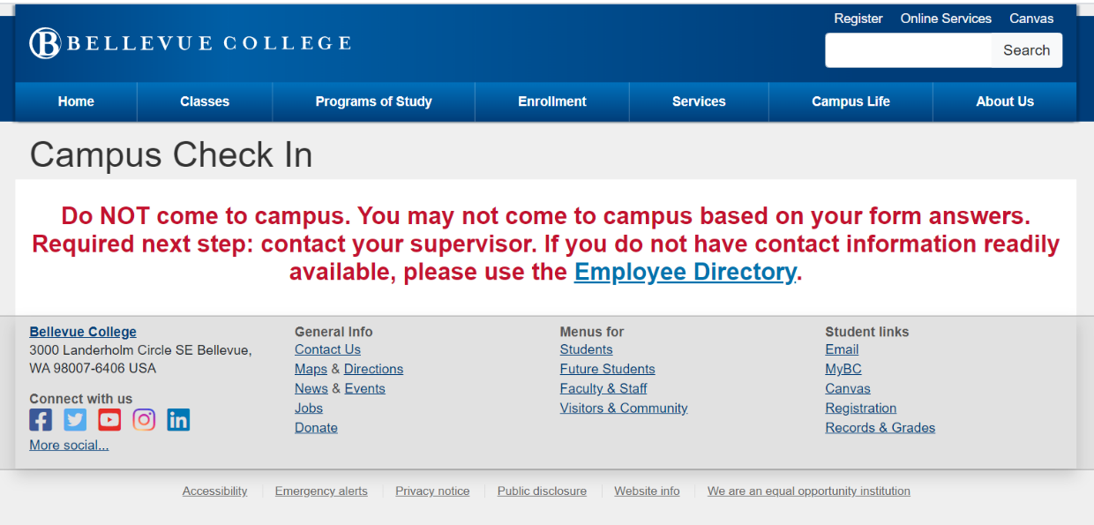
If You Test Positive or Are Self-Quarantining
DO NOT come to campus if:
  You had a positive test for COVID-19 in last 14 days OR
  You or a member of your household have been advised to self-quarantine for confirmed or suspected COVID-19 in last 14 days.
You must also:
  Notify your instructor.
  Complete a COVID-19 Report Form at www.bellevuecollege.edu/reportconcerns.
  Not return to campus until you are cleared to do so by appropriate medical authorities and the CARE Team.
Per directives from Governor Inslee, seek medical guidance from appropriate medical authorities.

Slide 13
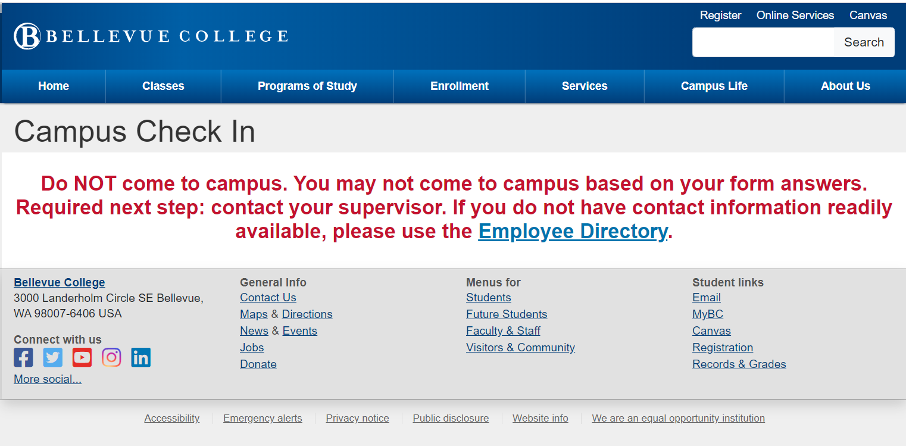
If You Have a Fever
DO NOT come to campus if:
  You have a fever (100.4F or higher), or sense having a fever.
You must also:
  Notify your instructor.
  Complete a COVID-19 Report Form at www.bellevuecollege.edu/reportconcerns.
  Not return to campus until you are cleared to do so by appropriate medical authorities and the CARE Team.
Per directives from Governor Inslee, seek medical guidance from appropriate medical authorities.

Slide 14
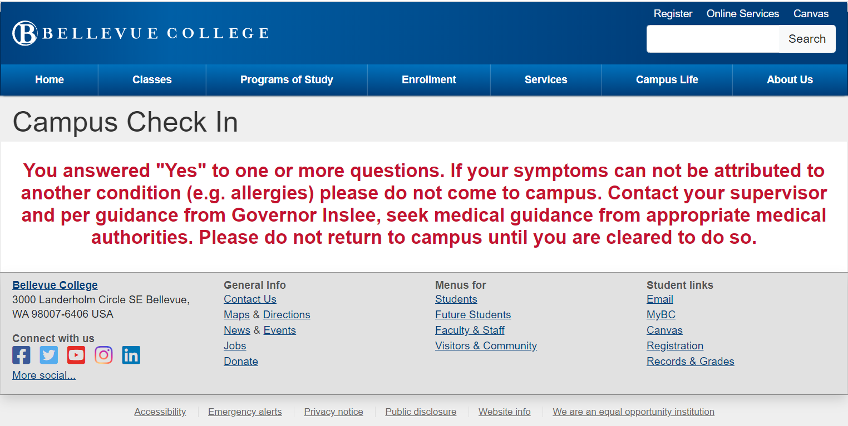
If Other Symptoms are Present
DO NOT come to campus if:
  You answered "Yes" to one or more questions AND
  Your symptoms can not be attributed to another condition (e.g. allergies).
You must also:
  Notify your instructor.
  Complete a COVID-19 Report Form at www.bellevuecollege.edu/reportconcerns.
  Not return to campus until you are cleared to do so by appropriate medical authorities and the CARE Team.
Per directives from Governor Inslee, seek medical guidance from appropriate medical authorities.

Slide 15
Frequently Asked Questions

Slide 16
Why Do I Need to Submit a Health Screening?
To protect the BC Community
To properly disinfect campus
To aid contact tracing
To comply with state guidance

Slide 17
Who Has Access to My Screening Answers?
Building Health Screening Location
ANSWERS TO INDIVIDUAL HEALTH QUESTIONS
NAME & IF CLEAR TO COME TO CAMPUS
DATE, TIME, LOCATION INFORMATION
Instructor
Campus Operations
Instructor
BC CARE Team
BC CARE Team
Building Health Screening Location
BC CARE Team

Slide 18
What Do I Do If I Forget to Check a Location?
Students can make multiple submissions.
Complete a new online health assessment if you forget a location or go somewhere unexpected.
It is important to submit corrections on the same day.

Slide 19
How Is My Personal Information Protected?
Health response data are kept confidential. A limited number of staff on the CARE Team has access if needed.
Per Proclamation 20-64, no personally identifiable information gathered for contact tracing purposes is released.
Records will be maintained until no longer needed, then destroyed.

Slide 20
What Is the CARE Team?
The CARE Team is a group of staff on campus who assist students when there is a concern or worry.
The CARE Team includes representatives from
  Academic Advising
  Counseling
  Disability Resource Center
  Human Resources
  International Education
  Instructional Deans
  Public Safety
  Student Conduct
  Student Affairs

Slide 21
What if I Entered Incorrect Information?
Complete a new health screening assessment with the correct information.
If you answered “yes” to a symptom, but do not have any symptoms, contact the CARE Team at care@bellevuecollege.edu immediately.

Slide 22
What Information Does My Instructor See?
Instructors can see if you completed the form and if you are cleared to come to class.
Instructors do NOT see your individual health answers.

Slide 23
Contact Information

Slide 24
CARE Team Contact Information
care@bellevuecollege.edu
Megan Kaptik, megan.kaptik@bellevuecollege.edu
Brenda Ivelisse, b.ivelisse@bellevuecollege.edu

