Slide 1
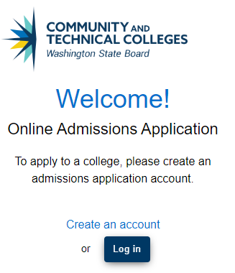
Washington’s Community and Technical Colleges
Online Admissions Application Portal Instructions
Step 1: Open the web site and Click “Create an Account”
Go to SBCTC - OAA User Log in
Create Bellevue College account.

Slide 2
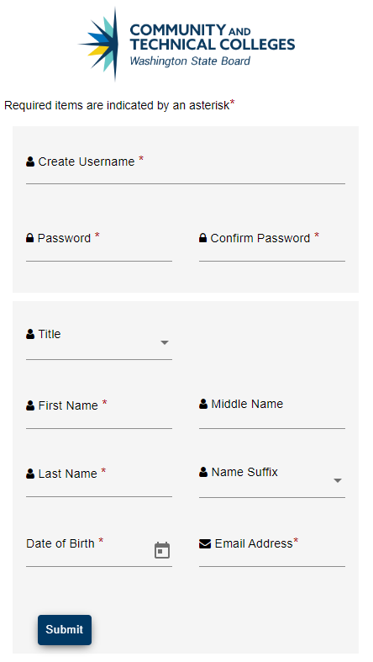
Step 2 : Create an Account
Enter Username – Lowercase characters only
Enter Password – Passwords are case sensitive and should be at least 8 characters and include at least one numeral (0-9) and one special character (~`!@#$%^&*()_-+={[}]|\:;"'<,>.?/). Example: Yellow!2
Write down your Username and Password. You will need your Username and Password.
Enter Title
Enter First Name, Middle Name, Last Name
Enter Name Suffix
Enter Date of Birth - Click on the calendar tool to select a date
Enter Valid Email Address
<TIP>
Note your Username and Password.

Slide 3
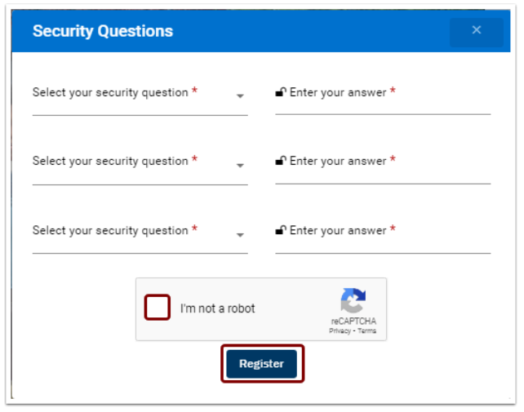
Step 3: Fill out Security Questions.
Answer the 3 security questions
Select the CAPTCHA box
Click on Submit - You will receive a one-time password (OTP) in your email. (Check Junk and Spam Email Folders)
<TIP>
Note your questions and answers.

Slide 4
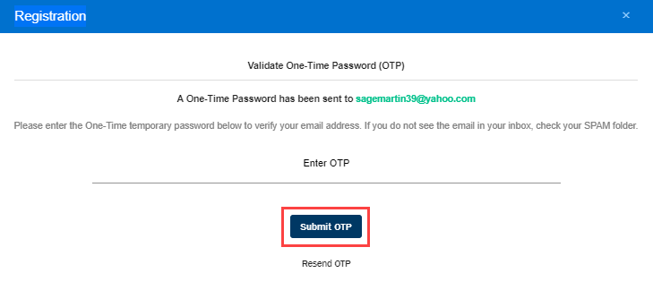
Step 4: Validate Your Email.
Enter the One-Time Password OTP emailed to you.
Click on Submit
Your account will be created and validated
Log in with your username and password to start the application process. A Welcome page and Start a New Application page will display.

Slide 5
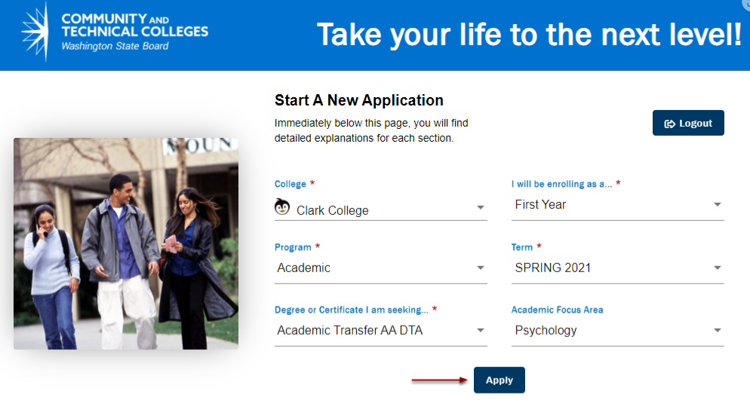
Step 5: New Application
College: Bellevue College
I will be enrolling as a…. :
First Year Student - you have not had any previous college experience or do not wish to transfer credits
Transfer Student - you would like to transfer credits from another school(s) to apply to your LWTech degree
Program: Choose from the best option below:
“Professional Technical” for degree and certificate programs.
“Academic” for DTA or AS degrees
“Baccalaureate” for BAS or BA degrees.
“Non-Award Seeking” if you are not attempting a degree or certificate
“Transitional Studies” for ESL or ABE
Term: When you would like to begin classes
Degree or Certificate I am seeking… : Search the Alphabetical list for your preferred degree or certificate
Academic Focus Area: Not a required field (skip)
Bellevue College
Transitional Studies
Spring 2024

Slide 6
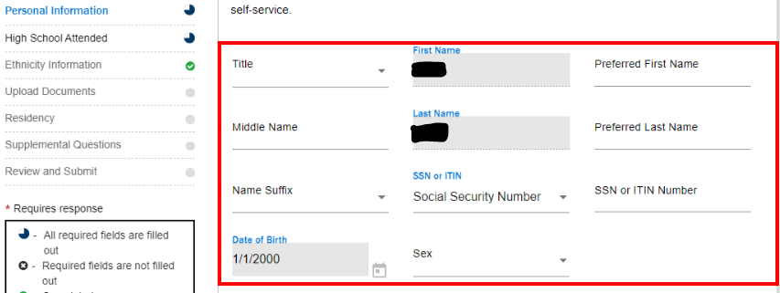
Step 6: Complete Personal information
Only the fields with (*) are required
If you feel comfortable filling in your mobile phone number and SSN, that information is helpful but not required

Slide 7
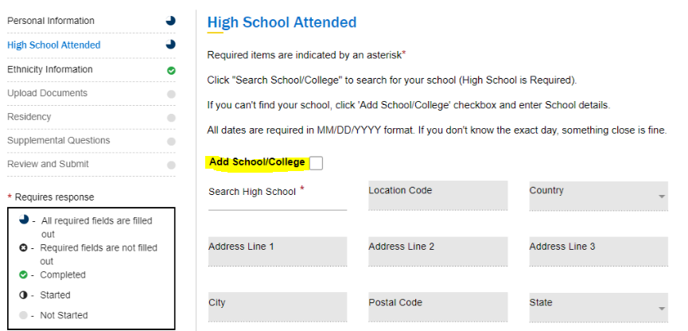
Step 7: High School Information
If you cannot find your school in the search, check the “Add School/College”
Choose your highest level of education
College information is optional

Slide 8
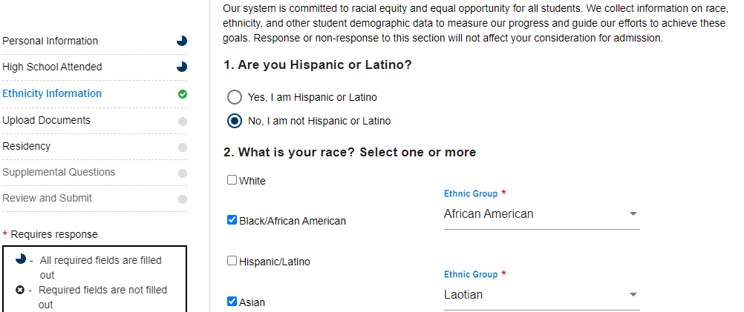
Step 8: Ethnicity Information
This information is not required, but it helps student data.

Slide 9
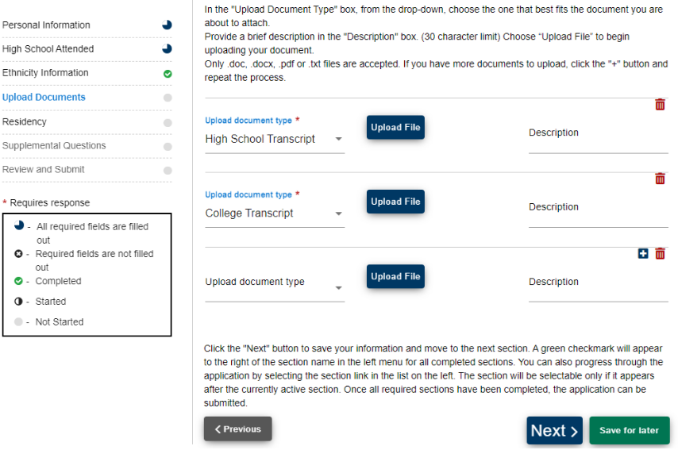
Step 9: Upload Documents
You can skip this page.

Slide 10
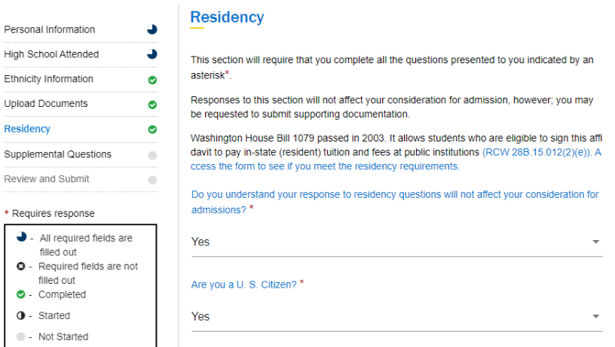
Step 11: Residency

Slide 11
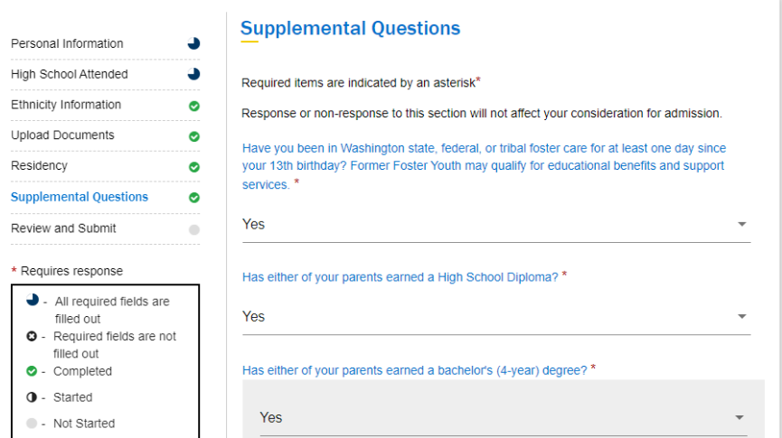
Step 12: Answer the Supplemental Questions
If you do not feel comfortable answer “Prefer not to answer” is an option.

Slide 12
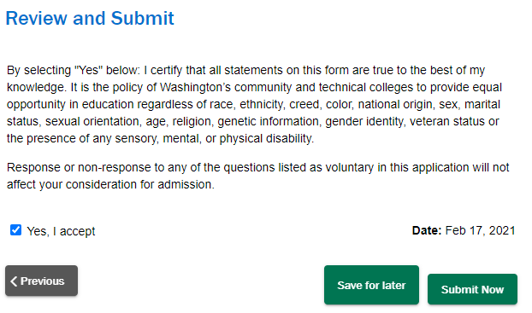
Step 13: Confirm and Submit your application.
Confirm your application and if you are agree submit this application.

Slide 13
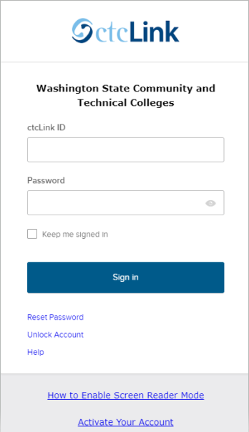
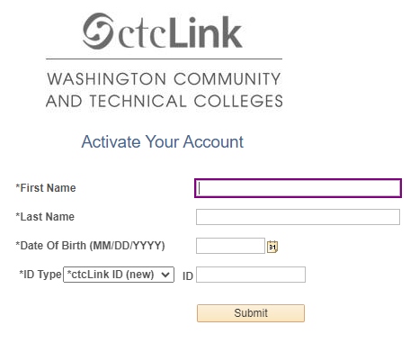
Step 14: Activate ctclink Account
Go tohttps://myaccount.ctclink.us
Select the Activate Your Account link bottom of the page.
Enter your legal First Name and Last Name.
Enter your Date of Birth (MM/DD/YYYY).
Enter your ctcLink ID.

Slide 14
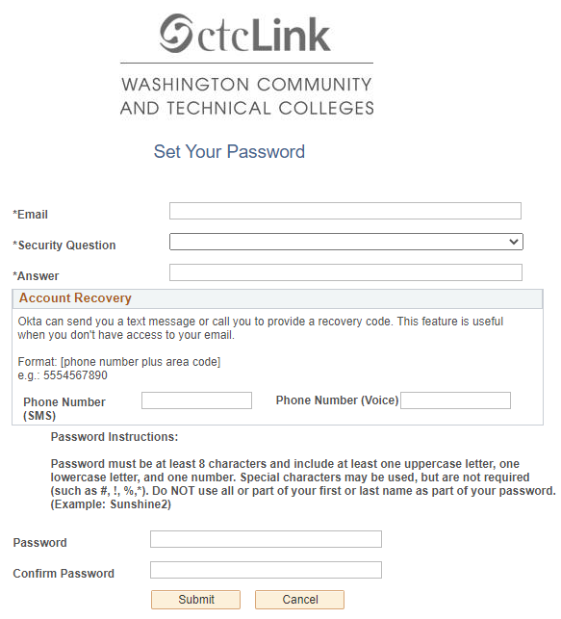
Step 15: Set Your Password
Enter your preferred Email address.
Select the Security Question from the drop-down menu.
Answer to your security question.
Account Recovery options > Enter Phone Number.
Create your Password.
<TIP>
Note your Username, Password and Security Question.

Slide 15
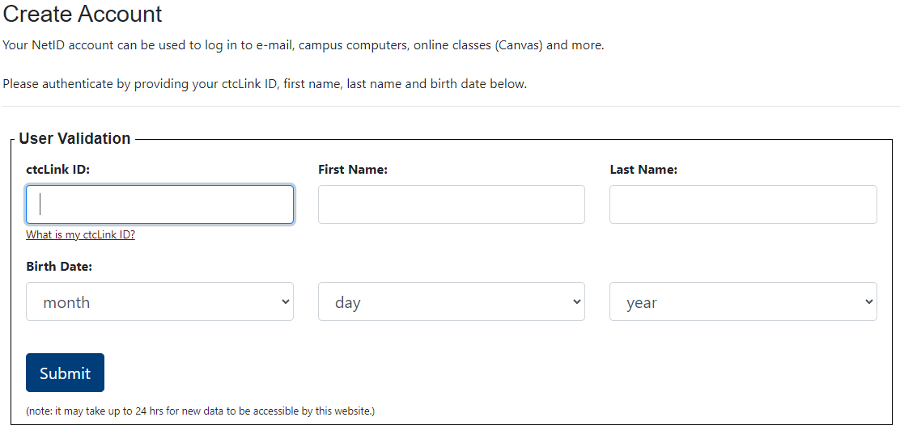
Step 16: Create NetID Account
Go to NetID Account Management - Bellevue College
Enter your ctcLink ID Number
Enter your First and Last Name
Enter your date of birth
Submit
Create a password
<TIP>
BC NetID is for get a Bellevue College Email
Open technology on campus
Note your NetID Username, Password and Bellevue College Email.
Wait 24 hours before access to Canvas.

