Slide 1
Free Money
and how to find it

Slide 2
Common Reasons Students Don’t Apply for Scholarships
My grades aren’t high enough
My family makes too much money
Only athletes get scholarships
It takes too much time

Slide 3
There are all kinds of scholarships!
Academic, athletic, need based, cultural, clubs, majors, interests, talents, volunteer work, etc.
Best duck calling skills, students who are left handed, etc.
You just need to find them!

Slide 4
Two Steps to Get Scholarships
Search
Apply

Slide 5
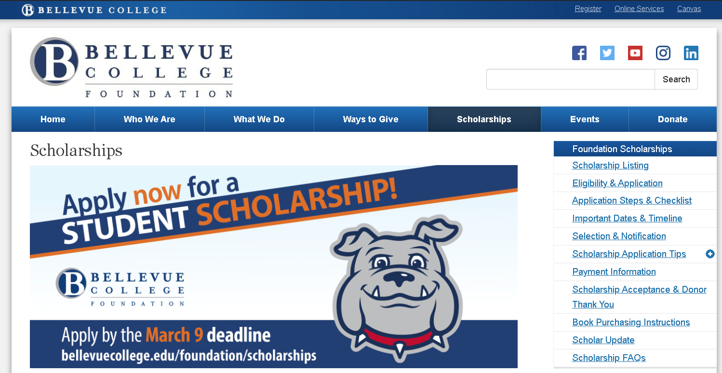
Step One: Search
Your College – the best resource!

Slide 6
Parents and the Community

Slide 7
www.thewashboard.org

Slide 8
www.collegeboard.com

Slide 9
www.fastweb.com

Slide 10
College Financial Aid Websites

Slide 11
Step Two: Apply
Start now!!!
Write a sample personal statement
Make lists of school activities, community service, awards, work experience, projects, and goals
Get recommendation letters

Slide 12
Personal Statements
Describe:
who you are – your interests, values, goals
key experiences that have impacted you
what you have done, activities – show, not tell

Slide 13
Activity List
Name and Description | Top 3 tasks performed | Top 3 demonstrated character qualities | Impact, results, positions held
Bellevue College Peer-to-Peer Mentor | Mentored new college students Served as a role model and volunteer for campus events | Responsibility Commitment Leadership | Mentored 6 students each quarter who completed school, 4 of them became Peer Mentors the following quarter
Camp Thunderbird Outdoor Education Program for Middle School Students | Supervised middle school students during weeklong camp Planned and implemented activities for participants Ensured a safe and inclusive environment for campers | Confidence Responsibility Leadership | Camp Leader Campers evaluations showed a high level of satisfaction with program 100% of campers participated in planned activities

Slide 14
Letters of Recommendation
Cultivate
Ask early
Get 2-3
Give very specific information
Thank the writer

Slide 15
The Perfect Application
Follows ALL directions
Looks professional
Has no typos, no mistakes
Includes a “thank you” cover letter

Slide 16
Applying for Scholarships
Do you want the free money?
It’s all up to you.
Just Do It!

